Slide 1

GEOGRAPHIC INFORMATION SYSTEM (GIS)
Ankara Bilim University
Departmen of Management Information System
Dr. Murat BAŞEĞMEZ

Slide 2
Functions of GIS
Geographic Information Systems (GIS) perform several critical functions that enable the efficient management, analysis, and visualization of spatial and non-spatial data. These functions are essential in various fields, including urban planning, environmental management, transportation, and disaster response.
The key functions of GIS include:

Slide 3
Functions of GIS
Data Collection
Computers Acquisition of spatial and non-spatial data from multiple sources such as satellite imagery, GPS, remote sensing, and field surveys.
Integration of data from different formats, including raster and vector datasets.
Continuous updating and validation of data to ensure accuracy and reliability.

Slide 4
Functions of GIS
Data Processing
Data management and manipulation to refine raw geospatial information.
Georeferencing and transformation of spatial datasets to align with standardized coordinate systems.
Data cleaning, error detection, and correction to enhance data integrity.

Slide 5
Functions of GIS
Data Analysis
Spatial analysis, including overlay, buffer, and proximity analysis, to extract meaningful insights.
Statistical analysis for decision-making, pattern recognition, and predictive modeling.
Geostatistical methods to analyze spatial relationships and trends over time.

Slide 6
Functions of GIS
Data Storage
Efficient data archiving and retrieval using spatial databases and cloud-based GIS platforms.
Organization of large geospatial datasets in relational databases for quick access and processing.
Implementation of metadata standards to improve data discoverability and usability.

Slide 7
Functions of GIS
Data Production
Generation of high-quality maps, 3D models, and thematic visualizations.
Development of tabular reports, charts, and graphical representations to support decision-making.
Integration with Geographic Information Visualization (GIV) techniques to enhance user engagement and interaction.

Slide 8
Types of Data in GIS
GIS data is categorized into two primary types:
spatial data
non-spatial data.
These data types form the backbone of GIS applications and enable comprehensive geospatial analysis.

Slide 9
Types of Data in GIS
Spatial Data
Spatial data represents the geographic location, shape, and relationships of features on the Earth's surface. It is further classified into:
Raster Data
Vector Data

Slide 10
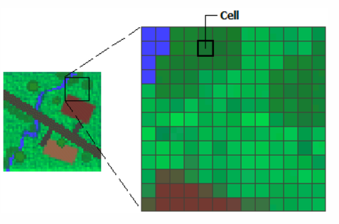
Types of Data in GIS
Raster Data
Consists of grid-based pixel structures where each cell represents a specific geographic feature.
Examples include satellite imagery, aerial photographs, and scanned maps.
Common applications involve land-use classification, climate modeling, and remote sensing analysis.

Slide 11
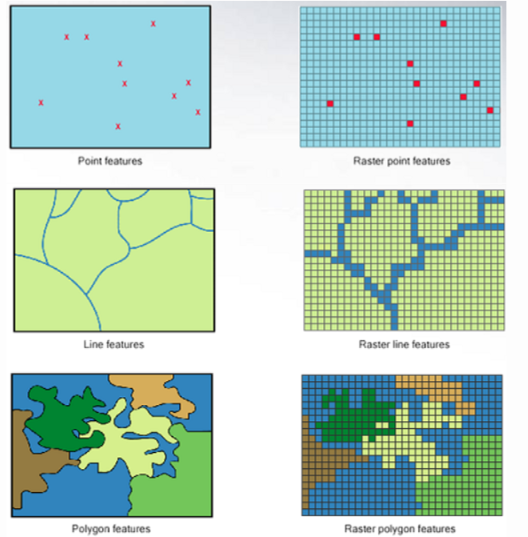
Types of Data in GIS
Vector Data
Represents spatial features using geometric shapes, including points, lines, and polygons.
Vector data is widely used in urban planning, transportation networks, and natural resource management.

Slide 12
Types of Data in GIS
Point Data
Represents specific locations of discrete features, such as buildings, trees, and infrastructure points.
Examples: GPS coordinates of landmarks, utility poles, and crime incident locations.

Slide 13
Types of Data in GIS
Line Data
Represents linear features such as roads, rivers, pipelines, and electrical grids.
Used in network analysis, transportation planning, and hydrological modeling.

Slide 14
Types of Data in GIS
Polygon Data
Represents area-based features such as land parcels, administrative boundaries, and land cover classifications.
Used in zoning regulations, land-use planning, and cadastral mapping.

Slide 15
Types of Data in GIS
Non-Spatial Data
Non-spatial data (also known as attribute data) provides descriptive characteristics of geographic features without representing their physical location.
It includes:

Slide 16
Types of Data in GIS
Attribute Data
Descriptive information linked to spatial features, enhancing the depth of GIS analysis.
Stored in attribute tables associated with spatial datasets.
Examples: land ownership records, demographic statistics, environmental quality indices, and infrastructure attributes.

Slide 17
Types of Data Representation in GIS
Spatial Information
Spatial information in GIS refers to data that describes the location, shape, size, and topology of geographic features.
GIS primarily employs two data models for spatial representation:

Slide 18
Types of Data Representation in GIS
Vector Data Model
Uses geometric primitives (points, lines, polygons) to depict real-world features.
Enables precise representation and topological analysis of spatial relationships.

Slide 19
Types of Data Representation in GIS
Raster Data Model
Composed of grid cells where each pixel holds a specific value representing spatial characteristics.
Ideal for continuous data such as elevation, temperature, and land cover classification.

Slide 20
Types of Data Representation in GIS
Non-Spatial Information
Non-spatial information complements spatial data by providing additional attributes about geographic entities.
These attributes help in classification, categorization, and in-depth analysis.

Slide 21
Types of Data Representation in GIS
Forms of Non-Spatial Information
Descriptive Data: Provides qualitative details about spatial features (e.g., road names, soil types, zoning classifications).
Textual Data: Contains alphanumeric descriptions such as addresses, labels, and street names.
Verbal Information: Includes annotations, narratives, or supplementary data related to geospatial entities.

Slide 22
Types of Data Representation in GIS
Examples of Non-Spatial Data in GIS
Demographic Data: Age distribution, gender ratios, employment statistics.
Environmental Data: Rainfall levels, air pollution indices, biodiversity records.
Ownership Details: Land tenure status, property boundaries, legal documentation.
Infrastructure Information: Number of public facilities, road classifications, service availability.

Slide 23
Types of Data Representation in GIS
Vector Data in GIS
Vector data models provide an efficient way to represent and analyze geographic features using discrete geometric shapes.
The three primary vector data structures include:

Slide 24
Types of Data Representation in GIS
Points
Represent precise locations of features, such as landmarks, water wells, and communication towers.
Utilized in geocoding, spatial pattern analysis, and facility location optimization.

Slide 25
Types of Data Representation in GIS
Lines
Depict linear features, such as roads, pipelines, rivers, and electrical transmission networks.
Essential for routing analysis, transportation planning, and hydrology studies.

Slide 26
Types of Data Representation in GIS
Polygons
Define area-based features, such as lakes, administrative zones, and protected regions.
Frequently used in land-use planning, resource management, and ecological assessments.

Slide 27
Types of Data Representation in GIS
Raster Data in GIS
Raster data provides a grid-based representation of spatial features, capturing continuous phenomena with high precision.
Key characteristics of raster data include:

Slide 28
Types of Data Representation in GIS
Pixel-Based Structure
Raster datasets consist of an array of pixels, each assigned a specific attribute value (e.g., elevation, temperature, vegetation index).

Slide 29
Types of Data Representation in GIS
Color and Attribute Differentiation
Features are distinguished based on pixel values, facilitating spectral analysis in remote sensing applications.

Slide 30
Types of Data Representation in GIS
Applications of Raster Data
Land cover classification using satellite imagery.
Climate change modeling through spatial interpolation techniques.
Environmental impact assessment by analyzing vegetation indices and pollution distribution.

Slide 31
Types of Data Representation in GIS
Applications of Raster Data
Land cover classification using satellite imagery.
Climate change modeling through spatial interpolation techniques.
Environmental impact assessment by analyzing vegetation indices and pollution distribution.

Slide 32
Types of Data Representation in GIS
GIS integrates diverse datasets, methodologies, and analytical techniques to enable informed decision-making in spatial sciences. By leveraging both spatial and non-spatial data representations, GIS supports various applications, ranging from urban planning and environmental management to disaster mitigation and public policy development.

Slide 33


Thank you…

