Slide 1

GEOGRAPHIC INFORMATION SYSTEM (GIS)
Ankara Bilim University
Departmen of Management Information System
Dr. Murat BAŞEĞMEZ

Slide 2

What is Geographic Information Systems (GIS)?
"GIS turns data into knowledge and maps into insights—because everything happens somewhere." 🌍📍

Slide 3
What is Geographic Information Systems (GIS)?
Geographic Information Systems (GIS) refer to a system that integrates hardware, software, and human resources to facilitate the storage, analysis, querying, and visualization of geospatial data,
GIS enables the processing and presentation of various data through different analytical methods, ultimately generating maps, reports, and graphical representations for decision-making purposes.

Slide 4
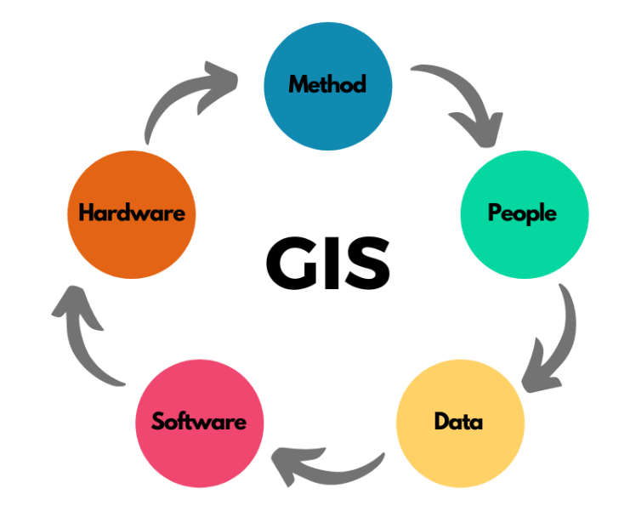
Components of GIS
Hardware
Hardware in GIS refers to technological tools that support the operation of GIS software, data processing, and analysis.
Examples include:
Computers
Tablets
Smartphones

Slide 5
Components of GIS
Software
GIS software is essential for visualizing, processing, and presenting geospatial data. Some common GIS software products include:
Database Management Systems (Oracle Spatial, ArcSDE, PostGIS, etc.)
Desktop GIS Applications (ArcGIS, MapInfo, Netcad, QGIS, Idrisi, etc.)
Geo-Web Servers (ArcGIS for Server, MapServer, GeoServer, Mapnik, etc.)

Slide 6
Components of GIS
Data
Data is the most critical component of GIS. Without data, GIS operations cannot be performed.
Methods
Once data is acquired, it must be analyzed using appropriate methodologies based on the intended purpose of the study.

Slide 7
Objectives of GIS
GIS is a powerful technology that integrates spatial and non-spatial data to analyze, visualize, and interpret patterns, relationships, and trends. The objectives of GIS can be categorized into several key areas:

Slide 8
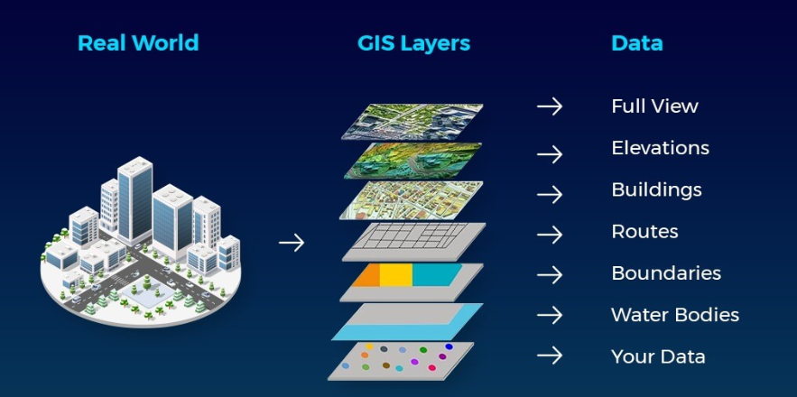
Objectives of GIS
Data Management and Integration
Collect, store, manage, and retrieve spatial data efficiently.
Integrate data from different sources such as satellite imagery, maps, GPS, and remote sensing.
Maintain spatial databases for various applications like urban planning, environmental monitoring, and transportation.

Slide 9
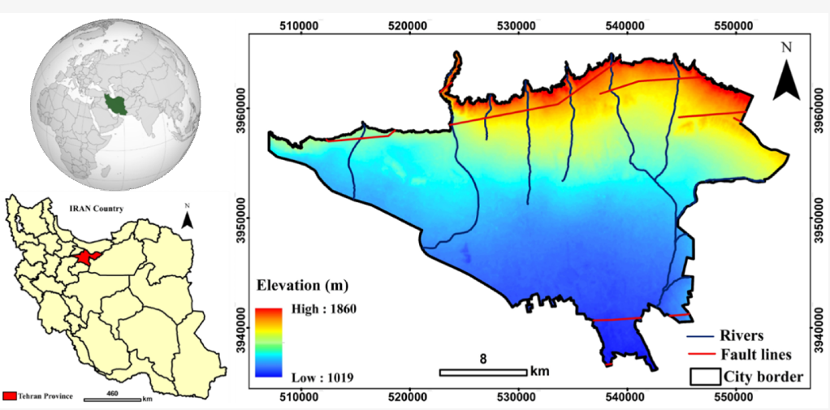
Objectives of GIS
Spatial Analysis and Decision Support
Perform spatial analysis to identify trends, patterns, and relationships in geographic data.
Support decision-making in urban planning, disaster management, resource allocation, and environmental conservation.
Use spatial modeling and predictive analytics to forecast future scenarios.

Slide 10
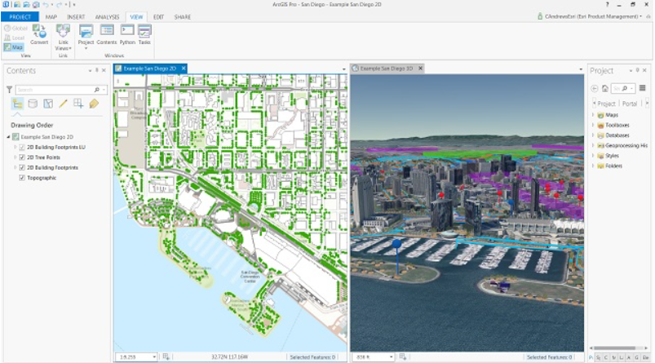
Objectives of GIS
Mapping and Visualization
Create accurate and interactive maps for better understanding and communication.
Generate thematic maps (e.g., climate maps, population density maps, land-use maps) for various sectors.
Develop 3D visualization and geospatial simulations for urban development and infrastructure projects.

Slide 11
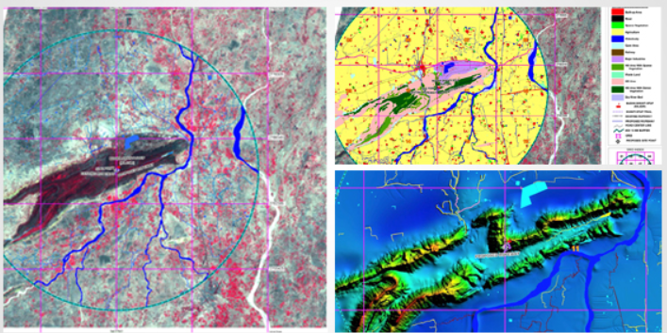
Objectives of GIS
Environmental and Natural Resource Management
Monitor and analyze environmental changes such as deforestation, air pollution, and water quality.
Manage natural resources like forests, water bodies, and mineral deposits.
Support conservation efforts by identifying areas of ecological importance and vulnerability.

Slide 12
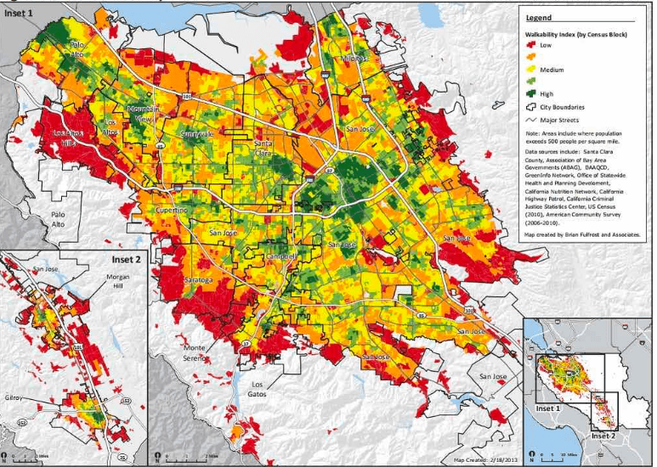
Objectives of GIS
Urban and Regional Planning
Assist in land-use planning, zoning regulations, and infrastructure development.
Optimize site selection for facilities such as schools, hospitals, and public transportation.
Improve traffic management, transportation networks, and smart city initiatives.

Slide 13
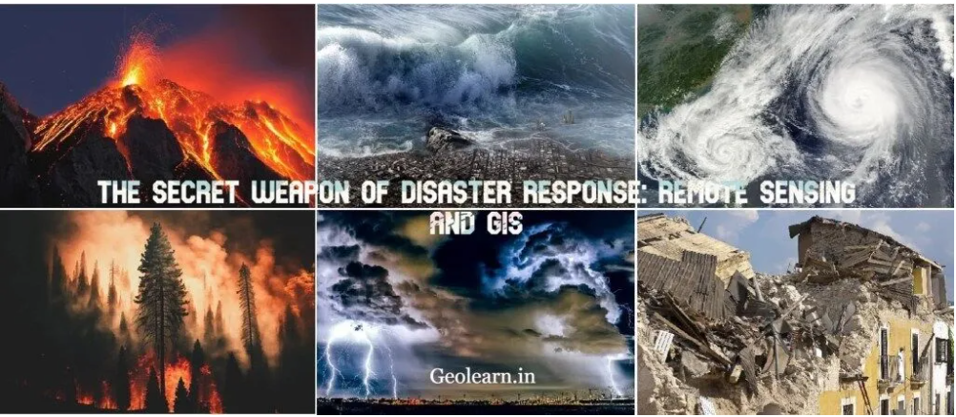
Objectives of GIS
Disaster Management and Risk Assessment
Analyze risk factors related to natural disasters such as earthquakes, floods, and hurricanes.
Develop early warning systems and emergency response plans.
Support post-disaster recovery and reconstruction efforts.

Slide 14
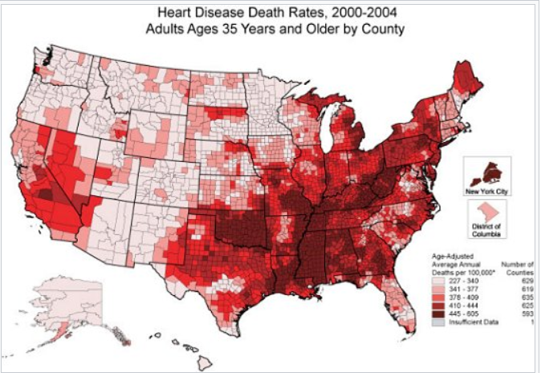
Objectives of GIS
Public Health and Epidemiology
Track disease outbreaks and assess public health risks.
Optimize healthcare facility distribution based on population needs.
Conduct spatial epidemiological studies to understand the spread of diseases.

Slide 15
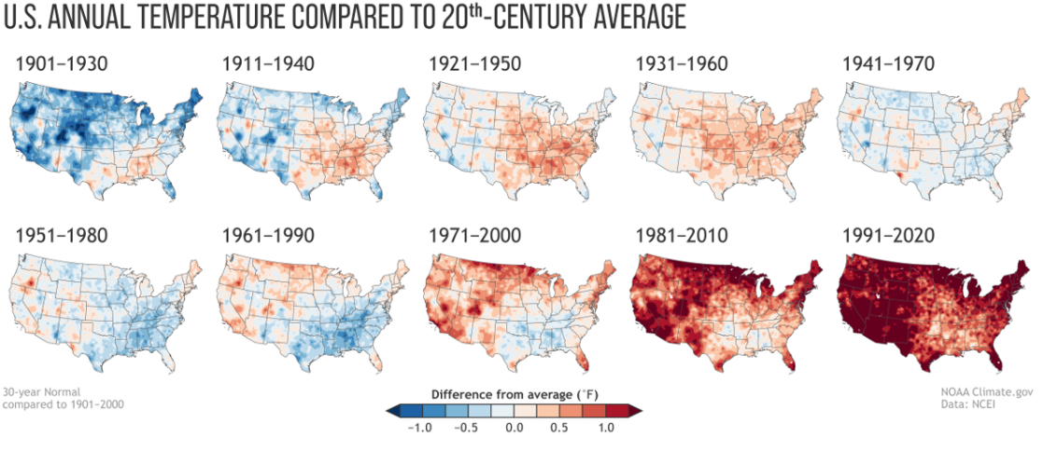
Objectives of GIS
Climate Change Analysis and Sustainability
Model climate change impacts on urban and natural environments.
Assess carbon footprints, heat island effects, and air quality changes.
Develop sustainable development strategies and policies.

Slide 16
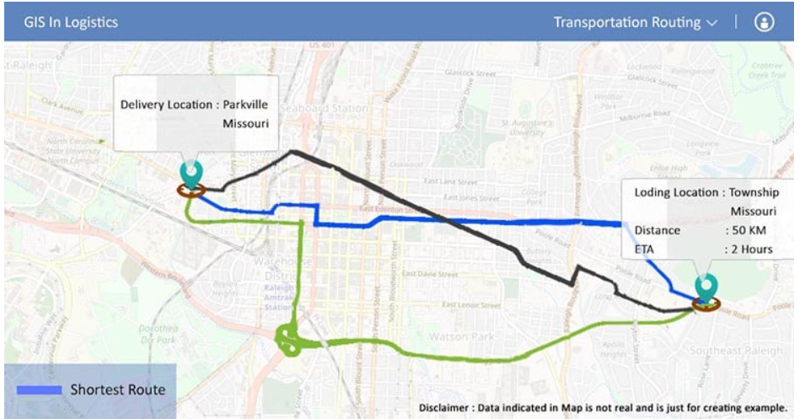
Objectives of GIS
Transportation and Logistics
Optimize route planning and logistics for supply chain management.
Improve navigation systems, public transportation planning, and smart mobility solutions.
Analyze traffic congestion and road safety patterns.

Slide 17
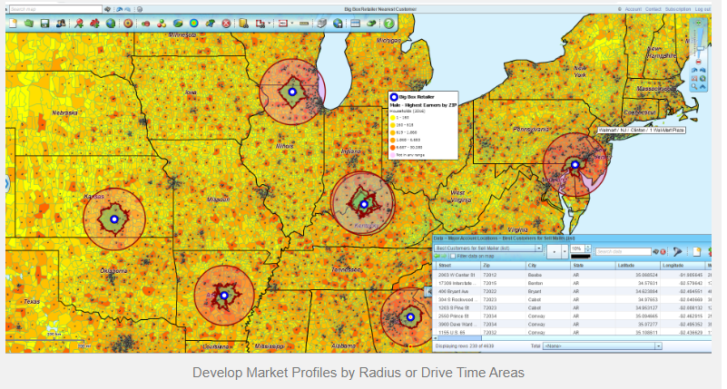
Objectives of GIS
Business and Market Analysis
Support site selection for businesses based on demographic and economic data.
Conduct market analysis using geospatial intelligence.
Improve customer targeting and regional marketing strategies.

Slide 18


Thank you…

