Slide 1
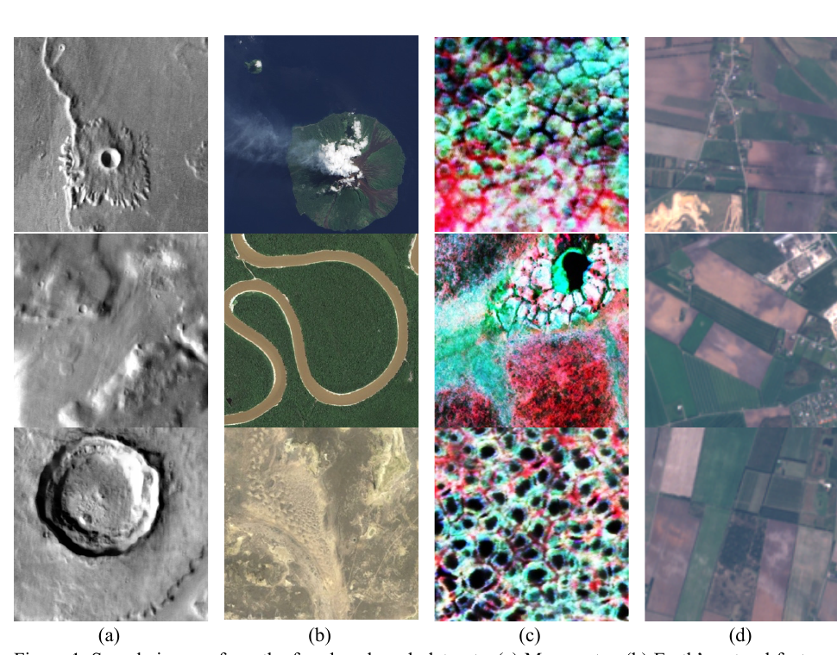
AI-ENHANCED
GEOGRAPHIC INFORMATION SYSTEMS
WEEK 13
Advanced GeoAI: foundation models, Explainability, and Responsible Use
MIS 369 · Ankara Science University
Dr. Murat BAŞEĞMEZ
Notes:
Instructor note: Explain how this week builds upon previous GIS concepts. Use the cover image solely as an introduction to the topic.
Source: https://arxiv.org/abs/2503.22081

Slide 2
Learning outcomes
WEEK 13
By the end of the lesson, the student will
Explains the concepts of geospatial foundation models and transfer learning
Evaluates the usage limitations of Prithvi, multimodal models, and prompt-based segmentation
Conducts spatial error and uncertainty analysis in conjunction with model explanation
Develops a governance plan addressing location privacy, spatial bias, and human oversight
The outcomes encompass the levels of concepts, application, and critical evaluation.
MIS 369 · AI-Enhanced Geographic Information Systems
Dr. Murat BAŞEĞMEZ
Notes:
Instructor note: Read the learning outcomes at the beginning of the class and link them to the laboratory assignment.
Source: https://arxiv.org/abs/2503.22081; https://arxiv.org/abs/2409.00489; https://arxiv.org/abs/2508.00858; https://digital-strategy.ec.europa.eu/en/policies/regulatory-framework-ai; https://pro.arcgis.com/en/pro-app/3.5/help/analysis/ai/geoai.htm

Slide 3
SECTION 1
Geospatial foundation models
Pre-training on large-scale unlabeled data generates shared representations for diverse tasks
This section will establish the connection between concepts, methods, and applications.
Notes:
Instructor note: Connect the current section to the previous one in a single sentence.
Source: https://arxiv.org/abs/2503.22081

Slide 4
The concept of a foundation model
WEEK 13
GEOSPATIAL FOUNDATION MODELLER
The model first learns a general representation, then adapts to a specific local task.
Pre-training is performed on large, mostly unlabeled datasets.
The encoder transforms images or time series into feature representations.
A lightweight model head is added for the downstream task.
Fine-tuning enables task adaptation with fewer labels.
Performance must also be tested for sensor and geographic robustness.
EXPLANATION SCHEME
1
Pre-training on large, mostly unlabeled data…
↓
2
Encoder converts image or time series into feature…
↓
3
Lightweight model head for downstream task…
Source: https://arxiv.org/abs/2503.22081
MIS 369 · AI-Enhanced Geographic Information Systems
Dr. Murat BAŞEĞMEZ
Notes:
Instructor note: The model first learns a general representation, then adapts to a specific local task. Ask students to separately identify the data, method, output, and limitations based on the visual or concept.
Source: https://arxiv.org/abs/2503.22081

Slide 5
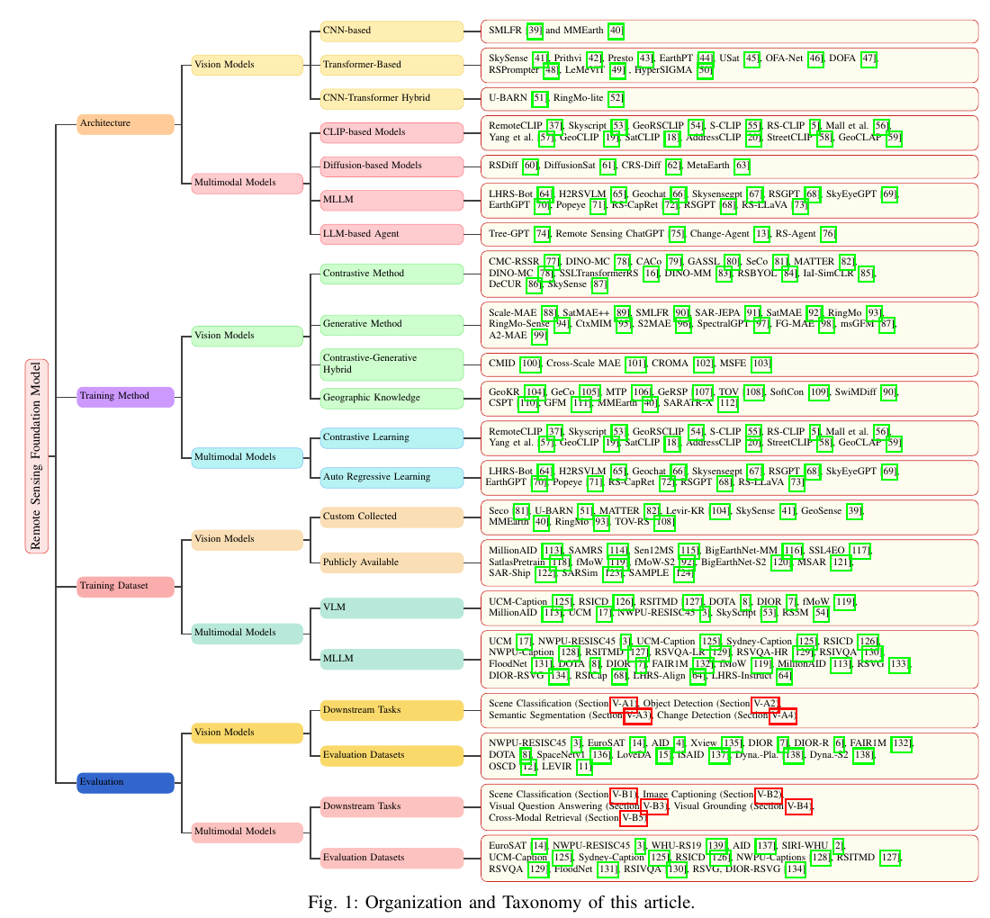
2025 foundation model taxonomy
WEEK 13
GEOSPATIAL FOUNDATION MODELLER
The field is expanding from mere image encoders to multimodal and agent-based systems.
Vision models: CNNs, Transformers, and hybrid architectures
Multimodal models: image-text, diffusion, and MLLMs
Training: contrastive, generative, and geo-informed
Evaluation: classification, detection, segmentation, and change detection
Visual interpretation: first identify the input/output, then determine what the colors and symbols represent.
Source: https://arxiv.org/abs/2503.22081
MIS 369 · AI-Enhanced Geographic Information Systems
Dr. Murat BAŞEĞMEZ
Notes:
Instructor note: The field is expanding from mere image encoders to multimodal and agent-based systems. Ask students to separately identify the data, method, output, and limitations based on the visual or concept.
Source: https://arxiv.org/abs/2503.22081

Slide 6
Prithvi'nin girdisi
WEEK 13
GEOSPATIAL FOUNDATION MODELLER
Prithvi targets multi-band and temporal Earth observation data instead of RGB
Pre-training with Harmonized Landsat Sentinel-2 data
Blue, Green, Red, Narrow NIR, SWIR1, and SWIR2 bands
C, T, H, W input structure including the time dimension
Adaptation for tasks such as land cover, flood, and burned area mapping
EXPLANATION SCHEME
Pre-training with Harmonized Landsat Sentinel-2 data…
Blue, Green, Red, Narrow NIR, SWIR1, and SWIR2…
C, T, H, W input structure including the time dimension
Tasks such as land cover, flood, and burned area…
genelden uygulamaya
Source: https://arxiv.org/abs/2409.00489
MIS 369 · AI-Enhanced Geographic Information Systems
Dr. Murat BAŞEĞMEZ
Notes:
Instructor note: Prithvi targets multi-band and temporal Earth observation data instead of RGB. Ask students to separately identify the data, method, output, and limitations based on the visual or concept.
Source: https://arxiv.org/abs/2409.00489

Slide 7
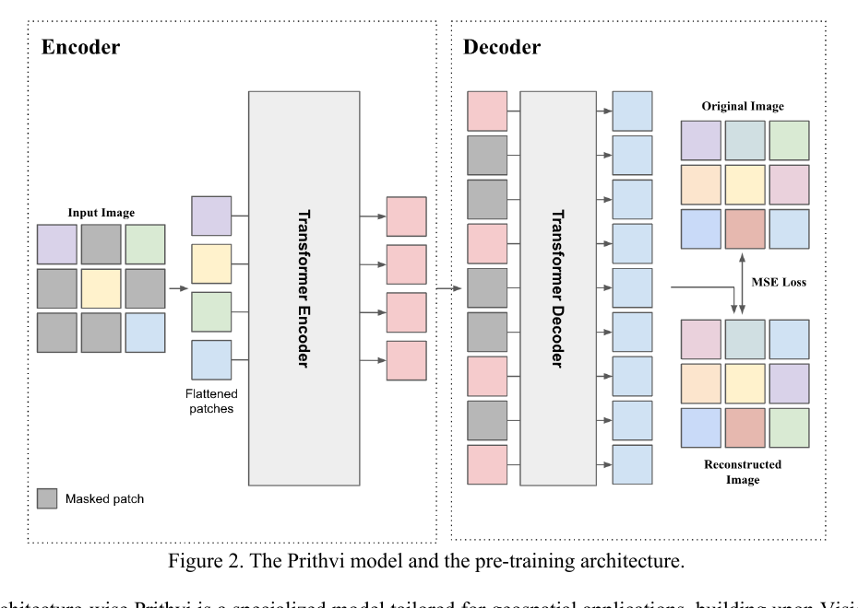
Masked autoencoder pre-training
WEEK 13
GEOSPATIAL FOUNDATION MODELLER
The model learns representations by reconstructing masked image patches
The image is divided into fixed-size patches.
A portion of the patches is masked.
The encoder represents the visible patches.
The decoder reconstructs the missing patches.
The encoder is reused for the downstream task.
Visual interpretation: first identify the input/output, then determine what the colors and symbols represent.
Source: https://arxiv.org/abs/2409.00489
MIS 369 · AI-Enhanced Geographic Information Systems
Dr. Murat BAŞEĞMEZ
Notes:
Instructor note: The model learns representations by reconstructing masked image patches. Ask students to separately identify the data, method, output, and limitations regarding the visual or concept.
Source: https://arxiv.org/abs/2409.00489

Slide 8
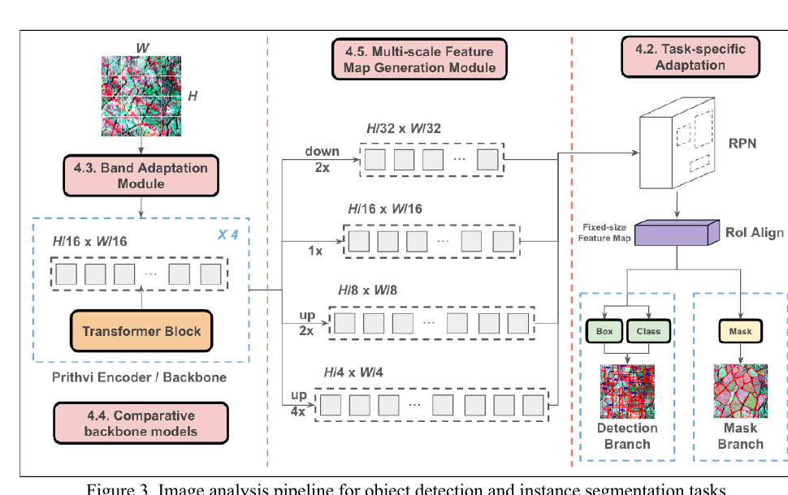
Task adaptation
WEEK 13
GEOSPATIAL FOUNDATION MODELLER
A foundation model is not the final map on its own
Band adaptation aligns source and target bands.
Multi-scale feature maps support both small and large objects.
A task-specific head generates detections or masks.
Fine-tuning is performed using local labels.
The result is evaluated in an independent geographic test.
Visual interpretation: first identify the input/output, then determine what the colors and symbols represent.
Source: https://arxiv.org/abs/2409.00489
MIS 369 · AI-Enhanced Geographic Information Systems
Dr. Murat BAŞEĞMEZ
Notes:
Instructor note: A foundation model is not the final map on its own. Ask students to separately identify the data, method, output, and limitations regarding the visual or concept.
Source: https://arxiv.org/abs/2409.00489

Slide 9
CHAPTER 2
Multimodal and novel GeoAI applications
Image, time-series, vector, text, and network data can be processed together
This section will establish the connection between concepts, methods, and applications.
Notes:
Instructor note: Connect the current section to the previous one in a single sentence.
Source: https://arxiv.org/abs/2503.22081

Slide 10
Multimodal GeoAI
WEEK 13
MULTIMODAL AND NOVEL GEOAI APPLICATIONS
Different data types describe the same geographic phenomenon from different perspectives
Optical imagery provides a view of the surface.
SAR can offer information on structure and moisture under cloudy conditions.
LiDAR provides elevation and 3D geometry.
OSM and administrative data add context regarding objects and relationships.
Text data can convey information about events and place names.
EXPLANATION SCHEME
1
Optical imagery provides a view of the surface
↓
2
SAR provides structural and moisture information in cloudy conditions
↓
3
LiDAR provides elevation and 3D form
Source: https://arxiv.org/abs/2503.22081
MIS 369 · AI-Enhanced Geographic Information Systems
Dr. Murat BAŞEĞMEZ
Notes:
Instructor note: Different data types explain the same geographic phenomenon from different perspectives. Ask students to separately identify the data, method, output, and limitations regarding the visual or concept.
Source: https://arxiv.org/abs/2503.22081

Slide 11
Vision–language modeller
WEEK 13
MULTIMODAL AND NOVEL GEOAI APPLICATIONS
Text and images are matched in a joint representation space.
Text-to-image search and scene classification
Object or region description using natural language
Image captioning and visual question answering
Misinterpretation of geographic names and scale poses significant risks.
Expert verification is mandatory for operational use.
EXPLANATION SCHEME
01
02
Text-to-image search and scene classification
Object or region description using natural language
03
04
Image captioning and visual question answering
Misinterpretation of geographic names and scale…
Source: https://arxiv.org/abs/2503.22081
MIS 369 · AI-Enhanced Geographic Information Systems
Dr. Murat BAŞEĞMEZ
Notes:
Instructor note: Text and images are matched in a joint representation space. Ask students to separately identify the data, method, output, and limitations regarding the visual or concept.
Source: https://arxiv.org/abs/2503.22081

Slide 12
Prompt-based segmentation
WEEK 13
MULTIMODAL AND NOVEL GEOAI APPLICATIONS
Point, box, or text prompts support rapid label generation.
The model generates a proposed mask.
The analyst corrects incorrect boundaries.
Corrected masks can be added to the local training dataset.
Prompt success depends on image resolution and object scale.
Automated output should not be used as a substitute for reference data.
EXPLANATION SCHEME
The model generates a proposal mask
The analyst corrects incorrect boundaries
Corrected masks [are added] to the local training dataset…
Prompt success [depends on] image resolution and object…
genelden uygulamaya
Source: https://pro.arcgis.com/en/pro-app/latest/help/analysis/deep-learning/deep-learning-in-arcgis-pro.htm
MIS 369 · AI-Enhanced Geographic Information Systems
Dr. Murat BAŞEĞMEZ
Notes:
Instructor note: Point, box, or text prompts support rapid label generation. Ask students to separately identify the data, method, output, and limitations regarding the visual or concept.
Source: https://pro.arcgis.com/en/pro-app/latest/help/analysis/deep-learning/deep-learning-in-arcgis-pro.htm

Slide 13
Spatial networks and GNNs
WEEK 13
MULTIMODAL AND NOVEL GEOAI APPLICATIONS
Graph Neural Networks can directly model neighborhood and connectivity
Nodes can be buildings, parcels, stations, or road intersections.
Edges represent distance, flow, adjacency, or functional relationships.
Message passing incorporates neighbor information into the node representation.
If the network definition is incorrect, the model may learn non-physical relationships.
EXPLANATION SCHEME
Nodes can be buildings, parcels, stations, or road intersect…
Message passing incorporates neighbor information into the node represent…
Edges represent distance, flow, adjacency, or functio…
If the network definition is incorrect, the model may learn non-physical rel…
Source: https://pro.arcgis.com/en/pro-app/3.5/help/analysis/ai/geoai.htm
MIS 369 · AI-Enhanced Geographic Information Systems
Dr. Murat BAŞEĞMEZ
Notes:
Instructor note: Graph Neural Networks can directly model neighborhood and connectivity. Ask students to separately identify the data, method, output, and limitations regarding the visual or concept.
Source: https://pro.arcgis.com/en/pro-app/3.5/help/analysis/ai/geoai.htm

Slide 14
Operational model selection
WEEK 13
MULTIMODAL AND NOVEL GEOAI APPLICATIONS
The largest model is not always the most suitable model
Input sensor and resolution compatibility
Label quantity and geographic extent
GPU, time, and energy budget
Output resolution and latency requirements
Fine-tuning and maintenance capacity
Need for explainability and governance
EXPLANATION SCHEME
QUESTION
↓
↓
↓
Input sensor and resolution compatibility
Label quantity and geographic extent
GPU, time, and energy budget
Source: https://arxiv.org/abs/2508.00858
MIS 369 · AI-Enhanced Geographic Information Systems
Dr. Murat BAŞEĞMEZ
Notes:
Instructor note: The largest model is not always the most suitable model. Ask students to separately identify the data, method, output, and limitations regarding the visual or concept.
Source: https://arxiv.org/abs/2508.00858

Slide 15
SECTION 3
Explainability and uncertainty
Model behavior is examined alongside geographic distribution
This section will establish the connection between concepts, methods, and applications.
Notes:
Instructor note: Connect the current section to the previous one in a single sentence.
Source: https://arxiv.org/abs/2503.22081

Slide 16
Global and local explanation
WEEK 13
EXPLAINABILITY AND UNCERTAINTY
A model's overall behavior is not the same as the rationale for a single prediction
Global explanation
Local explanation
Variable importance
Partial dependence
Overall model trend
Contributions to a single prediction
Comparison with neighboring samples
Rationale at a specific location
Source: https://doc.esri.com/en/arcgis-pro/latest/tool-reference/spatial-statistics/how-forest-works.html
MIS 369 · AI-Enhanced Geographic Information Systems
Dr. Murat BAŞEĞMEZ
Notes:
Instructor note: A model's overall behavior is not the same as the rationale for a single prediction. Ask students to separately identify the data, method, output, and limitations regarding the visual or concept.
Source: https://doc.esri.com/en/arcgis-pro/latest/tool-reference/spatial-statistics/how-forest-works.html

Slide 17
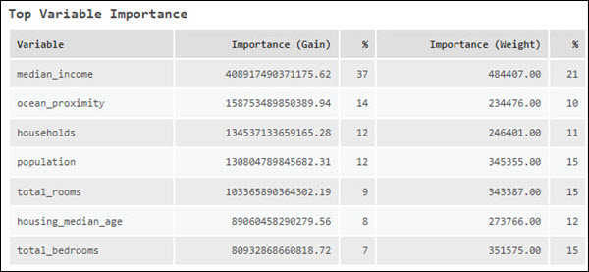
Limitations of variable importance
WEEK 13
EXPLAINABILITY AND UNCERTAINTY
The importance plot does not provide information on causality or directionality.
High importance indicates that the variable is used frequently or strongly in prediction.
Correlated variables may share importance.
Spatial proxy variables may indirectly carry sensitive social characteristics.
Importance results should be compared across different geographic blocks.
Visual interpretation: first identify the input/output, then determine what the colors and symbols represent.
Source: https://doc.esri.com/en/arcgis-pro/latest/tool-reference/spatial-statistics/how-forest-works.html
MIS 369 · AI-Enhanced Geographic Information Systems
Dr. Murat BAŞEĞMEZ
Notes:
Instructor note: The importance plot does not provide information on causality or directionality. Ask students to separately identify the data, method, output, and limitations regarding the visual or concept.
Source: https://doc.esri.com/en/arcgis-pro/latest/tool-reference/spatial-statistics/how-forest-works.html

Slide 18
Spatial explanation map
WEEK 13
EXPLAINABILITY AND UNCERTAINTY
A variable's contribution may vary by location.
Regional differences can be observed by mapping local contributions.
Clusters on the explanation map may indicate model bias or actual processes.
The sign and magnitude of the contribution should be interpreted in the context of the target.
Individual locations in sensitive areas should be anonymized.
EXPLANATION SCHEME
Regional differences can be observed by mapping local contributions...
Clusters on the explanation map may indicate model bias...
The sign and magnitude of the contribution should be interpreted in the context of the target...
Individual locations in sensitive areas should be anonymized...
genelden uygulamaya
Source: https://pro.arcgis.com/en/pro-app/3.5/help/analysis/ai/geoai.htm
MIS 369 · AI-Enhanced Geographic Information Systems
Dr. Murat BAŞEĞMEZ
Notes:
Instructor note: A variable's contribution may vary by location. Ask students to separately identify the data, method, output, and limitations regarding the visual or concept.
Source: https://pro.arcgis.com/en/pro-app/3.5/help/analysis/ai/geoai.htm

Slide 19
Sources of uncertainty
WEEK 13
EXPLAINABILITY AND UNCERTAINTY
Data, model, and distribution shifts produce different types of uncertainty
Aleatoric uncertainty stems from observation and process noise.
Epistemic uncertainty stems from limited data and model knowledge.
Domain shift separates training and operational distributions.
The map should display a confidence or uncertainty layer alongside the prediction.
EXPLANATION SCHEME
Aleatoric uncertainty stems from observation and process noise…
Domain shift separates training and operational distributions…
Epistemic uncertainty stems from limited data and model…
The map should display a confidence or uncertainty…
Source: https://arxiv.org/abs/2508.00858
MIS 369 · AI-Enhanced Geographic Information Systems
Dr. Murat BAŞEĞMEZ
Notes:
Instructor note: Data, model, and distribution shifts produce different types of uncertainty. Ask students to separately identify the data, method, output, and limitations regarding the visual or concept.
Source: https://arxiv.org/abs/2508.00858

Slide 20
Making decisions based on uncertainty
WEEK 13
EXPLAINABILITY AND UNCERTAINTY
Low-confidence predictions can be routed to a review queue rather than triggering an automated decision
High risk and high confidence: priority intervention
High risk and low confidence: field verification
Low risk and low confidence: need for data collection
Low risk and high confidence: routine monitoring
Thresholds are determined based on decision costs and resource capacity.
EXPLANATION SCHEME
QUESTION
↓
↓
↓
High risk and high confidence
High risk and low confidence
Low risk and low confidence
Source: https://pro.arcgis.com/en/pro-app/3.5/help/analysis/ai/geoai.htm
MIS 369 · AI-Enhanced Geographic Information Systems
Dr. Murat BAŞEĞMEZ
Notes:
Instructor note: Low-confidence predictions can be routed to a review queue rather than an automated decision. Ask students to separately identify the data, method, output, and limitations regarding the visual or concept.
Source: https://pro.arcgis.com/en/pro-app/3.5/help/analysis/ai/geoai.htm

Slide 21
CHAPTER 4
Responsible and governed GeoAI
Technical success is not the sole criterion for public decisions
This section will establish the connection between concepts, methods, and applications.
Notes:
Instructor note: Connect the current section to the previous one in a single sentence.
Source: https://arxiv.org/abs/2503.22081

Slide 22
Spatial bias
WEEK 13
RESPONSIBLE AND GOVERNED GEOAI
Data coverage gaps produce systematic error on the map
Urban areas may be more densely labeled than rural areas.
Access to high-resolution imagery may vary by region.
Historical service distribution may be embedded in the target label.
Model performance should be reported separately at the regional and social group levels.
EXPLANATION SCHEME
1
Urban areas more densely [labeled] than rural areas…
↓
2
Access to high-resolution imagery [varies] by region…
↓
3
Historical service distribution embedded in the target label…
Source: https://arxiv.org/abs/2508.00858
MIS 369 · AI-Enhanced Geographic Information Systems
Dr. Murat BAŞEĞMEZ
Notes:
Instructor note: Data coverage gaps produce systematic error on the map. Ask students to separately identify the data, method, output, and limitations regarding the visual or concept.
Source: https://arxiv.org/abs/2508.00858

Slide 23
Location privacy
WEEK 13
RESPONSIBLE AND GOVERNED GEOAI
Location data can reveal a person or behavior even if the identity is not directly present
Movement traces can reveal home and workplace locations.
Infrequent locations can facilitate re-identification.
Unnecessary precision should be reduced, and access restricted.
Aggregation, masking, or synthetic data can be considered for sharing.
EXPLANATION SCHEME
01
02
Movement traces can reveal home and workplace locations
Infrequent locations can facilitate re-identific…
03
04
Unnecessary precision should be reduced, and access rest…
Aggregation, masking, or s… can be considered for sharing.
Source: https://digital-strategy.ec.europa.eu/en/policies/regulatory-framework-ai
MIS 369 · AI-Enhanced Geographic Information Systems
Dr. Murat BAŞEĞMEZ
Notes:
Instructor note: Location data can reveal an individual or their behavior, even if their identity is not directly apparent. Ask students to separately identify the data, method, output, and limitations regarding the visual or concept.
Source: https://digital-strategy.ec.europa.eu/en/policies/regulatory-framework-ai

Slide 24
Human oversight
WEEK 13
RESPONSIBLE AND GOVERNED GEOAI
The analyst tests the model output against context, data quality, and domain knowledge.
The model generates a recommendation; an authorized person bears the responsibility for the decision.
Situations involving low confidence and high impact are subject to mandatory review.
The user sees the model's scope and failure conditions.
An appeal and correction mechanism is designed.
EXPLANATION SCHEME
The model generates recommendations
Low-trust and high-impact situations require…
The user [understands] the model's scope and failure c…
An appeal and correction mechanism is designed
genelden uygulamaya
Source: https://digital-strategy.ec.europa.eu/en/policies/regulatory-framework-ai
MIS 369 · AI-Enhanced Geographic Information Systems
Dr. Murat BAŞEĞMEZ
Notes:
Instructor note: The analyst tests the model output against context, data quality, and domain knowledge. Ask students to separately identify the data, method, output, and limitations on the visual or concept.
Source: https://digital-strategy.ec.europa.eu/en/policies/regulatory-framework-ai

Slide 25
GeoAI governance file
WEEK 13
RESPONSIBLE AND GOVERNED GEOAI
Each version is tracked with auditable evidence
Data card and source licenses
Model card and version information
Training code, parameters, and seed
Geographic and temporal validation results
Error, fairness, and privacy assessment
Personnel responsible for approval, usage, and updates
EXPLANATION SCHEME
Data card and source licenses
Training code, parameters, and seed
Model card and version information
Geographic and temporal validation results
Source: https://digital-strategy.ec.europa.eu/en/policies/regulatory-framework-ai
MIS 369 · AI-Enhanced Geographic Information Systems
Dr. Murat BAŞEĞMEZ
Notes:
Instructor note: Each version is tracked with auditable evidence. Ask students to separately identify the data, method, output, and limitations on the visual or concept.
Source: https://digital-strategy.ec.europa.eu/en/policies/regulatory-framework-ai

Slide 26
Post-deployment monitoring
WEEK 13
RESPONSIBLE AND GOVERNED GEOAI
Model performance is re-measured as data and geography change
Input distribution and sensor changes are monitored.
Regional error rates are calculated periodically.
New ground truth data is added to the evaluation pool.
Threshold or model updates are recorded as version releases.
Usage is halted when performance falls below the limit.
EXPLANATION SCHEME
QUESTION
↓
↓
↓
Input distribution and sensor changes are monitored
Regional error rates are calculated periodically
New ground truth data is added to the evaluation pool…
Source: https://arxiv.org/abs/2508.00858
MIS 369 · AI-Enhanced Geographic Information Systems
Dr. Murat BAŞEĞMEZ
Notes:
Instructor note: Model performance is re-measured as data and geography change. Ask students to separately identify the data, method, output, and limitations regarding the visual or concept.
Source: https://arxiv.org/abs/2508.00858

Slide 27
GUIDED EXERCISE
Responsible GeoAI audit lab
Prepare a pre-deployment audit file for a pre-trained image model or spatial prediction model.
Notes:
Instructor note: Explain at the beginning which files students are required to submit at the end of the lab.
Source: https://arxiv.org/abs/2503.22081

Slide 28
Lab scenario
WEEK 13
EXERCISE
Prepare a pre-deployment audit file for a pre-trained image model or spatial prediction model.
Specify the study area and unit of analysis.
Define the decision-maker and the expected output.
Establish a consistent chain between data, method, and validation.
MIS 369 · AI-Enhanced Geographic Information Systems
Dr. Murat BAŞEĞMEZ
Notes:
Instructor note: Ensure that students wishing to adapt the scenario to their own term projects do not expand the scope.
Source: https://arxiv.org/abs/2503.22081

Slide 29
Laboratory procedure steps
WEEK 13
EXERCISE
Investigate the source model's pre-training data, sensor, and geographic scope.
Document the risks of misalignment with the local task and domain shift.
Plan for at least two explanations and one uncertainty output.
Define controls for regional performance, privacy, and human oversight.
Determine usage authorization, monitoring thresholds, and the party responsible for updates.
Screenshots or evidence from the geoprocessing history must be saved for each step.
MIS 369 · AI-Enhanced Geographic Information Systems
Dr. Murat BAŞEĞMEZ
Notes:
Instructor note: Go through the steps sequentially with students; check the rationale behind decisions rather than just the results.
Source: https://arxiv.org/abs/2503.22081; https://arxiv.org/abs/2409.00489; https://arxiv.org/abs/2508.00858; https://digital-strategy.ec.europa.eu/en/policies/regulatory-framework-ai; https://pro.arcgis.com/en/pro-app/3.5/help/analysis/ai/geoai.htm

Slide 30
Laboratory quality control
WEEK 13
EXERCISE
Have the date, coordinate system, and resolution of the input data been recorded?
Are the training and test data geographically or temporally independent?
Have the tool parameters and random seed been recorded?
Has the result been verified using quantitative metrics and a map?
Have limitations and usage constraints been explained?
MIS 369 · AI-Enhanced Geographic Information Systems
Dr. Murat BAŞEĞMEZ
Notes:
Instructor note: Use this list at the end of the lesson for students to review each other's work.
Source: https://arxiv.org/abs/2503.22081

Slide 31
Lab submission package
WEEK 13
EXERCISE
Model card, risk matrix, validation plan, and human oversight workflow
Map or model output
Description of data and methods
Validation evidence
Interpretation of errors or uncertainty
References and brief usage constraints
MIS 369 · AI-Enhanced Geographic Information Systems
Dr. Murat BAŞEĞMEZ
Notes:
Instructor note: Ask them to keep the submission package as part of the term project.
Source: https://arxiv.org/abs/2503.22081

Slide 32
End-of-lesson check 1
WEEK 13
ASSESSMENT
What does adapting a foundation model to a downstream task entail?
A
Changing the map's color
B
Fine-tuning the pre-trained encoder for the local task
C
Deleting the coordinate system
D
Adding test data to the training set
MIS 369 · AI-Enhanced Geographic Information Systems
Dr. Murat BAŞEĞMEZ
Notes:
Instructor note: The correct answer is B. Also explain why the incorrect options are not suitable.
Source: https://arxiv.org/abs/2503.22081

Slide 33
End-of-lesson check 2
WEEK 13
ASSESSMENT
What does variable importance not prove?
A
That the model uses the variable
B
Nedensel etkiyi
C
That there is a difference in importance among variables
D
The model's splitting preferences
MIS 369 · AI-Enhanced Geographic Information Systems
Dr. Murat BAŞEĞMEZ
Notes:
Instructor note: The correct answer is B. Also explain why the incorrect options are not suitable.
Source: https://arxiv.org/abs/2503.22081

Slide 34
End-of-lesson check 3
WEEK 13
ASSESSMENT
What is the most appropriate action for a high-risk but low-confidence prediction?
A
Automated final decision
B
Sonucu silmek
C
Field and expert validation
D
Simply changing the color
MIS 369 · AI-Enhanced Geographic Information Systems
Dr. Murat BAŞEĞMEZ
Notes:
Instructor note: The correct answer is C. Also explain why the incorrect options are not suitable.
Source: https://arxiv.org/abs/2503.22081

Slide 35
WEEK 13 SUMMARY
Advanced GeoAI: foundation models, Explainability, and Responsible Use
Geospatial foundation models
Multimodal and novel GeoAI applications
Explainability and uncertainty
Responsible and governed GeoAI
Ana ilke
Geographic data structure, validation scheme, and usage context precede model selection.
Notes:
Instructor note: Ask students to summarize the four sections of the week in one sentence each, using their own examples.
Source: https://arxiv.org/abs/2503.22081; https://arxiv.org/abs/2409.00489; https://arxiv.org/abs/2508.00858; https://digital-strategy.ec.europa.eu/en/policies/regulatory-framework-ai; https://pro.arcgis.com/en/pro-app/3.5/help/analysis/ai/geoai.htm

Slide 36
Resources and further reading
WEEK 13
https://arxiv.org/abs/2503.22081
https://arxiv.org/abs/2409.00489
https://arxiv.org/abs/2508.00858
https://digital-strategy.ec.europa.eu/en/policies/regulatory-framework-ai
https://pro.arcgis.com/en/pro-app/3.5/help/analysis/ai/geoai.htm
The source of each external image in the presentation is indicated in the footer of the relevant slide and in the speaker notes.
MIS 369 · AI-Enhanced Geographic Information Systems
Dr. Murat BAŞEĞMEZ
Notes:
Instructor note: Share the resources with the students. Ask them to focus on the methodology, data splitting, and limitations sections when reading the articles.
Source: https://arxiv.org/abs/2503.22081; https://arxiv.org/abs/2409.00489; https://arxiv.org/abs/2508.00858; https://digital-strategy.ec.europa.eu/en/policies/regulatory-framework-ai; https://pro.arcgis.com/en/pro-app/3.5/help/analysis/ai/geoai.htm

