Slide 1
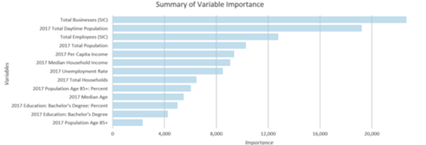
AI-ENHANCED
GEOGRAPHIC INFORMATION SYSTEMS
Week 10
Supervised Spatial machine learning
MIS 369 · Ankara Science University
Dr. Murat BAŞEĞMEZ
Notes:
Instructor note: Explain how this week builds upon previous GIS concepts. Use the cover image solely to introduce the topic.
Source: https://doc.esri.com/en/arcgis-pro/latest/tool-reference/spatial-statistics/how-forest-works.html

Slide 2
Learning outcomes
Week 10
By the end of the lesson, the student will
Matches classification and regression problems with the correct target type
Explains the operating logic of Random Forest and Gradient Boosting models
Sets up the ArcGIS Pro Forest-based and Boosted tool and interprets the outputs
Evaluates performance using spatial validation, error maps, and uncertainty analysis
The outcomes encompass the levels of concepts, application, and critical evaluation.
MIS 369 · AI-Enhanced Geographic Information Systems
Dr. Murat BAŞEĞMEZ
Notes:
Instructor note: Read the learning outcomes at the beginning of the lesson and link them to the lab submission.
Source: https://doc.esri.com/en/arcgis-pro/latest/tool-reference/spatial-statistics/how-forest-works.html; https://doi.org/10.1111/ecog.02881; https://www.fatiando.org/verde/latest/gallery/train_test_split.html

Slide 3
SECTION 1
Supervised learning problem
The model learns to make predictions for new observations based on known targets
This section will establish the connection between concepts, methods, and applications.
Notes:
Instructor note: Connect this section to the previous one in a single sentence.
Source: https://doc.esri.com/en/arcgis-pro/latest/tool-reference/spatial-statistics/how-forest-works.html

Slide 4
Classification and regression
Week 10
SUPERVISED LEARNING PROBLEM
The nature of the target variable determines the method and metric
Classification
Regresyon
Binary: suitable / unsuitable
Multiclass: low / medium / high
Output: class and probability
Continuous target: price, demand, temperature
Output: numerical prediction
Error: observed minus predicted
Source: https://doc.esri.com/en/arcgis-pro/latest/tool-reference/spatial-statistics/how-forest-works.html
MIS 369 · AI-Enhanced Geographic Information Systems
Dr. Murat BAŞEĞMEZ
Notes:
Instructor note: The nature of the target variable determines the method and metric. Ask students to separately identify the data, method, output, and limitations based on the visual or concept.
Source: https://doc.esri.com/en/arcgis-pro/latest/tool-reference/spatial-statistics/how-forest-works.html

Slide 5
Why is a baseline model necessary?
Week 10
SUPERVISED LEARNING PROBLEM
A complex model must outperform a simple reference
In regression, the mean or a linear model can serve as the baseline.
In classification, the majority class or a simple logistic model can be used.
The baseline model demonstrates whether the new method actually adds value.
Comparisons must be made using the same data split and the same metrics.
EXPLANATION SCHEME
01
02
In regression, the mean or a linear model serves as the bas…
In classification, the majority class or a simple lo…
03
04
The baseline model [determines whether] the new method truly adds val…
Comparison using the same data split and the same metrics…
Source: https://doi.org/10.1111/ecog.02881
MIS 369 · AI-Enhanced Geographic Information Systems
Dr. Murat BAŞEĞMEZ
Notes:
Instructor note: A complex model must outperform a simple reference model. Ask students to separately identify the data, method, output, and limitations based on the visual or concept.
Source: https://doi.org/10.1111/ecog.02881

Slide 6
Decision tree
Week 10
SUPERVISED LEARNING PROBLEM
The tree splits observations into increasingly homogeneous groups using feature thresholds
Each node selects a variable and a threshold.
The leaf node produces a class or numerical prediction.
A deep tree can memorize the training data.
A single tree is interpretable but can be unstable regarding data changes.
EXPLANATION SCHEME
Each node selects a variable and a threshold
The leaf node produces a class or numerical prediction
A deep tree can memorize the training data
A single tree is interpretable but [sensitive] to data chan…
genelden uygulamaya
Source: https://doc.esri.com/en/arcgis-pro/latest/tool-reference/spatial-statistics/how-forest-works.html
MIS 369 · AI-Enhanced Geographic Information Systems
Dr. Murat BAŞEĞMEZ
Notes:
Instructor note: The tree splits observations into increasingly homogeneous groups using feature thresholds. Ask students to separately identify the data, method, output, and limitations based on the visual or concept.
Source: https://doc.esri.com/en/arcgis-pro/latest/tool-reference/spatial-statistics/how-forest-works.html

Slide 7
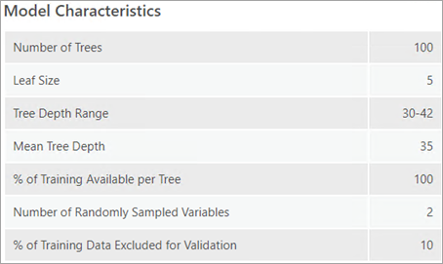
Random Forest
Week 10
SUPERVISED LEARNING PROBLEM
Combining many different trees reduces variance
Each tree is built using a different subset of observations and variables.
Voting is used for classification, while averaging is used for regression.
Out-of-bag observations provide an additional error estimate.
The result generally becomes more stable as the number of trees increases.
Visual interpretation: first identify the input/output, then determine what the colors and symbols represent.
Source: https://doc.esri.com/en/arcgis-pro/latest/tool-reference/spatial-statistics/how-forest-works.html
MIS 369 · AI-Enhanced Geographic Information Systems
Dr. Murat BAŞEĞMEZ
Notes:
Instructor note: Combining many different trees reduces variance. Ask students to separately identify the data, method, output, and limitations based on the visual or concept.
Source: https://doc.esri.com/en/arcgis-pro/latest/tool-reference/spatial-statistics/how-forest-works.html

Slide 8
Gradient Boosting
Week 10
SUPERVISED LEARNING PROBLEM
Sequential trees attempt to reduce previous errors
The new tree focuses on the residuals of the previous model.
Learning rate and tree depth determine capacity.
Regularization and early stopping reduce overfitting.
Boosting can be powerful but is more sensitive to settings than Random Forest.
EXPLANATION SCHEME
QUESTION
↓
↓
↓
The new tree focuses on the residuals of the previous model…
Learning rate and tree depth determine capacity…
Regularization and early stopping [address] overfitting…
Source: https://doc.esri.com/en/arcgis-pro/latest/tool-reference/spatial-statistics/how-forest-works.html
MIS 369 · AI-Enhanced Geographic Information Systems
Dr. Murat BAŞEĞMEZ
Notes:
Instructor note: Sequential trees attempt to reduce previous errors. Ask students to separately identify data, methods, outputs, and limitations regarding the visual or concept.
Source: https://doc.esri.com/en/arcgis-pro/latest/tool-reference/spatial-statistics/how-forest-works.html

Slide 9
CHAPTER 2
Spatial features and training
Model inputs must represent geographic processes
This section will establish the connection between concepts, methods, and applications.
Notes:
Instructor note: Connect this section to the previous one in a single sentence.
Source: https://doc.esri.com/en/arcgis-pro/latest/tool-reference/spatial-statistics/how-forest-works.html

Slide 10
Feature engineering
Week 10
SPATIAL FEATURES AND TRAINING
Adding coordinates alone does not create a spatial model
Distance, accessibility, density, and neighborhood must be related to the process.
Raster values ​​must align with the target date.
Categorical variables must be encoded correctly.
Highly correlated variables representing the same phenomenon can be simplified.
EXPLANATION SCHEME
1
Distance, accessibility, density, and neighborhood [related to] the process…
↓
2
Raster values ​​must align with the target date…
↓
3
Categorical variables must be encoded correctly…
Source: https://doc.esri.com/en/arcgis-pro/latest/tool-reference/spatial-statistics/how-forest-works.html
MIS 369 · AI-Enhanced Geographic Information Systems
Dr. Murat BAŞEĞMEZ
Notes:
Instructor note: Adding coordinates alone does not create a spatial model. Ask students to separately identify data, methods, outputs, and limitations regarding the visual or concept.
Source: https://doc.esri.com/en/arcgis-pro/latest/tool-reference/spatial-statistics/how-forest-works.html

Slide 11
Distance features
Week 10
SPATIAL FEATURES AND TRAINING
The proximity variable represents physical access or exposure.
The ArcGIS tool can calculate the distance from training features to the nearest explanatory feature.
For points, lines, and polygons, the nearest segment is considered.
Euclidean distance does not always represent travel time.
The distance type and coordinate system must be reported.
EXPLANATION SCHEME
01
02
The ArcGIS tool [calculates distance] from training features to the nearest…
For points, lines, and polygons, the nearest segment…
03
04
Euclidean distance does not always represent travel time…
The distance type and coordinate system must be reported…
Source: https://doc.esri.com/en/arcgis-pro/latest/tool-reference/spatial-statistics/how-forest-works.html
MIS 369 · AI-Enhanced Geographic Information Systems
Dr. Murat BAŞEĞMEZ
Notes:
Instructor note: The proximity variable represents physical access or exposure. Ask students to separately identify the data, method, output, and limitations based on the visual or concept.
Source: https://doc.esri.com/en/arcgis-pro/latest/tool-reference/spatial-statistics/how-forest-works.html

Slide 12
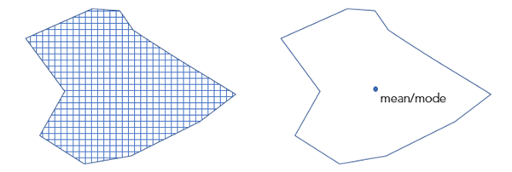
Explanatory rasters
Week 10
SPATIAL FEATURES AND TRAINING
The model samples raster information at point or polygon locations.
For points, the cell value is retrieved.
For polygons, the mean or majority value can be used.
Rasters must also be present in the prediction area.
Reliable extrapolation is not expected for values ​​far outside the training range.
Visual interpretation: first identify the input/output, then determine what the colors and symbols represent.
Source: https://doc.esri.com/en/arcgis-pro/latest/tool-reference/spatial-statistics/how-forest-works.html
MIS 369 · AI-Enhanced Geographic Information Systems
Dr. Murat BAŞEĞMEZ
Notes:
Instructor note: The model samples raster information at point or polygon locations. Ask students to separately identify the data, method, output, and limitations regarding the visual or concept.
Source: https://doc.esri.com/en/arcgis-pro/latest/tool-reference/spatial-statistics/how-forest-works.html

Slide 13
Imbalanced classes
Week 10
SPATIAL FEATURES AND TRAINING
High accuracy can mask the fact that the minority class is being missed
Examine the number of samples per class and the geographic distribution.
Report precision, recall, F1, and MCC alongside accuracy.
Demonstrate how changing the threshold affects false positives and false negatives.
Class weighting or balanced sampling should be applied only to the training data.
EXPLANATION SCHEME
Examine the number of samples per class and the geographic distributi…
Demonstrate how changing the threshold affects false positives and false neg…
Report precision, recall, F1, and MCC alongside accuracy…
Class weighting or balanced sampling should be applied only…
Source: https://doc.esri.com/en/arcgis-pro/latest/tool-reference/spatial-statistics/how-forest-works.html
MIS 369 · AI-Enhanced Geographic Information Systems
Dr. Murat BAŞEĞMEZ
Notes:
Instructor note: High accuracy can mask the fact that the minority class is being missed. Ask students to separately identify the data, method, output, and limitations regarding the visual or concept.
Source: https://doc.esri.com/en/arcgis-pro/latest/tool-reference/spatial-statistics/how-forest-works.html

Slide 14
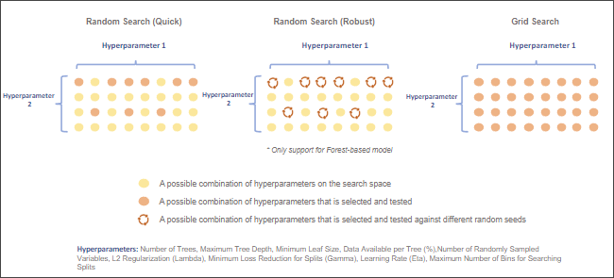
Hyperparameter search
Week 10
SPATIAL FEATURES AND TRAINING
The search is conducted only within the training and validation sets
Number of trees, depth, leaf size, and number of sampled variables can be tested.
Learning rate and regularization are important for boosting. The search space is first defined within reasonable limits. The final selection is evaluated only once in the independent test region.
Visual interpretation: first identify the input/output, then determine what the colors and symbols represent.
Source: https://doc.esri.com/en/arcgis-pro/latest/tool-reference/spatial-statistics/how-forest-works.html
MIS 369 · AI-Enhanced Geographic Information Systems
Dr. Murat BAŞEĞMEZ
Notes:
Instructor note: The search is conducted only within the training and validation sets. Ask students to separately identify the data, method, output, and limitations based on the visual or concept.
Source: https://doc.esri.com/en/arcgis-pro/latest/tool-reference/spatial-statistics/how-forest-works.html

Slide 15
SECTION 3
ArcGIS Pro workflow
The model is examined using "Train only," then a prediction is generated.
This section will establish the connection between concepts, methods, and applications.
Notes:
Instructor note: Connect this section to the previous one in a single sentence.
Source: https://doc.esri.com/en/arcgis-pro/latest/tool-reference/spatial-statistics/how-forest-works.html

Slide 16
Forest-based and Boosted tool
Week 10
ARCGIS PRO WORKFLOW
The tool supports classification and regression within the same workflow.
"Input Training Features" and "Variable to Predict" are selected.
Field, distance feature, and raster inputs can be added.
The model type is set to "Forest-based" or "Gradient Boosted."
The mode is selected as "Train only," "Predict to features," or "Predict to raster."
EXPLANATION SCHEME
1
Input Training Features and Variable to Predic…
↓
2
Field, distance feature, and raster inputs can be add…
↓
3
Model type is Forest-based or Gradient Boosted…
Source: https://doc.esri.com/en/arcgis-pro/latest/tool-reference/spatial-statistics/how-forest-works.html
MIS 369 · AI-Enhanced Geographic Information Systems
Dr. Murat BAŞEĞMEZ
Notes:
Instructor note: The tool supports classification and regression within the same workflow. Ask students to separately identify the data, method, output, and limitations based on the visual or concept.
Source: https://doc.esri.com/en/arcgis-pro/latest/tool-reference/spatial-statistics/how-forest-works.html

Slide 17
Recommended workflow
Week 10
ARCGIS PRO WORKFLOW
Understand the model first, then generate a prediction map.
Evaluate variables and settings using "Train only."
Examine the validation results and variable ranges.
Rebuild the selected model using the entire training dataset.
Provide the same variables and units in the prediction area.
Share the prediction map and the error map together.
EXPLANATION SCHEME
01
02
...variables and settings with 'Train only'...
...validation results and variable ranges...
03
04
...rebuild the selected model with all training data...
...same variables and units in the prediction area...
Source: https://doc.esri.com/en/arcgis-pro/latest/tool-reference/spatial-statistics/how-forest-works.html
MIS 369 · AI-Enhanced Geographic Information Systems
Dr. Murat BAŞEĞMEZ
Notes:
Instructor note: Understand the model first, then generate the prediction map. Ask students to separately identify the data, method, output, and limitations on the visual or concept.
Source: https://doc.esri.com/en/arcgis-pro/latest/tool-reference/spatial-statistics/how-forest-works.html

Slide 18
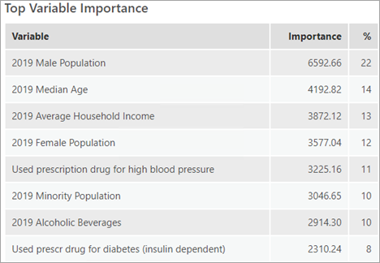
Variable importance
Week 10
ARCGIS PRO WORKFLOW
Importance indicates which variables the model uses in the splits.
For Random Forest, importance is derived from Gini contributions.
For Boosting, gain, weight, and cover have different meanings.
High importance is not proof of causality.
Correlated variables may share importance among themselves.
Visual interpretation: first identify the input/output, then determine what the colors and symbols represent.
Source: https://doc.esri.com/en/arcgis-pro/latest/tool-reference/spatial-statistics/how-forest-works.html
MIS 369 · AI-Enhanced Geographic Information Systems
Dr. Murat BAŞEĞMEZ
Notes:
Instructor note: Importance indicates which variables the model uses in the splits. Ask students to separately identify the data, method, output, and limitations on the visual or concept.
Source: https://doc.esri.com/en/arcgis-pro/latest/tool-reference/spatial-statistics/how-forest-works.html

Slide 19
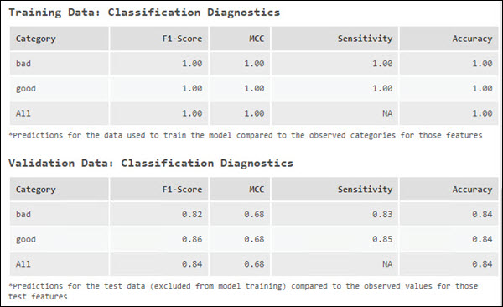
Training and validation diagnostics
Week 10
ARCGIS PRO WORKFLOW
A large difference between training and validation indicates overfitting
In regression, R², MAE, RMSE, and error distribution are examined.
In classification, class-based F1, MCC, sensitivity, and accuracy are reported.
Random holdout alone does not measure spatial transferability.
The same model should also be tested using spatial blocks.
Visual interpretation: first identify the input/output, then determine what the colors and symbols represent.
Source: https://doc.esri.com/en/arcgis-pro/latest/tool-reference/spatial-statistics/how-forest-works.html
MIS 369 · AI-Enhanced Geographic Information Systems
Dr. Murat BAŞEĞMEZ
Notes:
Instructor note: A large difference between training and validation indicates overfitting. Ask students to separately identify the data, method, output, and limitations on the visual or concept.
Source: https://doc.esri.com/en/arcgis-pro/latest/tool-reference/spatial-statistics/how-forest-works.html

Slide 20
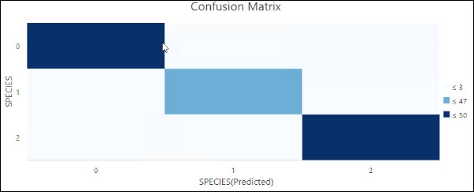
Confusion matrix
Week 10
ARCGIS PRO WORKFLOW
Shows the cost of decisions regarding which classes are confused with one another
Rows represent observed classes; columns represent predicted classes.
The diagonal indicates correct classifications.
High error in a minority class may not be apparent in the overall accuracy.
Generate separate matrices for training, spatial testing, and different regions.
Visual interpretation: first identify the input/output, then determine what the colors and symbols represent.
Source: https://doc.esri.com/en/arcgis-pro/latest/tool-reference/spatial-statistics/how-forest-works.html
MIS 369 · AI-Enhanced Geographic Information Systems
Dr. Murat BAŞEĞMEZ
Notes:
Instructor note: Shows the cost of decisions regarding which classes are confused with one another. Ask students to separately identify the data, method, output, and limitations on the visual or concept.
Source: https://doc.esri.com/en/arcgis-pro/latest/tool-reference/spatial-statistics/how-forest-works.html

Slide 21
CHAPTER 4
Validation, interpretation, and reporting
The model score is interpreted in conjunction with the error pattern on the map.
This section will establish the connection between concepts, methods, and applications.
Notes:
Instructor note: Connect this section to the previous one in a single sentence.
Source: https://doc.esri.com/en/arcgis-pro/latest/tool-reference/spatial-statistics/how-forest-works.html

Slide 22
Regression metrics
Week 10
VALIDATION, INTERPRETATION, AND REPORTING
MAE indicates typical error; RMSE indicates sensitivity to large errors.
MAE is in the unit of the target variable and is easy to interpret.
RMSE penalizes large errors more heavily.
R² summarizes explained variance but can increase with additional variables.
Models with different target scales cannot be directly compared using MAE.
EXPLANATION SCHEME
1
MAE is in the unit of the target variable and is easy to int…
↓
2
RMSE penalizes large errors more heavily
↓
3
R² summarizes explained variance but can increase with additional var…
Source: https://doc.esri.com/en/arcgis-pro/latest/tool-reference/spatial-statistics/how-forest-works.html
MIS 369 · AI-Enhanced Geographic Information Systems
Dr. Murat BAŞEĞMEZ
Notes:
Instructor note: MAE indicates typical error; RMSE indicates sensitivity to large errors. Ask students to separately identify the data, method, output, and limitations based on the visual or concept.
Source: https://doc.esri.com/en/arcgis-pro/latest/tool-reference/spatial-statistics/how-forest-works.html

Slide 23
Error map
Week 10
VALIDATION, INTERPRETATION, AND REPORTING
The spatial pattern of residuals may indicate a missing process or bias.
A positive residual indicates an area where the model under-predicted.
A negative residual indicates over-prediction.
Remaining spatial autocorrelation in the residuals suggests the model has not fully captured the geographic structure.
A regional error summary can provide the decision-maker with more information than an average score.
EXPLANATION SCHEME
01
02
A positive residual indicates an area where the model under-predicted…
A negative residual indicates over-prediction.
03
04
Remaining spatial autocorrelation in the residuals suggests the model…
The regional error summary provides the decision-maker with an average sco…
Source: https://doi.org/10.1111/ecog.02881
MIS 369 · AI-Enhanced Geographic Information Systems
Dr. Murat BAŞEĞMEZ
Notes:
Instructor note: The spatial pattern of residuals may indicate a missing process or bias. Ask students to separately identify the data, method, output, and limitations on the visual or concept.
Source: https://doi.org/10.1111/ecog.02881

Slide 24
Random test and spatial test
Week 10
VALIDATION, INTERPRETATION, AND REPORTING
The difference between the two scores indicates the risk of transfer.
The random test measures performance close to the existing sample distribution.
The spatial test better simulates performance in a new region.
If the difference is large, the model may have memorized local patterns.
If the area of ​​application is limited to the current geography, this limitation is noted on the model card.
EXPLANATION SCHEME
The random test measures performance close to the existing sample distribution…
The spatial test better simulates performance in a new region…
If the difference is large, the model may have memorized local patterns…
If the area of ​​application is limited to the current geography…
genelden uygulamaya
Source: https://doi.org/10.1111/ecog.02881
MIS 369 · AI-Enhanced Geographic Information Systems
Dr. Murat BAŞEĞMEZ
Notes:
Instructor note: The difference between the two scores indicates the risk of transfer. Ask students to separately identify the data, method, output, and limitations on the visual or concept.
Source: https://doi.org/10.1111/ecog.02881

Slide 25
Uncertainty and threshold
Week 10
VALIDATION, INTERPRETATION, AND REPORTING
Prediction probability is presented alongside the decision threshold
The default 0.50 threshold is not suitable for every decision problem.
A more sensitive threshold may be chosen if the cost of false negatives is high.
Uncertain predictions can be flagged for additional field verification.
Probability calibration should be examined using geographic test data.
EXPLANATION SCHEME
The default 0.50 threshold is not suitable for every decision problem…
Uncertain predictions can be flagged for additional field verification…
A more sensitive threshold may be chosen if the cost of false negatives is high…
Probability calibration should be examined using geographic test data…
Source: https://doc.esri.com/en/arcgis-pro/latest/tool-reference/spatial-statistics/how-forest-works.html
MIS 369 · AI-Enhanced Geographic Information Systems
Dr. Murat BAŞEĞMEZ
Notes:
Instructor note: Prediction probability is presented alongside the decision threshold. Ask students to separately identify the data, method, output, and limitations within the visual or concept.
Source: https://doc.esri.com/en/arcgis-pro/latest/tool-reference/spatial-statistics/how-forest-works.html

Slide 26
Supervised model report
Week 10
VALIDATION, INTERPRETATION, AND REPORTING
The reproducible report presents data, the model, validation, and limitations together
Data period, spatial extent, and target definition
Feature engineering and preprocessing
Model and hyperparameters
Spatial partitioning strategy
Metrics, error map, and class-based results
Usage limitations and update plan
EXPLANATION SCHEME
QUESTION
↓
↓
↓
Data period, spatial extent, and target definition
Feature engineering and preprocessing
Model and hyperparameters
Source: https://doc.esri.com/en/arcgis-pro/latest/tool-reference/spatial-statistics/how-forest-works.html
MIS 369 · AI-Enhanced Geographic Information Systems
Dr. Murat BAŞEĞMEZ
Notes:
Instructor note: The reproducible report presents data, the model, validation, and limitations together. Ask students to separately identify the data, methods, outputs, and limitations within the visual or concept.
Source: https://doc.esri.com/en/arcgis-pro/latest/tool-reference/spatial-statistics/how-forest-works.html

Slide 27
GUIDED EXERCISE
Spatial supervised learning lab
Model the demand for a public service or a risk score using Forest-based Regression/Classification.
Notes:
Instructor note: Clearly state at the beginning which files students need to submit upon completing the lab.
Source: https://doc.esri.com/en/arcgis-pro/latest/tool-reference/spatial-statistics/how-forest-works.html

Slide 28
Lab scenario
Week 10
EXERCISE
Model the demand for a public service or a risk score using Forest-based Regression/Classification.
Specify the study area and unit of analysis.
Define the decision-maker and the expected output.
Establish a consistent chain between data, method, and validation.
MIS 369 · AI-Enhanced Geographic Information Systems
Dr. Murat BAŞEĞMEZ
Notes:
Instructor note: Ensure that students wishing to adapt the scenario to their own term projects do not expand the scope excessively.
Source: https://doc.esri.com/en/arcgis-pro/latest/tool-reference/spatial-statistics/how-forest-works.html

Slide 29
Laboratory procedure steps
Week 10
EXERCISE
Check the target and explanatory fields; remove any fields that could cause target leakage.
Add a distance feature and at least two explanatory rasters.
Build the base model in "Train only" mode and examine variable importance.
Conduct a second evaluation by holding out a geographic region for testing.
Present prediction, error, and uncertainty maps within the same layout.
Screenshots or evidence from the geoprocessing history must be saved for each step.
MIS 369 · AI-Enhanced Geographic Information Systems
Dr. Murat BAŞEĞMEZ
Notes:
Instructor note: Go through the steps sequentially with the students; focus on the rationale behind decisions rather than just the results.
Source: https://doc.esri.com/en/arcgis-pro/latest/tool-reference/spatial-statistics/how-forest-works.html; https://doi.org/10.1111/ecog.02881; https://www.fatiando.org/verde/latest/gallery/train_test_split.html

Slide 30
Laboratory quality control
Week 10
EXERCISE
Have the date, coordinate system, and resolution of the input data been recorded?
Are the training and test data geographically or temporally independent?
Have the tool parameters and random seed been recorded?
Has the result been verified using quantitative metrics and a map?
Have limitations and usage constraints been explained?
MIS 369 · AI-Enhanced Geographic Information Systems
Dr. Murat BAŞEĞMEZ
Notes:
Instructor note: Use this list at the end of the lesson for students to review each other's work.
Source: https://doc.esri.com/en/arcgis-pro/latest/tool-reference/spatial-statistics/how-forest-works.html

Slide 31
Lab submission package
Week 10
EXERCISE
Tool parameters, performance table, variable importance, and spatial error map
Map or model output
Description of data and methods
Validation evidence
Interpretation of errors or uncertainty
References and brief usage constraints
MIS 369 · AI-Enhanced Geographic Information Systems
Dr. Murat BAŞEĞMEZ
Notes:
Instructor note: Ask them to save the delivery package as part of the term project.
Source: https://doc.esri.com/en/arcgis-pro/latest/tool-reference/spatial-statistics/how-forest-works.html

Slide 32
End-of-lesson check 1
Week 10
ASSESSMENT
What information does the next tree in a Gradient Boosting model focus on?
A
Coordinate system
B
The errors of the previous model
C
Only the majority class
D
Map colors
MIS 369 · AI-Enhanced Geographic Information Systems
Dr. Murat BAŞEĞMEZ
Notes:
Instructor note: The correct answer is B. Also explain why the incorrect options are not suitable.
Source: https://doc.esri.com/en/arcgis-pro/latest/tool-reference/spatial-statistics/how-forest-works.html

Slide 33
End-of-lesson check 2
Week 10
ASSESSMENT
Which is the correct interpretation of variable importance?
A
It proves a causal effect
B
It shows the variable's contribution to model splits
C
It guarantees the same relationship in every region
D
It eliminates measurement error
MIS 369 · AI-Enhanced Geographic Information Systems
Dr. Murat BAŞEĞMEZ
Notes:
Instructor note: The correct answer is B. Also explain why the incorrect options are not suitable.
Source: https://doc.esri.com/en/arcgis-pro/latest/tool-reference/spatial-statistics/how-forest-works.html

Slide 34
End-of-lesson check 3
Week 10
ASSESSMENT
Which is more suitable for measuring performance in a new geography?
A
Training accuracy
B
Random 10% holdout
C
Geographic region holdout
D
Additional color classes
MIS 369 · AI-Enhanced Geographic Information Systems
Dr. Murat BAŞEĞMEZ
Notes:
Instructor note: Correct answer is C. Also explain why the incorrect options are not suitable.
Source: https://doc.esri.com/en/arcgis-pro/latest/tool-reference/spatial-statistics/how-forest-works.html

Slide 35
WEEK 10 SUMMARY
Supervised Spatial machine learning
Supervised learning problem
Spatial features and training
ArcGIS Pro workflow
Validation, interpretation, and reporting
Ana ilke
Geographic data structure, validation scheme, and usage context precede model selection.
Notes:
Instructor note: Ask students to summarize the four parts of the week in one sentence each, using their own examples.
Source: https://doc.esri.com/en/arcgis-pro/latest/tool-reference/spatial-statistics/how-forest-works.html; https://doi.org/10.1111/ecog.02881; https://www.fatiando.org/verde/latest/gallery/train_test_split.html

Slide 36
Resources and further reading
Week 10
https://doc.esri.com/en/arcgis-pro/latest/tool-reference/spatial-statistics/how-forest-works.html
https://doi.org/10.1111/ecog.02881
https://www.fatiando.org/verde/latest/gallery/train_test_split.html
The source of each external image in the presentation is indicated in the footer of the relevant slide and in the speaker notes.
MIS 369 · AI-Enhanced Geographic Information Systems
Dr. Murat BAŞEĞMEZ
Notes:
Instructor note: Share the resources with the students. Ask them to focus on the methodology, data splitting, and limitations sections of the articles.
Source: https://doc.esri.com/en/arcgis-pro/latest/tool-reference/spatial-statistics/how-forest-works.html; https://doi.org/10.1111/ecog.02881; https://www.fatiando.org/verde/latest/gallery/train_test_split.html

