Slide 1

AI-ENHANCED
GEOGRAPHIC INFORMATION SYSTEMS
WEEK 8
Web GIS, Cloud, and Midterm Review
MIS 369 · Ankara Science University
Dr. Murat BAŞEĞMEZ
Notes:
Instructor note: Introduce the week's topic by connecting it to the previous lesson.
Source: https://doc.arcgis.com/en/arcgis-online/get-started/what-is-agol.htm; GIS Instructor notes provided by the user

Slide 2
This week's learning outcomes
WEEK 8
01
02
03
Concept
Application
Critique
Uses key terms correctly
Executes the ArcGIS Pro workflow
Explains data and method limitations
MIS 369
Dr. Murat BAŞEĞMEZ
Notes:
Instructor note: Explain the concepts using examples.
Source: https://doc.arcgis.com/en/arcgis-online/get-started/what-is-agol.htm; GIS Instructor notes provided by the user

Slide 3
Three-hour lesson flow
WEEK 8
Part one: conceptual foundation and visual examples
Part two: step-by-step demonstration in ArcGIS Pro
Part three: guided lab and assessment
MIS 369
Dr. Murat BAŞEĞMEZ
Notes:
Instructor note: Explain the small output to be submitted at the end of the lesson at the beginning.
Source: https://doc.arcgis.com/en/arcgis-online/get-started/what-is-agol.htm; user-provided GIS Instructor notes

Slide 4
SECTION 1
Web GIS architecture
The client, service, and data layers work together over the network
Notes:
Instructor note: The client, service, and data layers work together over the network
Source: Lesson plan

Slide 5
Web GIS architecture
WEEK 8
01
02
03
Client
Service
Data
Browser or mobile application
Map and analysis service
Hosted or referenced layer
MIS 369
Dr. Murat BAŞEĞMEZ
Notes:
Instructor note: Explain the concepts using examples.
Source: https://doc.arcgis.com/en/arcgis-online/get-started/what-is-agol.htm; GIS Instructor notes provided by the user

Slide 6
Web GIS architecture: concept and implementation
WEEK 8
Kavramsal anlam
ArcGIS Pro equivalent
Client: Browser or mobile application
ArcGIS Online Map Viewer
Service: Map and analysis service
The output is examined together in the map and table.
Data: Hosted or referenced layer
Parameters and environment settings are saved.
MIS 369
Dr. Murat BAŞEĞMEZ
Notes:
Instructor note: Relate the concept to the software tool; do not use the tool name in place of the concept.
Source: https://doc.arcgis.com/en/arcgis-online/get-started/what-is-agol.htm; user-provided GIS Instructor notes

Slide 7
Web GIS architecture workflow
WEEK 8
01
02
03
04
05
Question
Data
Process
Kontrol
Yorum
The client, service, and data layers work together over the network
Client and Service
ArcGIS Online Map Viewer
Parameters and output quality
Decision context and constraints
MIS 369
Dr. Murat BAŞEĞMEZ
Notes:
Instructor note: Ask students to adapt the workflow to their own project questions.
Source: https://doc.arcgis.com/en/arcgis-online/get-started/what-is-agol.htm; user-provided GIS Instructor notes

Slide 8
Critical checks for Web GIS architecture
WEEK 8
1
2
3
!
Data
Scale
Method
Risk
Does the input data meet the client requirement?
Are the unit of analysis and resolution appropriate for the question?
Have the ArcGIS Online Map Viewer parameters been justified?
Network and service outages affect application access
MIS 369
Dr. Murat BAŞEĞMEZ
Notes:
Instructor note: Use these checks as a brief checklist prior to implementation.
Source: https://doc.arcgis.com/en/arcgis-online/get-started/what-is-agol.htm; user-provided GIS Instructor notes

Slide 9
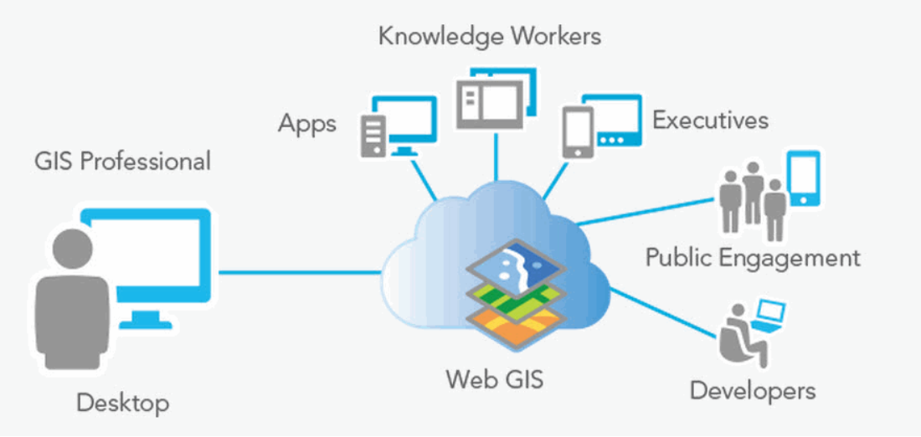
Web GIS architecture: visual application
WEEK 8
The client, service, and data layers work together over the network
MIS 369
Dr. Murat BAŞEĞMEZ
Notes:
Instructor note: Have students identify the data layers, analysis inputs, and potential outputs shown in the visual.
Source: https://doc.arcgis.com/en/arcgis-online/get-started/what-is-agol.htm; user-provided GIS Instructor notes

Slide 10
CHAPTER 2
Web map and layer
Symbol, pop-up, and visibility settings are stored within the web map
Notes:
Instructor note: Symbol, pop-up, and visibility settings are stored within the web map
Source: Lesson plan

Slide 11
Web map and layer
WEEK 8
01
02
03
Feature layer
Tile layer
Image layer
Sorgulanabilir nesneler
Fast rendering
Raster and imagery
MIS 369
Dr. Murat BAŞEĞMEZ
Notes:
Instructor note: Explain the concepts using examples.
Source: https://doc.arcgis.com/en/arcgis-online/get-started/what-is-agol.htm; GIS Instructor notes provided by the user

Slide 12
Web map and layer: concepts and application
WEEK 8
Kavramsal anlam
ArcGIS Pro equivalent
Feature layer: Sorgulanabilir nesneler
Map Viewer, Layers, and Properties
Tile layer: Fast rendering
The output is examined together in the map and table.
Image layer: Raster and imagery
Parameters and environment settings are saved.
MIS 369
Dr. Murat BAŞEĞMEZ
Notes:
Instructor note: Relate the concept to the software tool; do not use the tool name in place of the concept.
Source: https://doc.arcgis.com/en/arcgis-online/get-started/what-is-agol.htm; user-provided GIS Instructor notes

Slide 13
Web map and layer workflow
WEEK 8
01
02
03
04
05
Question
Data
Process
Kontrol
Yorum
Symbol, pop-up, and visibility settings are stored within the web map
Feature layer and Tile layer
Map Viewer, Layers, and Properties
Parameters and output quality
Decision context and constraints
MIS 369
Dr. Murat BAŞEĞMEZ
Notes:
Instructor note: Ask students to adapt the workflow to their own project questions.
Source: https://doc.arcgis.com/en/arcgis-online/get-started/what-is-agol.htm; user-provided GIS Instructor notes

Slide 14
Critical checks for web maps and layers
WEEK 8
1
2
3
!
Data
Scale
Method
Risk
Does the input data meet the feature layer requirements?
Are the unit of analysis and resolution appropriate for the question?
Have the Map Viewer, Layers, and Properties parameters been justified?
A shared view does not modify the source data
MIS 369
Dr. Murat BAŞEĞMEZ
Notes:
Instructor note: Use these checks as a brief checklist prior to implementation.
Source: https://doc.arcgis.com/en/arcgis-online/get-started/what-is-agol.htm; user-provided GIS Instructor notes

Slide 15
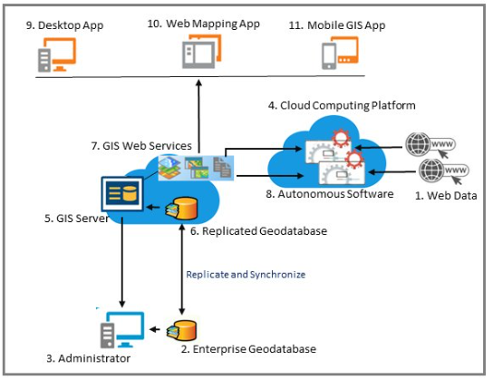
Web map and layer: visual application
WEEK 8
Symbol, pop-up, and visibility settings are stored within the web map
MIS 369
Dr. Murat BAŞEĞMEZ
Notes:
Instructor note: Have students identify the data layers, analysis inputs, and potential outputs shown in the visual.
Source: https://doc.arcgis.com/en/arcgis-online/get-started/what-is-agol.htm; user-provided GIS Instructor notes

Slide 16
SECTION 3
Sharing and security
Content owner manages access levels and user permissions
Notes:
Instructor note: Content owner manages access levels and user permissions
Source: Lesson plan

Slide 17
Sharing and security
WEEK 8
01
02
03
Private
Group
Public
Owner only
Specific workgroup
Public
MIS 369
Dr. Murat BAŞEĞMEZ
Notes:
Instructor note: Explain the concepts using examples.
Source: https://doc.arcgis.com/en/arcgis-online/get-started/what-is-agol.htm; GIS Instructor notes provided by the user

Slide 18
Sharing and security: concepts and application
WEEK 8
Kavramsal anlam
ArcGIS Pro equivalent
Private: Owner only
Share, Groups, and hosted feature layer views
Group: Specific workgroup
The output is examined together in the map and table.
Public: Public
Parameters and environment settings are saved.
MIS 369
Dr. Murat BAŞEĞMEZ
Notes:
Instructor note: Relate the concept to the software tool; do not use the tool name in place of the concept.
Source: https://doc.arcgis.com/en/arcgis-online/get-started/what-is-agol.htm; user-provided GIS Instructor notes

Slide 19
Sharing and security workflow
WEEK 8
01
02
03
04
05
Question
Data
Process
Kontrol
Yorum
Content owner manages access levels and user permissions
Private and Group
Share, Groups, and hosted feature layer views
Parameters and output quality
Decision context and constraints
MIS 369
Dr. Murat BAŞEĞMEZ
Notes:
Instructor note: Ask students to adapt the workflow to their own project questions.
Source: https://doc.arcgis.com/en/arcgis-online/get-started/what-is-agol.htm; user-provided GIS Instructor notes

Slide 20
Critical controls for sharing and security
WEEK 8
1
2
3
!
Data
Scale
Method
Risk
Does the input data meet the private requirement?
Are the unit of analysis and resolution appropriate for the question?
Have the Share, Groups, and hosted feature layer views parameters been justified?
Sensitive attributes should not be published in the public-facing layer
MIS 369
Dr. Murat BAŞEĞMEZ
Notes:
Instructor note: Use these checks as a brief checklist prior to implementation.
Source: https://doc.arcgis.com/en/arcgis-online/get-started/what-is-agol.htm; user-provided GIS Instructor notes

Slide 21
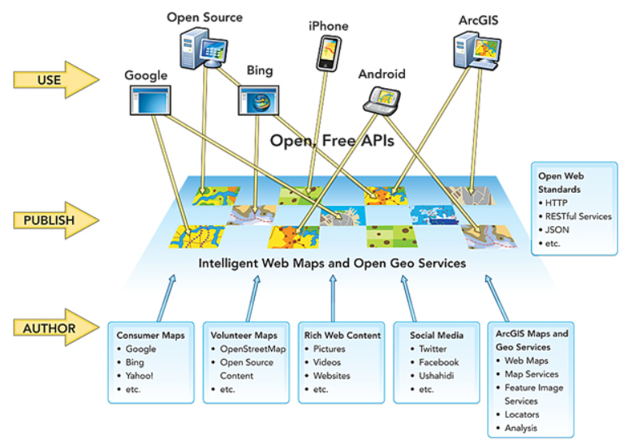
Sharing and security: visual application
WEEK 8
Content owner manages access levels and user permissions
MIS 369
Dr. Murat BAŞEĞMEZ
Notes:
Instructor note: Have students identify the data layers, analysis inputs, and potential outputs shown in the visual.
Source: https://doc.arcgis.com/en/arcgis-online/get-started/what-is-agol.htm; user-provided GIS Instructor notes

Slide 22
CHAPTER 4
Web applications
The map is transformed into an application for different user tasks
Notes:
Explanatory note: The map is transformed into an application for different user tasks
Source: Lesson plan

Slide 23
Web applications
WEEK 8
01
02
03
Dashboard
StoryMaps
Experience
Operational indicators
Narrative and context
Custom interface
MIS 369
Dr. Murat BAŞEĞMEZ
Notes:
Instructor note: Explain the concepts using examples.
Source: https://doc.arcgis.com/en/arcgis-online/get-started/what-is-agol.htm; GIS Instructor notes provided by the user

Slide 24
Web applications: concept and implementation
WEEK 8
Kavramsal anlam
ArcGIS Pro equivalent
Dashboard: Operational indicators
Dashboards, StoryMaps, and Experience Builder
StoryMaps: Narrative and context
The output is examined together in the map and table.
Experience: Custom interface
Parameters and environment settings are saved.
MIS 369
Dr. Murat BAŞEĞMEZ
Notes:
Instructor note: Relate the concept to the software tool; do not use the tool name in place of the concept.
Source: https://doc.arcgis.com/en/arcgis-online/get-started/what-is-agol.htm; user-provided GIS Instructor notes

Slide 25
Web applications workflow
WEEK 8
01
02
03
04
05
Question
Data
Process
Kontrol
Yorum
The map is transformed into an application for different user tasks
Dashboards and StoryMaps
Dashboards, StoryMaps, and Experience Builder
Parameters and output quality
Decision context and constraints
MIS 369
Dr. Murat BAŞEĞMEZ
Notes:
Instructor note: Ask students to adapt the workflow to their own project questions.
Source: https://doc.arcgis.com/en/arcgis-online/get-started/what-is-agol.htm; user-provided GIS Instructor notes

Slide 26
Critical checks for web applications
WEEK 8
1
2
3
!
Data
Scale
Method
Risk
Does the input data meet the dashboard requirements?
Are the unit of analysis and resolution appropriate for the question?
Have the parameters for Dashboards, StoryMaps, and Experience Builder been justified?
The decision message may weaken as the number of indicators increases
MIS 369
Dr. Murat BAŞEĞMEZ
Notes:
Instructor note: Use these checks as a brief checklist prior to implementation.
Source: https://doc.arcgis.com/en/arcgis-online/get-started/what-is-agol.htm; user-provided GIS Instructor notes

Slide 27
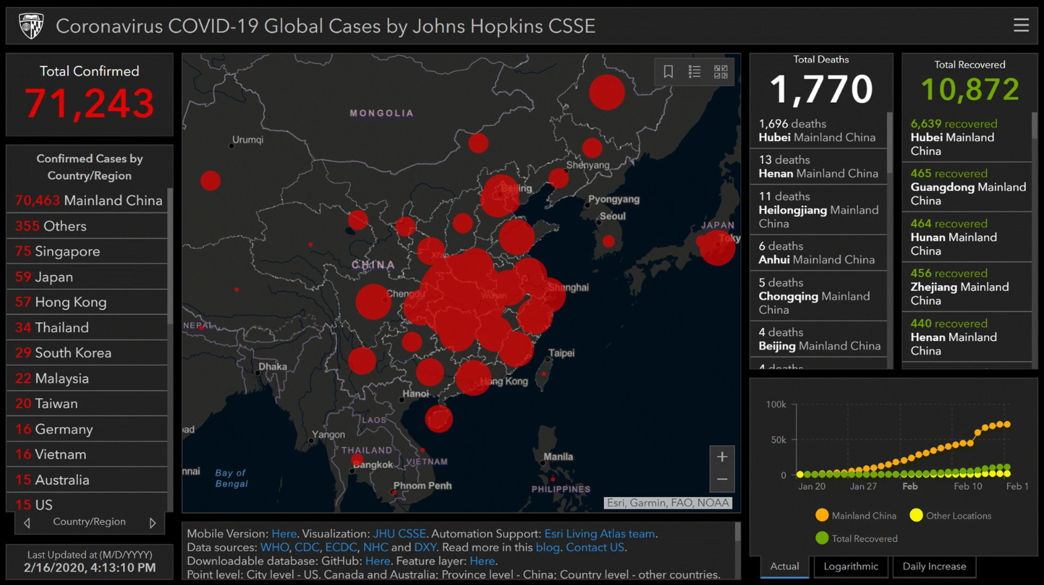
Web applications: visual implementation
WEEK 8
The map is transformed into an application for different user tasks
MIS 369
Dr. Murat BAŞEĞMEZ
Notes:
Instructor note: Have students identify the data layers, analysis inputs, and potential outputs shown in the visual.
Source: https://doc.arcgis.com/en/arcgis-online/get-started/what-is-agol.htm; user-provided GIS Instructor notes

Slide 28
CHAPTER 5
Midterm review framework
Concepts from the first seven weeks are integrated into the data, analysis, and presentation chain
Notes:
Instructor note: Concepts from the first seven weeks are integrated into the data, analysis, and presentation chain
Source: Lesson plan

Slide 29
Midterm review framework
WEEK 8
01
02
03
Data
Analysis
Sunum
Model and coordinate
Tool appropriate for the question
Correct symbol and source
MIS 369
Dr. Murat BAŞEĞMEZ
Notes:
Instructor note: Explain the concepts using examples.
Source: https://doc.arcgis.com/en/arcgis-online/get-started/what-is-agol.htm; GIS Instructor notes provided by the user

Slide 30
Midterm review framework: concept and application
WEEK 8
Kavramsal anlam
ArcGIS Pro equivalent
Data: Model and coordinate
Geoprocessing History and project review
Analysis: Tool appropriate for the question
The output is examined together in the map and table.
Presentation: Correct symbol and source
Parameters and environment settings are saved.
MIS 369
Dr. Murat BAŞEĞMEZ
Notes:
Instructor note: Relate the concept to the software tool; do not use the tool name in place of the concept.
Source: https://doc.arcgis.com/en/arcgis-online/get-started/what-is-agol.htm; user-provided GIS Instructor notes

Slide 31
Midterm review framework workflow
WEEK 8
01
02
03
04
05
Question
Data
Process
Kontrol
Yorum
Concepts from the first seven weeks are integrated into the data, analysis, and presentation chain
Data and Analysis
Geoprocessing History and project review
Parameters and output quality
Decision context and constraints
MIS 369
Dr. Murat BAŞEĞMEZ
Notes:
Instructor note: Ask students to adapt the workflow to their own project questions.
Source: https://doc.arcgis.com/en/arcgis-online/get-started/what-is-agol.htm; user-provided GIS Instructor notes

Slide 32
Critical checks for the midterm review framework
WEEK 8
1
2
3
!
Data
Scale
Method
Risk
Does the input data meet the data requirements?
Are the unit of analysis and resolution appropriate for the question?
Have the parameters for Geoprocessing History and project review been justified?
Memorizing the tool does not prevent conceptual errors
MIS 369
Dr. Murat BAŞEĞMEZ
Notes:
Instructor note: Use these checks as a brief checklist prior to implementation.
Source: https://doc.arcgis.com/en/arcgis-online/get-started/what-is-agol.htm; user-provided GIS Instructor notes

Slide 33
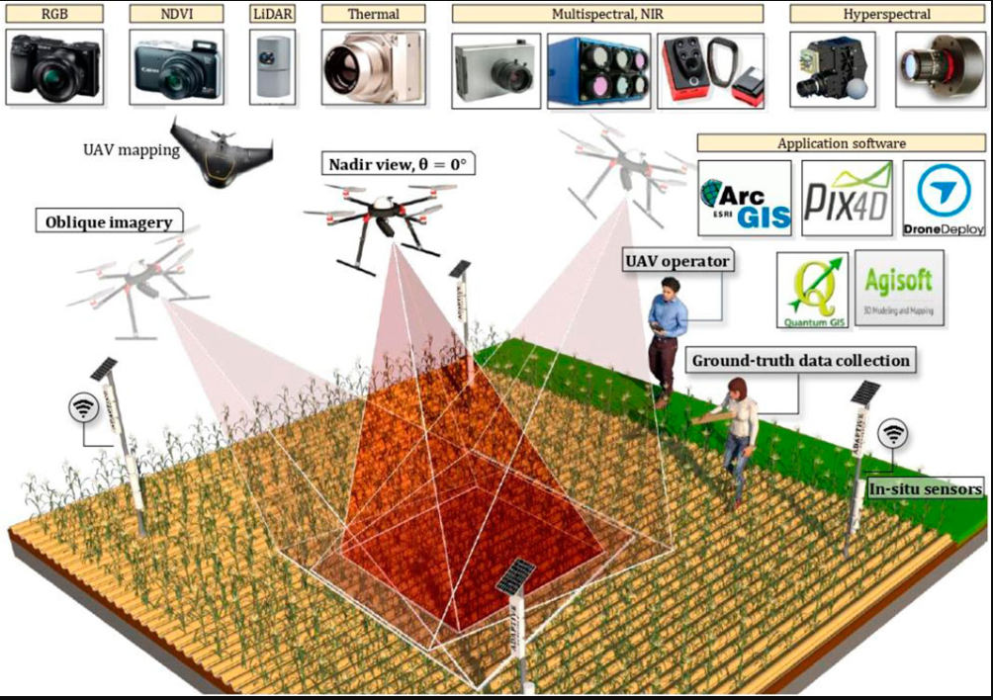
Midterm review framework: visual exercise
WEEK 8
Concepts from the first seven weeks are integrated into the data, analysis, and presentation chain
MIS 369
Dr. Murat BAŞEĞMEZ
Notes:
Instructor note: Have students identify the data layers, analysis inputs, and potential outputs shown in the visual.
Source: https://doc.arcgis.com/en/arcgis-online/get-started/what-is-agol.htm; user-provided GIS Instructor notes

Slide 34
LAB
Guided exercise
Creating a web map, sharing layers, and designing a simple dashboard on ArcGIS Online
Notes:
Instructor note: Creating a web map, sharing layers, and designing a simple dashboard on ArcGIS Online
Source: Lesson plan

Slide 35
Laboratory procedure plan
WEEK 8
Prepare the working folder and the geodatabase.
Creating a web map, sharing layers, and designing a simple dashboard on ArcGIS Online
Check intermediate results using the map and table.
Record the processing history and parameters.
Add a note regarding the methodology and limitations to the final map.
MIS 369
Dr. Murat BAŞEĞMEZ
Notes:
Instructor note: Break the exercise down into small steps and check students' screens at each step.
Source: https://doc.arcgis.com/en/arcgis-online/get-started/what-is-agol.htm; user-provided GIS Instructor notes

Slide 36
Lab submission package
WEEK 8
01
02
03
Map
Evidence
Yorum
Title, legend, scale, and source
Tool parameters or notebook output
150–200-word summary of findings and limitations
MIS 369
Dr. Murat BAŞEĞMEZ
Notes:
Instructor note: Explain the concepts using examples.
Source: https://doc.arcgis.com/en/arcgis-online/get-started/what-is-agol.htm; GIS Instructor notes provided by the user

Slide 37
Implementation checklist
WEEK 8
01
02
03
Input
Process
Output
Correct layer, area, and coordinate system
Parameters and environment settings saved
Map, table, and interpretation are consistent with each other
MIS 369
Dr. Murat BAŞEĞMEZ
Notes:
Instructor note: Explain the concepts using examples.
Source: https://doc.arcgis.com/en/arcgis-online/get-started/what-is-agol.htm; GIS Instructor notes provided by the user

Slide 38
Connection to the term project
WEEK 8
Which of this week's concepts is essential for your project problem?
Which data or method could most significantly influence your decision?
Add a quality control item related to this week to your project log.
MIS 369
Dr. Murat BAŞEĞMEZ
Notes:
Instructor note: Ask students to make a brief addition to their project log.
Source: https://doc.arcgis.com/en/arcgis-online/get-started/what-is-agol.htm; user-provided GIS Instructor notes

Slide 39
End-of-lesson check 1
WEEK 8
What is the most important initial decision regarding Web GIS architecture?
A
Simply choosing a color
B
Defining the problem and data requirements
C
Using the most complex tool
D
Sharing the output without checking it
MIS 369
Dr. Murat BAŞEĞMEZ
Notes:
Instructor note: The correct answer is option B.
Source: https://doc.arcgis.com/en/arcgis-online/get-started/what-is-agol.htm; user-provided GIS Instructor notes

Slide 40
End-of-lesson check 2
WEEK 8
Which of the following most strengthens quality in sharing and security operations?
A
Saving parameters and validating the result
B
Not changing layer names
C
Using only a single criterion
D
Making the map as colorful as possible
MIS 369
Dr. Murat BAŞEĞMEZ
Notes:
Instructor note: The correct answer is option A.
Source: https://doc.arcgis.com/en/arcgis-online/get-started/what-is-agol.htm; user-provided GIS Instructor notes

Slide 41
End-of-lesson check 3
WEEK 8
Why is the mere execution of an ArcGIS Pro tool not proof of a correct result?
A
Because tools work only with raster data
B
Because the output file can be very large
C
Because data, scale, parameters, and validation affect the result
D
Because the map lacks a north arrow
MIS 369
Dr. Murat BAŞEĞMEZ
Notes:
Instructor note: The correct answer is option C.
Source: https://doc.arcgis.com/en/arcgis-online/get-started/what-is-agol.htm; user-provided GIS Instructor notes

Slide 42
WEEK 8 SUMMARY
Web GIS, Cloud, and Midterm Review
Web GIS architecture
Web map and layer
Sharing and security
Web applications
Midterm review framework
Preparation for next week: review the concepts in your exercise file
Notes:
Instructor note: Ask students to review the week's five key concepts using examples.
Source: https://doc.arcgis.com/en/arcgis-online/get-started/what-is-agol.htm; user-provided GIS Instructor notes

Slide 43
Resources and further reading
WEEK 8
https://doc.arcgis.com/en/arcgis-online/get-started/what-is-agol.htm
ArcGIS Pro 3.5 Documentation
User-provided GIS Instructor notes
In-class exercise data and instructor notes
MIS 369
Dr. Murat BAŞEĞMEZ
Notes:
Instructor note: Share the resources with students after the lesson.
Source: https://doc.arcgis.com/en/arcgis-online/get-started/what-is-agol.htm; user-provided GIS Instructor notes

