Slide 1
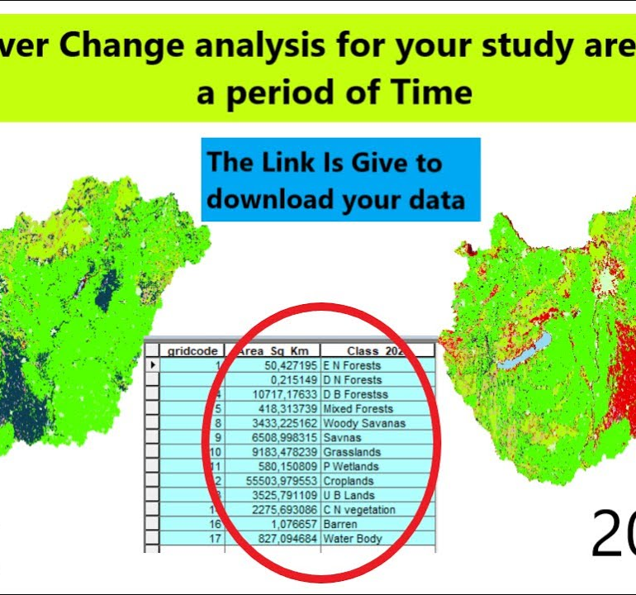
AI-ENHANCED
GEOGRAPHIC INFORMATION SYSTEMS
WEEK 7
Raster Analysis, Remote Sensing, and Terrain
MIS 369 · Ankara Science University
Dr. Murat BAŞEĞMEZ
Notes:
Instructor note: Introduce the week's topic by connecting it to the previous lesson.
Source: https://pro.arcgis.com/en/pro-app/3.5/help/analysis/spatial-analyst/performing-analysis/performing-raster-analysis.htm; user-provided GIS Instructor notes

Slide 2
This week's learning outcomes
WEEK 7
01
02
03
Concept
Application
Critique
Uses key terms correctly
Executes the ArcGIS Pro workflow
Explains data and method limitations
MIS 369
Dr. Murat BAŞEĞMEZ
Notes:
Instructor note: Explain the concepts using examples.
Source: https://pro.arcgis.com/en/pro-app/3.5/help/analysis/spatial-analyst/performing-analysis/performing-raster-analysis.htm; GIS Instructor notes provided by the user

Slide 3
Three-hour lesson flow
WEEK 7
Part one: conceptual foundation and visual examples
Part two: step-by-step demonstration in ArcGIS Pro
Part three: guided lab and assessment
MIS 369
Dr. Murat BAŞEĞMEZ
Notes:
Instructor note: Explain the small output to be submitted at the end of the lesson at the beginning.
Source: https://pro.arcgis.com/en/pro-app/3.5/help/analysis/spatial-analyst/performing-analysis/performing-raster-analysis.htm; user-provided GIS Instructor notes

Slide 4
SECTION 1
Raster resolution
Cell size affects detail, file size, and processing time
Notes:
Instructor note: Cell size affects detail, file size, and processing time
Source: Lesson plan

Slide 5
Raster resolution
WEEK 7
01
02
03
Spatial
Spectral
Temporal
Cell size
Number of bands
Observation frequency
MIS 369
Dr. Murat BAŞEĞMEZ
Notes:
Instructor note: Explain the concepts using examples.
Source: https://pro.arcgis.com/en/pro-app/3.5/help/analysis/spatial-analyst/performing-analysis/performing-raster-analysis.htm; GIS Instructor notes provided by the user

Slide 6
Raster resolution: concept and application
WEEK 7
Kavramsal anlam
ArcGIS Pro equivalent
Spatial: Cell size
Raster Properties and Cell Size
Spectral: Number of bands
The output is examined together in the map and table.
Temporal: Observation frequency
Parameters and environment settings are saved.
MIS 369
Dr. Murat BAŞEĞMEZ
Notes:
Instructor note: Relate the concept to the software tool; do not use the tool name in place of the concept.
Source: https://pro.arcgis.com/en/pro-app/3.5/help/analysis/spatial-analyst/performing-analysis/performing-raster-analysis.htm; user-provided GIS Instructor notes

Slide 7
Raster resolution workflow
WEEK 7
01
02
03
04
05
Question
Data
Process
Kontrol
Yorum
Cell size affects detail, file size, and processing time
Spatial and Spectral
Raster Properties and Cell Size
Parameters and output quality
Decision context and constraints
MIS 369
Dr. Murat BAŞEĞMEZ
Notes:
Instructor note: Ask students to adapt the workflow to their own project questions.
Source: https://pro.arcgis.com/en/pro-app/3.5/help/analysis/spatial-analyst/performing-analysis/performing-raster-analysis.htm; user-provided GIS Instructor notes

Slide 8
Critical checks for raster resolution
WEEK 7
1
2
3
!
Data
Scale
Method
Risk
Does the input data meet spatial requirements?
Are the unit of analysis and resolution appropriate for the question?
Have the Raster Properties and Cell Size parameters been justified?
Different resolutions can represent the same phenomenon differently
MIS 369
Dr. Murat BAŞEĞMEZ
Notes:
Instructor note: Use these checks as a quick checklist before implementation.
Source: https://pro.arcgis.com/en/pro-app/3.5/help/analysis/spatial-analyst/performing-analysis/performing-raster-analysis.htm; user-provided GIS Instructor notes

Slide 9

Raster resolution: visual exercise
WEEK 7
Cell size affects detail, file size, and processing time
MIS 369
Dr. Murat BAŞEĞMEZ
Notes:
Instructor note: Have students identify the data layers, analysis inputs, and potential outputs shown in the image.
Source: https://pro.arcgis.com/en/pro-app/3.5/help/analysis/spatial-analyst/performing-analysis/performing-raster-analysis.htm; User-provided GIS Instructor notes

Slide 10
CHAPTER 2
Satellite imagery and bands
The electromagnetic spectrum distinguishes between different surface features
Notes:
Instructor note: The electromagnetic spectrum distinguishes between different surface features
Source: Lesson plan

Slide 11
Satellite imagery and bands
WEEK 7
01
02
03
Visible
NIR
SWIR
Visible to the human eye
Vegetation and moisture information
Moisture and burned area sensitivity
MIS 369
Dr. Murat BAŞEĞMEZ
Notes:
Instructor note: Explain the concepts using examples.
Source: https://pro.arcgis.com/en/pro-app/3.5/help/analysis/spatial-analyst/performing-analysis/performing-raster-analysis.htm; GIS Instructor notes provided by the user

Slide 12
Satellite imagery and bands: concepts and application
WEEK 7
Kavramsal anlam
ArcGIS Pro equivalent
Visible: Visible to the human eye
Composite bands and band combinations
NIR: Vegetation and moisture information
The output is examined together in the map and table.
SWIR: Moisture and burned area sensitivity
Parameters and environment settings are saved.
MIS 369
Dr. Murat BAŞEĞMEZ
Notes:
Instructor note: Relate the concept to the software tool; do not use the tool name in place of the concept.
Source: https://pro.arcgis.com/en/pro-app/3.5/help/analysis/spatial-analyst/performing-analysis/performing-raster-analysis.htm; user-provided GIS Instructor notes

Slide 13
Satellite imagery and bands workflow
WEEK 7
01
02
03
04
05
Question
Data
Process
Kontrol
Yorum
The electromagnetic spectrum distinguishes between different surface features
Visible and NIR
Composite bands and band combinations
Parameters and output quality
Decision context and constraints
MIS 369
Dr. Murat BAŞEĞMEZ
Notes:
Instructor note: Ask students to adapt the workflow to their own project questions.
Source: https://pro.arcgis.com/en/pro-app/3.5/help/analysis/spatial-analyst/performing-analysis/performing-raster-analysis.htm; user-provided GIS Instructor notes

Slide 14
Critical checks for satellite imagery and bands
WEEK 7
1
2
3
!
Data
Scale
Method
Risk
Does the input data meet the visible band requirement?
Are the unit of analysis and resolution appropriate for the question?
Have the composite band and band combination parameters been justified?
Sensor bands may not share the same wavelength and resolution
MIS 369
Dr. Murat BAŞEĞMEZ
Notes:
Instructor note: Use these checks as a quick checklist before implementation.
Source: https://pro.arcgis.com/en/pro-app/3.5/help/analysis/spatial-analyst/performing-analysis/performing-raster-analysis.htm; user-provided GIS Instructor notes

Slide 15

Satellite imagery and bands: visual application
WEEK 7
The electromagnetic spectrum distinguishes between different surface features
MIS 369
Dr. Murat BAŞEĞMEZ
Notes:
Instructor note: Have students identify the data layers, analysis inputs, and potential outputs shown in the image.
Source: https://pro.arcgis.com/en/pro-app/3.5/help/analysis/spatial-analyst/performing-analysis/performing-raster-analysis.htm; User-provided GIS Instructor notes

Slide 16
SECTION 3
Spectral indices
Band ratios enhance specific surface features
Notes:
Instructor note: Band ratios enhance specific surface features
Source: Lesson plan

Slide 17
Spectral indices
WEEK 7
01
02
03
NDVI
NDWI
NBR
Vegetation vigor
Water and moisture
Burned area
MIS 369
Dr. Murat BAŞEĞMEZ
Notes:
Instructor note: Explain the concepts using examples.
Source: https://pro.arcgis.com/en/pro-app/3.5/help/analysis/spatial-analyst/performing-analysis/performing-raster-analysis.htm; GIS Instructor notes provided by the user

Slide 18
Spectral indices: concept and application
WEEK 7
Kavramsal anlam
ArcGIS Pro equivalent
NDVI: Vegetation vigor
Raster Functions and Band Arithmetic
NDWI: Water and moisture
The output is examined together in the map and table.
NBR: Burned area
Parameters and environment settings are saved.
MIS 369
Dr. Murat BAŞEĞMEZ
Notes:
Instructor note: Relate the concept to the software tool; do not use the tool name in place of the concept.
Source: https://pro.arcgis.com/en/pro-app/3.5/help/analysis/spatial-analyst/performing-analysis/performing-raster-analysis.htm; user-provided GIS Instructor notes

Slide 19
Spectral indices workflow
WEEK 7
01
02
03
04
05
Question
Data
Process
Kontrol
Yorum
Band ratios enhance specific surface features
NDVI and NDWI
Raster Functions and Band Arithmetic
Parameters and output quality
Decision context and constraints
MIS 369
Dr. Murat BAŞEĞMEZ
Notes:
Instructor note: Ask students to adapt the workflow to their own project questions.
Source: https://pro.arcgis.com/en/pro-app/3.5/help/analysis/spatial-analyst/performing-analysis/performing-raster-analysis.htm; user-provided GIS Instructor notes

Slide 20
Critical checks for spectral indices
WEEK 7
1
2
3
!
Data
Scale
Method
Risk
Does the input data meet NDVI requirements?
Are the unit of analysis and resolution appropriate for the question?
Are the Raster Functions and Band Arithmetic parameters justified?
Index thresholds vary by season and sensor
MIS 369
Dr. Murat BAŞEĞMEZ
Notes:
Instructor note: Use these checks as a quick checklist before implementation.
Source: https://pro.arcgis.com/en/pro-app/3.5/help/analysis/spatial-analyst/performing-analysis/performing-raster-analysis.htm; user-provided GIS Instructor notes

Slide 21
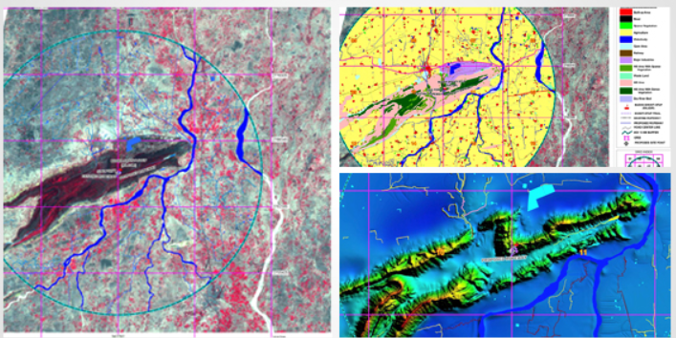
Spectral indices: visual application
WEEK 7
Band ratios enhance specific surface features
MIS 369
Dr. Murat BAŞEĞMEZ
Notes:
Instructor note: Have students identify the data layers, analysis inputs, and potential outputs shown in the image.
Source: https://pro.arcgis.com/en/pro-app/3.5/help/analysis/spatial-analyst/performing-analysis/performing-raster-analysis.htm; User-provided GIS Instructor notes

Slide 22
CHAPTER 4
DEM and terrain derivatives
The elevation surface serves as input for slope, aspect, and flow analyses
Notes:
Explanatory note: The elevation surface serves as input for slope, aspect, and flow analyses
Source: Lesson plan

Slide 23
DEM and terrain derivatives
WEEK 7
01
02
03
Slope
Aspect
Hillshade
Rate of elevation change
Slope aspect
Hillshade
MIS 369
Dr. Murat BAŞEĞMEZ
Notes:
Instructor note: Explain the concepts using examples.
Source: https://pro.arcgis.com/en/pro-app/3.5/help/analysis/spatial-analyst/performing-analysis/performing-raster-analysis.htm; GIS Instructor notes provided by the user

Slide 24
DEM and terrain derivatives: concepts and application
WEEK 7
Kavramsal anlam
ArcGIS Pro equivalent
Slope: Rate of elevation change
Slope, Aspect, and Hillshade
Aspect: Slope orientation
The output is examined together in the map and table.
Hillshade: Shaded relief
Parameters and environment settings are saved.
MIS 369
Dr. Murat BAŞEĞMEZ
Notes:
Instructor note: Relate the concept to the software tool; do not use the tool name in place of the concept.
Source: https://pro.arcgis.com/en/pro-app/3.5/help/analysis/spatial-analyst/performing-analysis/performing-raster-analysis.htm; user-provided GIS Instructor notes

Slide 25
DEM and terrain derivatives workflow
WEEK 7
01
02
03
04
05
Question
Data
Process
Kontrol
Yorum
The elevation surface serves as input for slope, aspect, and flow analyses
Slope and Aspect
Slope, Aspect, and Hillshade
Parameters and output quality
Decision context and constraints
MIS 369
Dr. Murat BAŞEĞMEZ
Notes:
Instructor note: Ask students to adapt the workflow to their own project questions.
Source: https://pro.arcgis.com/en/pro-app/3.5/help/analysis/spatial-analyst/performing-analysis/performing-raster-analysis.htm; user-provided GIS Instructor notes

Slide 26
Critical checks for DEM and terrain derivatives
WEEK 7
1
2
3
!
Data
Scale
Method
Risk
Does the input data meet slope requirements?
Are the unit of analysis and resolution appropriate for the question?
Have Slope, Aspect, and Hillshade parameters been justified?
Calculating slope directly from a geographic-coordinate DEM can result in unit errors
MIS 369
Dr. Murat BAŞEĞMEZ
Notes:
Instructor note: Use these checks as a quick checklist before implementation.
Source: https://pro.arcgis.com/en/pro-app/3.5/help/analysis/spatial-analyst/performing-analysis/performing-raster-analysis.htm; user-provided GIS Instructor notes

Slide 27
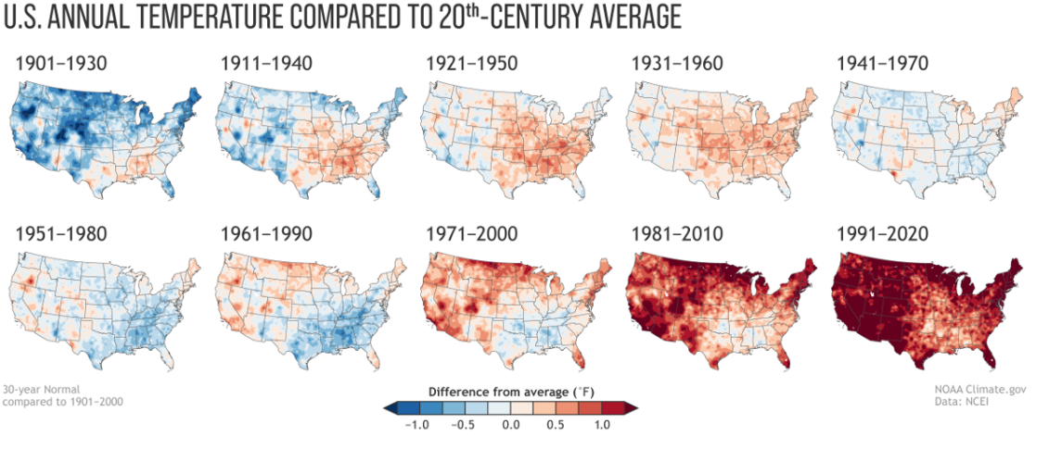
DEM and terrain derivatives: visual application
WEEK 7
The elevation surface serves as input for slope, aspect, and flow analyses
MIS 369
Dr. Murat BAŞEĞMEZ
Notes:
Instructor note: Have students identify the data layers, analysis inputs, and potential outputs shown in the image.
Source: https://pro.arcgis.com/en/pro-app/3.5/help/analysis/spatial-analyst/performing-analysis/performing-raster-analysis.htm; User-provided GIS Instructor notes

Slide 28
CHAPTER 5
Map algebra and suitability
Raster values ​​are normalized to a common scale and combined
Notes:
Note: Raster values ​​are normalized to a common scale and combined
Source: Lesson plan

Slide 29
Map algebra and suitability
WEEK 7
01
02
03
Reclassify
Distance
Weighted Sum
New class values
Proximity surface
Weighted combination
MIS 369
Dr. Murat BAŞEĞMEZ
Notes:
Instructor note: Explain the concepts using examples.
Source: https://pro.arcgis.com/en/pro-app/3.5/help/analysis/spatial-analyst/performing-analysis/performing-raster-analysis.htm; GIS Instructor notes provided by the user

Slide 30
Map algebra and suitability: concepts and application
WEEK 7
Kavramsal anlam
ArcGIS Pro equivalent
Reclassify: New class values
Raster Calculator, Reclassify, and Weighted Overlay
Distance: Proximity surface
The output is examined together in the map and table.
Weighted Sum: Weighted combination
Parameters and environment settings are saved.
MIS 369
Dr. Murat BAŞEĞMEZ
Notes:
Instructor note: Relate the concept to the software tool; do not use the tool name in place of the concept.
Source: https://pro.arcgis.com/en/pro-app/3.5/help/analysis/spatial-analyst/performing-analysis/performing-raster-analysis.htm; user-provided GIS Instructor notes

Slide 31
Map algebra and suitability workflow
WEEK 7
01
02
03
04
05
Question
Data
Process
Kontrol
Yorum
Raster values ​​are normalized to a common scale and combined
Reclassify and Distance
Raster Calculator, Reclassify, and Weighted Overlay
Parameters and output quality
Decision context and constraints
MIS 369
Dr. Murat BAŞEĞMEZ
Notes:
Instructor note: Ask students to adapt the workflow to their own project questions.
Source: https://pro.arcgis.com/en/pro-app/3.5/help/analysis/spatial-analyst/performing-analysis/performing-raster-analysis.htm; user-provided GIS Instructor notes

Slide 32
Critical checks for map algebra and suitability
WEEK 7
1
2
3
!
Data
Scale
Method
Risk
Does the input data meet the reclassification requirement?
Are the unit of analysis and resolution appropriate for the question?
Have the Raster Calculator, Reclassify, and Weighted Overlay parameters been justified?
Normalization and weight choices strongly influence the results
MIS 369
Dr. Murat BAŞEĞMEZ
Notes:
Instructor note: Use these checks as a quick checklist before implementation.
Source: https://pro.arcgis.com/en/pro-app/3.5/help/analysis/spatial-analyst/performing-analysis/performing-raster-analysis.htm; user-provided GIS Instructor notes

Slide 33
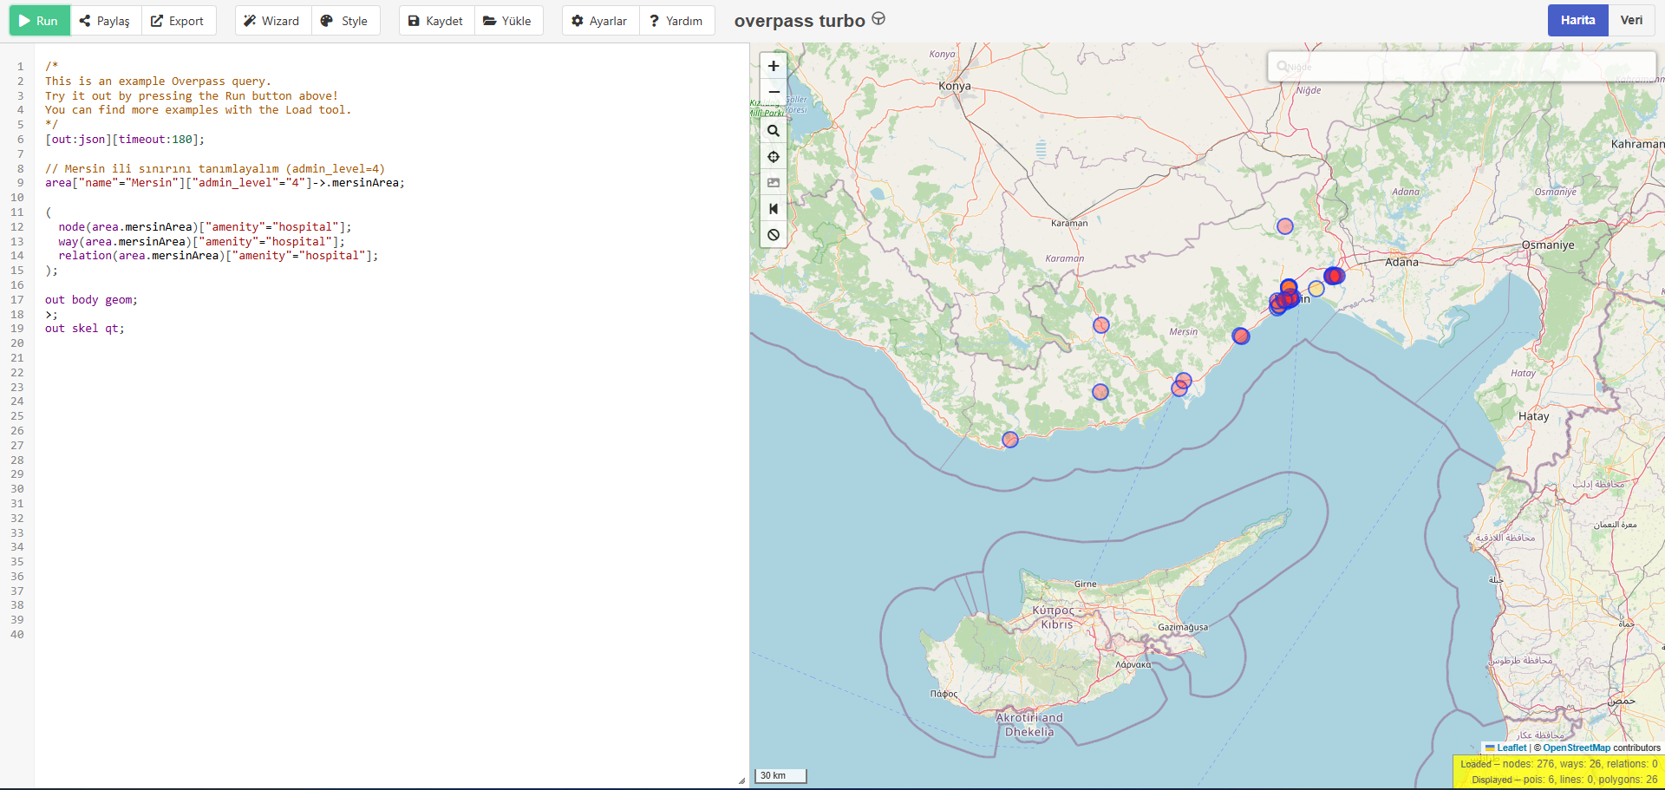
Map algebra and suitability: visual exercise
WEEK 7
Raster values ​​are normalized to a common scale and combined
MIS 369
Dr. Murat BAŞEĞMEZ
Notes:
Instructor note: Have students identify the data layers, analysis inputs, and potential outputs shown in the image.
Source: https://pro.arcgis.com/en/pro-app/3.5/help/analysis/spatial-analyst/performing-analysis/performing-raster-analysis.htm; User-provided GIS Instructor notes

Slide 34
LAB
Guided exercise
Generating slope and aspect from a DEM, reclassifying, and preparing a weighted suitability surface
Notes:
Instructor note: Generating slope and aspect from a DEM, reclassifying, and preparing a weighted suitability surface
Source: Lesson plan

Slide 35
Laboratory procedure plan
WEEK 7
Prepare the working folder and the geodatabase.
Generating slope and aspect from a DEM, reclassifying, and preparing a weighted suitability surface
Check intermediate results using the map and table.
Record the processing history and parameters.
Add a note regarding the methodology and limitations to the final map.
MIS 369
Dr. Murat BAŞEĞMEZ
Notes:
Instructor note: Break the exercise down into small steps and check students' screens at each step.
Source: https://pro.arcgis.com/en/pro-app/3.5/help/analysis/spatial-analyst/performing-analysis/performing-raster-analysis.htm; user-provided GIS Instructor notes

Slide 36
Lab submission package
WEEK 7
01
02
03
Map
Evidence
Yorum
Title, legend, scale, and source
Tool parameters or notebook output
150–200-word summary of findings and limitations
MIS 369
Dr. Murat BAŞEĞMEZ
Notes:
Instructor note: Explain the concepts using examples.
Source: https://pro.arcgis.com/en/pro-app/3.5/help/analysis/spatial-analyst/performing-analysis/performing-raster-analysis.htm; GIS Instructor notes provided by the user

Slide 37
Implementation checklist
WEEK 7
01
02
03
Input
Process
Output
Correct layer, area, and coordinate system
Parameters and environment settings saved
Map, table, and interpretation are consistent with each other
MIS 369
Dr. Murat BAŞEĞMEZ
Notes:
Instructor note: Explain the concepts using examples.
Source: https://pro.arcgis.com/en/pro-app/3.5/help/analysis/spatial-analyst/performing-analysis/performing-raster-analysis.htm; GIS Instructor notes provided by the user

Slide 38
Connection to the term project
WEEK 7
Which of this week's concepts is essential for your project problem?
Which data or method could most significantly influence your decision?
Add a quality control item related to this week to your project log.
MIS 369
Dr. Murat BAŞEĞMEZ
Notes:
Instructor note: Ask students to make a brief addition to their project log.
Source: https://pro.arcgis.com/en/pro-app/3.5/help/analysis/spatial-analyst/performing-analysis/performing-raster-analysis.htm; user-provided GIS Instructor notes

Slide 39
End-of-lesson check 1
WEEK 7
What is the most important initial decision regarding raster resolution?
A
Simply choosing a color
B
Defining the problem and data requirements
C
Using the most complex tool
D
Sharing the output without checking it
MIS 369
Dr. Murat BAŞEĞMEZ
Notes:
Instructor note: The correct answer is option B.
Source: https://pro.arcgis.com/en/pro-app/3.5/help/analysis/spatial-analyst/performing-analysis/performing-raster-analysis.htm; user-provided GIS Instructor notes

Slide 40
End-of-lesson check 2
WEEK 7
Which of the following most enhances quality in a spectral indices study?
A
Saving parameters and validating the result
B
Not changing layer names
C
Using only a single criterion
D
Making the map as colorful as possible
MIS 369
Dr. Murat BAŞEĞMEZ
Notes:
Instructor note: The correct answer is option A.
Source: https://pro.arcgis.com/en/pro-app/3.5/help/analysis/spatial-analyst/performing-analysis/performing-raster-analysis.htm; GIS Instructor notes provided by the user

Slide 41
End-of-lesson check 3
WEEK 7
Why is the mere execution of an ArcGIS Pro tool not proof of a correct result?
A
Because tools work only with raster data
B
Because the output file can be very large
C
Because data, scale, parameters, and validation affect the result
D
Because the map lacks a north arrow
MIS 369
Dr. Murat BAŞEĞMEZ
Notes:
Instructor note: The correct answer is option C.
Source: https://pro.arcgis.com/en/pro-app/3.5/help/analysis/spatial-analyst/performing-analysis/performing-raster-analysis.htm; GIS Instructor notes provided by the user

Slide 42
WEEK 7 SUMMARY
Raster Analysis, Remote Sensing, and Terrain
Raster resolution
Satellite imagery and bands
Spectral indices
DEM and terrain derivatives
Map algebra and suitability
Preparation for next week: review the concepts in your exercise file
Notes:
Instructor note: Ask students to review the week's five main concepts using examples.
Source: https://pro.arcgis.com/en/pro-app/3.5/help/analysis/spatial-analyst/performing-analysis/performing-raster-analysis.htm; GIS Instructor notes provided by the user

Slide 43
Resources and further reading
WEEK 7
https://pro.arcgis.com/en/pro-app/3.5/help/analysis/spatial-analyst/performing-analysis/performing-raster-analysis.htm
ArcGIS Pro 3.5 Documentation
User-provided GIS Instructor notes
In-class exercise data and instructor notes
MIS 369
Dr. Murat BAŞEĞMEZ
Notes:
Instructor note: Share the resources with students after the lesson.
Source: https://pro.arcgis.com/en/pro-app/3.5/help/analysis/spatial-analyst/performing-analysis/performing-raster-analysis.htm; GIS Instructor notes provided by the user

