Slide 1

AI-ENHANCED
GEOGRAPHIC INFORMATION SYSTEMS
WEEK 6
Vector-Based Spatial Analysis
MIS 369 · Ankara Science University
Dr. Murat BAŞEĞMEZ
Notes:
Instructor note: Introduce the week's topic by connecting it to the previous lesson.
Source: https://pro.arcgis.com/en/pro-app/3.5/tool-reference/analysis/an-overview-of-the-analysis-toolbox.htm; user-provided GIS Instructor notes

Slide 2
This week's learning outcomes
WEEK 6
01
02
03
Concept
Application
Critique
Uses key terms correctly
Executes the ArcGIS Pro workflow
Explains data and method limitations
MIS 369
Dr. Murat BAŞEĞMEZ
Notes:
Instructor note: Explain the concepts using an example.
Source: https://pro.arcgis.com/en/pro-app/3.5/tool-reference/analysis/an-overview-of-the-analysis-toolbox.htm; user-provided GIS Instructor notes

Slide 3
Three-hour lesson flow
WEEK 6
Part one: conceptual foundation and visual examples
Part two: step-by-step demonstration in ArcGIS Pro
Part three: guided lab and assessment
MIS 369
Dr. Murat BAŞEĞMEZ
Notes:
Instructor note: Explain the small output to be submitted at the end of the lesson at the beginning.
Source: https://pro.arcgis.com/en/pro-app/3.5/tool-reference/analysis/an-overview-of-the-analysis-toolbox.htm; user-provided GIS Instructor notes

Slide 4
SECTION 1
Analysis question and unit
Tool selection is based on the research question and the unit of analysis
Notes:
Instructor note: Tool selection is based on the research question and the unit of analysis
Source: Lesson plan

Slide 5
Analysis question and unit
WEEK 6
01
02
03
Target
Unit
Criterion
Information to be generated
Point, parcel, or grid
Success indicator
MIS 369
Dr. Murat BAŞEĞMEZ
Notes:
Instructor note: Explain the concepts using an example.
Source: https://pro.arcgis.com/en/pro-app/3.5/tool-reference/analysis/an-overview-of-the-analysis-toolbox.htm; user-provided GIS Instructor notes

Slide 6
Analysis question and unit: concept and application
WEEK 6
Kavramsal anlam
ArcGIS Pro equivalent
Goal: Information to be generated
Analysis toolbox and Environments
Unit: Point, parcel, or grid
The output is examined together in the map and table.
Criterion: Success indicator
Parameters and environment settings are saved.
MIS 369
Dr. Murat BAŞEĞMEZ
Notes:
Instructor note: Relate the concept to the software tool; do not use the tool name in place of the concept.
Source: https://pro.arcgis.com/en/pro-app/3.5/tool-reference/analysis/an-overview-of-the-analysis-toolbox.htm; GIS Instructor notes provided by the user

Slide 7
Analysis question and unit workflow
WEEK 6
01
02
03
04
05
Question
Data
Process
Kontrol
Yorum
Tool selection is based on the research question and the unit of analysis
Objective and Unit
Analysis toolbox and Environments
Parameters and output quality
Decision context and constraints
MIS 369
Dr. Murat BAŞEĞMEZ
Notes:
Instructor note: Ask students to adapt the workflow to their own project questions.
Source: https://pro.arcgis.com/en/pro-app/3.5/tool-reference/analysis/an-overview-of-the-analysis-toolbox.htm; GIS Instructor notes provided by the user

Slide 8
Critical checks for the analysis question and unit
WEEK 6
1
2
3
!
Data
Scale
Method
Risk
Does the input data meet the objective requirements?
Are the unit of analysis and resolution appropriate for the question?
Have the Analysis toolbox and Environments parameters been justified?
Starting with the tool list produces results without a clear purpose
MIS 369
Dr. Murat BAŞEĞMEZ
Notes:
Instructor note: Use these checks as a brief checklist before implementation.
Source: https://pro.arcgis.com/en/pro-app/3.5/tool-reference/analysis/an-overview-of-the-analysis-toolbox.htm; GIS Instructor notes provided by the user

Slide 9
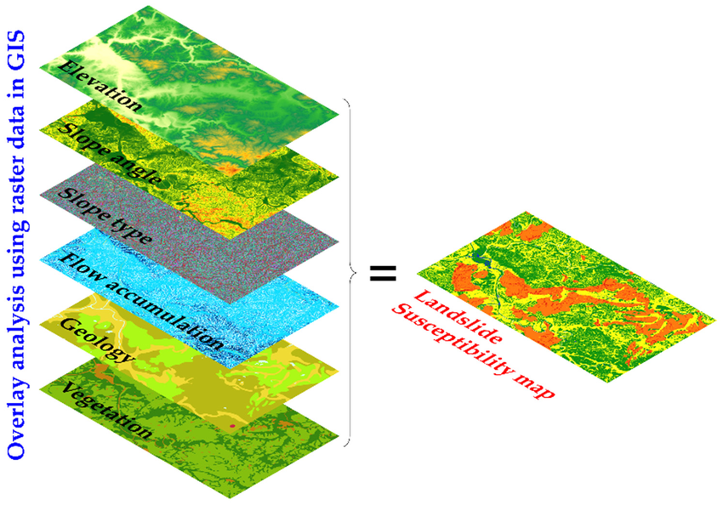
Analysis question and unit: visual application
WEEK 6
Tool selection is based on the research question and the unit of analysis
MIS 369
Dr. Murat BAŞEĞMEZ
Notes:
Instructor note: Have students identify the data layers, analysis inputs, and potential outputs shown in the visual.
Source: https://pro.arcgis.com/en/pro-app/3.5/tool-reference/analysis/an-overview-of-the-analysis-toolbox.htm; User-provided GIS Instructor notes

Slide 10
CHAPTER 2
Selection and query
Subsets are created using attribute and location conditions
Notes:
Explanatory note: Subsets are created using attribute and location conditions
Source: Lesson plan

Slide 11
Selection and query
WEEK 6
01
02
03
Attribute
Location
Expression
Based on field value
Based on spatial relationship
Logical condition
MIS 369
Dr. Murat BAŞEĞMEZ
Notes:
Instructor note: Explain the concepts using an example.
Source: https://pro.arcgis.com/en/pro-app/3.5/tool-reference/analysis/an-overview-of-the-analysis-toolbox.htm; user-provided GIS Instructor notes

Slide 12
Selection and query: concepts and application
WEEK 6
Kavramsal anlam
ArcGIS Pro equivalent
Attribute: Based on field value
Select By Attributes and Select By Location
Location: Based on spatial relationship
The output is examined together in the map and table.
Expression: Logical condition
Parameters and environment settings are saved.
MIS 369
Dr. Murat BAŞEĞMEZ
Notes:
Instructor note: Relate the concept to the software tool; do not use the tool name in place of the concept.
Source: https://pro.arcgis.com/en/pro-app/3.5/tool-reference/analysis/an-overview-of-the-analysis-toolbox.htm; GIS Instructor notes provided by the user

Slide 13
Selection and query workflow
WEEK 6
01
02
03
04
05
Question
Data
Process
Kontrol
Yorum
Subsets are created using attribute and location conditions
Attribute and Location
Select By Attributes and Select By Location
Parameters and output quality
Decision context and constraints
MIS 369
Dr. Murat BAŞEĞMEZ
Notes:
Instructor note: Ask students to adapt the workflow to their own project questions.
Source: https://pro.arcgis.com/en/pro-app/3.5/tool-reference/analysis/an-overview-of-the-analysis-toolbox.htm; GIS Instructor notes provided by the user

Slide 14
Critical checks for selection and query
WEEK 6
1
2
3
!
Data
Scale
Method
Risk
Does the input data meet the attribute requirement?
Are the unit of analysis and resolution appropriate for the question?
Have the Select By Attributes and Select By Location parameters been justified?
Selected records may inadvertently limit subsequent analysis
MIS 369
Dr. Murat BAŞEĞMEZ
Notes:
Instructor note: Use these checks as a brief checklist before implementation.
Source: https://pro.arcgis.com/en/pro-app/3.5/tool-reference/analysis/an-overview-of-the-analysis-toolbox.htm; GIS Instructor notes provided by the user

Slide 15
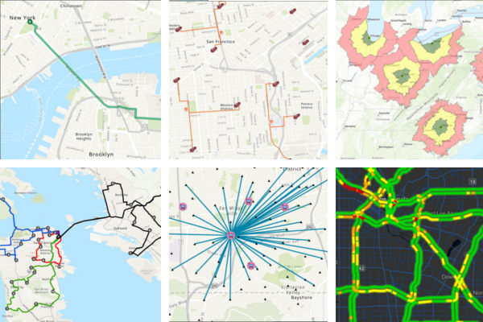
Selection and query: visual application
WEEK 6
Subsets are created using attribute and location conditions
MIS 369
Dr. Murat BAŞEĞMEZ
Notes:
Instructor note: Have students identify the data layers, analysis inputs, and potential outputs shown in the visual.
Source: https://pro.arcgis.com/en/pro-app/3.5/tool-reference/analysis/an-overview-of-the-analysis-toolbox.htm; User-provided GIS Instructor notes

Slide 16
SECTION 3
Proximity analysis
Distance and service area measure spatial accessibility
Notes:
Instructor note: Distance and service area measure spatial accessibility
Source: Lesson plan

Slide 17
Proximity analysis
WEEK 6
01
02
03
Buffer
Near
Thiessen
Zone within a specified distance
Nearest feature
Allocation to the nearest source
MIS 369
Dr. Murat BAŞEĞMEZ
Notes:
Instructor note: Explain the concepts using an example.
Source: https://pro.arcgis.com/en/pro-app/3.5/tool-reference/analysis/an-overview-of-the-analysis-toolbox.htm; user-provided GIS Instructor notes

Slide 18
Proximity analysis: concept and application
WEEK 6
Kavramsal anlam
ArcGIS Pro equivalent
Buffer: Zone within a specified distance
Buffer, Multiple Ring Buffer, and Near
Near: Nearest feature
The output is examined together in the map and table.
Thiessen: Allocation to the nearest source
Parameters and environment settings are saved.
MIS 369
Dr. Murat BAŞEĞMEZ
Notes:
Instructor note: Relate the concept to the software tool; do not use the tool name in place of the concept.
Source: https://pro.arcgis.com/en/pro-app/3.5/tool-reference/analysis/an-overview-of-the-analysis-toolbox.htm; GIS Instructor notes provided by the user

Slide 19
Proximity analysis workflow
WEEK 6
01
02
03
04
05
Question
Data
Process
Kontrol
Yorum
Distance and service area measure spatial accessibility
Buffer and Near
Buffer, Multiple Ring Buffer, and Near
Parameters and output quality
Decision context and constraints
MIS 369
Dr. Murat BAŞEĞMEZ
Notes:
Instructor note: Ask students to adapt the workflow to their own project questions.
Source: https://pro.arcgis.com/en/pro-app/3.5/tool-reference/analysis/an-overview-of-the-analysis-toolbox.htm; GIS Instructor notes provided by the user

Slide 20
Critical checks for proximity analysis
WEEK 6
1
2
3
!
Data
Scale
Method
Risk
Does the input data meet the buffer requirement?
Are the unit of analysis and resolution appropriate for the question?
Have the Buffer, Multiple Ring Buffer, and Near parameters been justified?
Euclidean distance does not always represent travel time
MIS 369
Dr. Murat BAŞEĞMEZ
Notes:
Instructor note: Use these checks as a brief checklist before implementation.
Source: https://pro.arcgis.com/en/pro-app/3.5/tool-reference/analysis/an-overview-of-the-analysis-toolbox.htm; GIS Instructor notes provided by the user

Slide 21
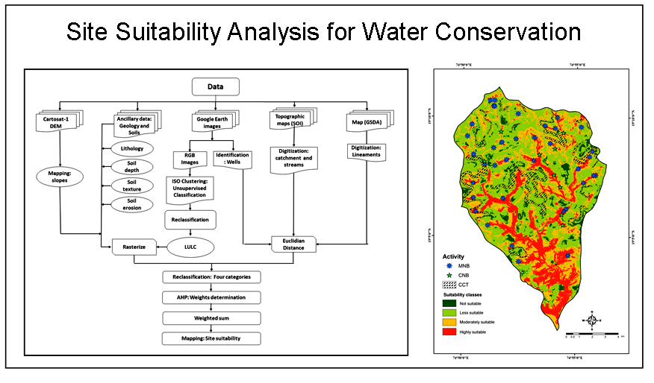
Proximity analysis: visual application
WEEK 6
Distance and service area measure spatial accessibility
MIS 369
Dr. Murat BAŞEĞMEZ
Notes:
Instructor note: Have students identify the data layers, analysis inputs, and potential outputs shown in the visual.
Source: https://pro.arcgis.com/en/pro-app/3.5/tool-reference/analysis/an-overview-of-the-analysis-toolbox.htm; User-provided GIS Instructor notes

Slide 22
CHAPTER 4
Overlay analysis
Geometries and attributes of layers are combined
Notes:
Explanation note: Layer geometries and attributes are combined
Source: Lesson plan

Slide 23
Overlay analysis
WEEK 6
01
02
03
Intersect
Union
Erase
Shared area
All polygon areas
Erased area
MIS 369
Dr. Murat BAŞEĞMEZ
Notes:
Instructor note: Explain the concepts using an example.
Source: https://pro.arcgis.com/en/pro-app/3.5/tool-reference/analysis/an-overview-of-the-analysis-toolbox.htm; user-provided GIS Instructor notes

Slide 24
Overlay analysis: concept and application
WEEK 6
Kavramsal anlam
ArcGIS Pro equivalent
Intersect: Shared area
Intersect, Union, and Erase
Union: All polygon areas
The output is examined together in the map and table.
Erase: Erased area
Parameters and environment settings are saved.
MIS 369
Dr. Murat BAŞEĞMEZ
Notes:
Instructor note: Relate the concept to the software tool; do not use the tool name in place of the concept.
Source: https://pro.arcgis.com/en/pro-app/3.5/tool-reference/analysis/an-overview-of-the-analysis-toolbox.htm; GIS Instructor notes provided by the user

Slide 25
Overlay analysis workflow
WEEK 6
01
02
03
04
05
Question
Data
Process
Kontrol
Yorum
Geometries and attributes of layers are combined
Intersect and Union
Intersect, Union, and Erase
Parameters and output quality
Decision context and constraints
MIS 369
Dr. Murat BAŞEĞMEZ
Notes:
Instructor note: Ask students to adapt the workflow to their own project questions.
Source: https://pro.arcgis.com/en/pro-app/3.5/tool-reference/analysis/an-overview-of-the-analysis-toolbox.htm; GIS Instructor notes provided by the user

Slide 26
Critical checks for overlay analysis
WEEK 6
1
2
3
!
Data
Scale
Method
Risk
Does the input data meet the intersect requirement?
Are the unit of analysis and resolution appropriate for the question?
Are the Intersect, Union, and Erase parameters justified?
Geometric fragmentation alters record counts and measurements
MIS 369
Dr. Murat BAŞEĞMEZ
Notes:
Instructor note: Use these checks as a brief checklist before implementation.
Source: https://pro.arcgis.com/en/pro-app/3.5/tool-reference/analysis/an-overview-of-the-analysis-toolbox.htm; GIS Instructor notes provided by the user

Slide 27
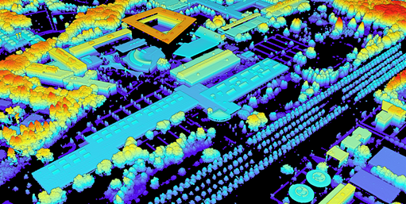
Overlay analysis: visual application
WEEK 6
Geometries and attributes of layers are combined
MIS 369
Dr. Murat BAŞEĞMEZ
Notes:
Instructor note: Have students identify the data layers, analysis inputs, and potential outputs shown in the visual.
Source: https://pro.arcgis.com/en/pro-app/3.5/tool-reference/analysis/an-overview-of-the-analysis-toolbox.htm; User-provided GIS Instructor notes

Slide 28
CHAPTER 5
Spatial Join and network
Attribute transfer based on location and network-based accessibility calculation
Notes:
Instructor note: Attribute transfer based on location and network-based accessibility calculation
Source: Lesson plan

Slide 29
Spatial Join and network
WEEK 6
01
02
03
Spatial Join
Network
Service Area
Spatial matching
Connected lines
Time- or distance-based accessibility
MIS 369
Dr. Murat BAŞEĞMEZ
Notes:
Instructor note: Explain the concepts using an example.
Source: https://pro.arcgis.com/en/pro-app/3.5/tool-reference/analysis/an-overview-of-the-analysis-toolbox.htm; user-provided GIS Instructor notes

Slide 30
Spatial Join and network: concepts and application
WEEK 6
Kavramsal anlam
ArcGIS Pro equivalent
Spatial Join: Spatial matching
Spatial Join, Network Dataset, and Service Area
Network: Connected lines
The output is examined together in the map and table.
Service Area: Time- or distance-based accessibility
Parameters and environment settings are saved.
MIS 369
Dr. Murat BAŞEĞMEZ
Notes:
Instructor note: Relate the concept to the software tool; do not use the tool name in place of the concept.
Source: https://pro.arcgis.com/en/pro-app/3.5/tool-reference/analysis/an-overview-of-the-analysis-toolbox.htm; GIS Instructor notes provided by the user

Slide 31
Spatial Join and network workflow
WEEK 6
01
02
03
04
05
Question
Data
Process
Kontrol
Yorum
Attribute transfer based on location and network-based accessibility calculation
Spatial Join and Network
Spatial Join, Network Dataset, and Service Area
Parameters and output quality
Decision context and constraints
MIS 369
Dr. Murat BAŞEĞMEZ
Notes:
Instructor note: Ask students to adapt the workflow to their own project questions.
Source: https://pro.arcgis.com/en/pro-app/3.5/tool-reference/analysis/an-overview-of-the-analysis-toolbox.htm; GIS Instructor notes provided by the user

Slide 32
Critical checks for Spatial Join and network
WEEK 6
1
2
3
!
Data
Scale
Method
Risk
Does the input data meet Spatial Join requirements?
Are the unit of analysis and resolution appropriate for the question?
Have the Spatial Join, Network Dataset, and Service Area parameters been justified?
Match type and network constraints determine the results
MIS 369
Dr. Murat BAŞEĞMEZ
Notes:
Instructor note: Use these checks as a brief checklist before implementation.
Source: https://pro.arcgis.com/en/pro-app/3.5/tool-reference/analysis/an-overview-of-the-analysis-toolbox.htm; GIS Instructor notes provided by the user

Slide 33
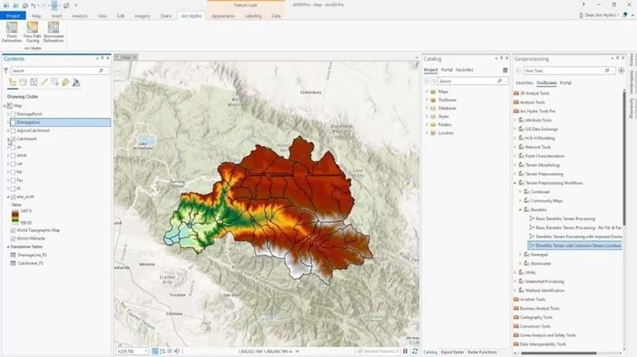
Spatial Join and network: visual exercise
WEEK 6
Attribute transfer based on location and network-based accessibility calculation
MIS 369
Dr. Murat BAŞEĞMEZ
Notes:
Instructor note: Have students identify the data layers, analysis inputs, and potential outputs shown in the visual.
Source: https://pro.arcgis.com/en/pro-app/3.5/tool-reference/analysis/an-overview-of-the-analysis-toolbox.htm; User-provided GIS Instructor notes

Slide 34
LAB
Guided exercise
Sequentially using Select, Buffer, Spatial Join, and Overlay tools for school accessibility
Notes:
Instructor note: Sequentially using Select, Buffer, Spatial Join, and Overlay tools for school accessibility
Source: Lesson plan

Slide 35
Laboratory procedure plan
WEEK 6
Prepare the working folder and the geodatabase.
Sequentially using Select, Buffer, Spatial Join, and Overlay tools for school accessibility
Check intermediate results using the map and table.
Record the processing history and parameters.
Add a note regarding the methodology and limitations to the final map.
MIS 369
Dr. Murat BAŞEĞMEZ
Notes:
Instructor note: Break the exercise down into small steps and check students' screens at each step.
Source: https://pro.arcgis.com/en/pro-app/3.5/tool-reference/analysis/an-overview-of-the-analysis-toolbox.htm; user-provided GIS Instructor notes

Slide 36
Lab submission package
WEEK 6
01
02
03
Map
Evidence
Yorum
Title, legend, scale, and source
Tool parameters or notebook output
150–200-word summary of findings and limitations
MIS 369
Dr. Murat BAŞEĞMEZ
Notes:
Instructor note: Explain the concepts using an example.
Source: https://pro.arcgis.com/en/pro-app/3.5/tool-reference/analysis/an-overview-of-the-analysis-toolbox.htm; user-provided GIS Instructor notes

Slide 37
Implementation checklist
WEEK 6
01
02
03
Input
Process
Output
Correct layer, area, and coordinate system
Parameters and environment settings saved
Map, table, and interpretation are consistent with each other
MIS 369
Dr. Murat BAŞEĞMEZ
Notes:
Instructor note: Explain the concepts using an example.
Source: https://pro.arcgis.com/en/pro-app/3.5/tool-reference/analysis/an-overview-of-the-analysis-toolbox.htm; user-provided GIS Instructor notes

Slide 38
Connection to the term project
WEEK 6
Which of this week's concepts is essential for your project problem?
Which data or method could most significantly influence your decision?
Add a quality control item related to this week to your project log.
MIS 369
Dr. Murat BAŞEĞMEZ
Notes:
Instructor note: Ask students to make a brief addition to their project log.
Source: https://pro.arcgis.com/en/pro-app/3.5/tool-reference/analysis/an-overview-of-the-analysis-toolbox.htm; user-provided GIS Instructor notes

Slide 39
End-of-lesson check 1
WEEK 6
What is the most important initial decision regarding the analysis question and unit?
A
Simply choosing a color
B
Defining the problem and data requirements
C
Using the most complex tool
D
Sharing the output without checking it
MIS 369
Dr. Murat BAŞEĞMEZ
Notes:
Instructor note: The correct answer is option B.
Source: https://pro.arcgis.com/en/pro-app/3.5/tool-reference/analysis/an-overview-of-the-analysis-toolbox.htm; user-provided GIS Instructor notes

Slide 40
End-of-lesson check 2
WEEK 6
Which of the following most strengthens the quality of a proximity analysis study?
A
Saving parameters and validating the result
B
Not changing layer names
C
Using only a single criterion
D
Making the map as colorful as possible
MIS 369
Dr. Murat BAŞEĞMEZ
Notes:
Instructor note: The correct answer is option A.
Source: https://pro.arcgis.com/en/pro-app/3.5/tool-reference/analysis/an-overview-of-the-analysis-toolbox.htm; user-provided GIS Instructor notes

Slide 41
End-of-lesson check 3
WEEK 6
Why is the mere execution of an ArcGIS Pro tool not proof of a correct result?
A
Because tools work only with raster data
B
Because the output file can be very large
C
Because data, scale, parameters, and validation affect the result
D
Because the map lacks a north arrow
MIS 369
Dr. Murat BAŞEĞMEZ
Notes:
Instructor note: The correct answer is option C.
Source: https://pro.arcgis.com/en/pro-app/3.5/tool-reference/analysis/an-overview-of-the-analysis-toolbox.htm; user-provided GIS Instructor notes

Slide 42
WEEK 6 SUMMARY
Vector-Based Spatial Analysis
Analysis question and unit
Selection and query
Proximity analysis
Overlay analysis
Spatial Join and network
Preparation for next week: review the concepts in your exercise file
Notes:
Instructor note: Ask students to review the week's five main concepts using examples.
Source: https://pro.arcgis.com/en/pro-app/3.5/tool-reference/analysis/an-overview-of-the-analysis-toolbox.htm; user-provided GIS Instructor notes

Slide 43
Resources and further reading
WEEK 6
https://pro.arcgis.com/en/pro-app/3.5/tool-reference/analysis/an-overview-of-the-analysis-toolbox.htm
ArcGIS Pro 3.5 Documentation
User-provided GIS Instructor notes
In-class exercise data and instructor notes
MIS 369
Dr. Murat BAŞEĞMEZ
Notes:
Instructor note: Share the resources with students after the lesson.
Source: https://pro.arcgis.com/en/pro-app/3.5/tool-reference/analysis/an-overview-of-the-analysis-toolbox.htm; user-provided GIS Instructor notes

