Slide 1

AI-ENHANCED
GEOGRAPHIC INFORMATION SYSTEMS
WEEK 5
Data Quality and Geodatabase Management
MIS 369 · Ankara Science University
Dr. Murat BAŞEĞMEZ
Notes:
Instructor note: Introduce the week's topic by connecting it to the previous lesson.
Source: https://pro.arcgis.com/en/pro-app/3.5/help/data/geodatabases/manage-file-gdb/file-geodatabases.htm; user-provided GIS Instructor notes

Slide 2
This week's learning outcomes
WEEK 5
01
02
03
Concept
Application
Critique
Uses key terms correctly
Executes the ArcGIS Pro workflow
Explains data and method limitations
MIS 369
Dr. Murat BAŞEĞMEZ
Notes:
Instructor note: Explain the concepts using an example.
Source: https://pro.arcgis.com/en/pro-app/3.5/help/data/geodatabases/manage-file-gdb/file-geodatabases.htm; user-provided GIS Instructor notes

Slide 3
Three-hour lesson flow
WEEK 5
Part one: conceptual foundation and visual examples
Part two: step-by-step demonstration in ArcGIS Pro
Part three: guided lab and assessment
MIS 369
Dr. Murat BAŞEĞMEZ
Notes:
Instructor note: Explain the small output to be submitted at the end of the lesson right at the beginning.
Source: https://pro.arcgis.com/en/pro-app/3.5/help/data/geodatabases/manage-file-gdb/file-geodatabases.htm; user-provided GIS Instructor notes

Slide 4
SECTION 1
Data lifecycle
Planning, production, maintenance, and archiving are designed together
Notes:
Instructor note: Planning, production, maintenance, and archiving are designed together
Source: Lesson plan

Slide 5
Data lifecycle
WEEK 5
01
02
03
Production
Maintenance
Archive
Source and method
Responsibility for updates
Versioning and history
MIS 369
Dr. Murat BAŞEĞMEZ
Notes:
Instructor note: Explain the concepts using an example.
Source: https://pro.arcgis.com/en/pro-app/3.5/help/data/geodatabases/manage-file-gdb/file-geodatabases.htm; user-provided GIS Instructor notes

Slide 6
Data lifecycle: concept and practice
WEEK 5
Kavramsal anlam
ArcGIS Pro equivalent
Production: Source and method
Catalog, metadata, and History
Maintenance: Responsibility for updates
The output is examined together in the map and table.
Archive: Versioning and history
Parameters and environment settings are saved.
MIS 369
Dr. Murat BAŞEĞMEZ
Notes:
Instructor note: Relate the concept to the software tool; do not use the tool name in place of the concept.
Source: https://pro.arcgis.com/en/pro-app/3.5/help/data/geodatabases/manage-file-gdb/file-geodatabases.htm; user-provided GIS Instructor notes

Slide 7
Data lifecycle workflow
WEEK 5
01
02
03
04
05
Question
Data
Process
Kontrol
Yorum
Planning, production, maintenance, and archiving are designed together
Production and Maintenance
Catalog, metadata, and History
Parameters and output quality
Decision context and constraints
MIS 369
Dr. Murat BAŞEĞMEZ
Notes:
Instructor note: Ask students to adapt the workflow to their own project questions.
Source: https://pro.arcgis.com/en/pro-app/3.5/help/data/geodatabases/manage-file-gdb/file-geodatabases.htm; user-provided GIS Instructor notes

Slide 8
Critical checks for the data lifecycle
WEEK 5
1
2
3
!
Data
Scale
Method
Risk
Does the input data meet production requirements?
Are the unit of analysis and resolution appropriate for the question?
Have the Catalog, metadata, and History parameters been justified?
Data without a designated updater quickly becomes obsolete
MIS 369
Dr. Murat BAŞEĞMEZ
Notes:
Instructor note: Use these checks as a quick checklist before the practical exercise.
Source: https://pro.arcgis.com/en/pro-app/3.5/help/data/geodatabases/manage-file-gdb/file-geodatabases.htm; user-provided GIS Instructor notes

Slide 9
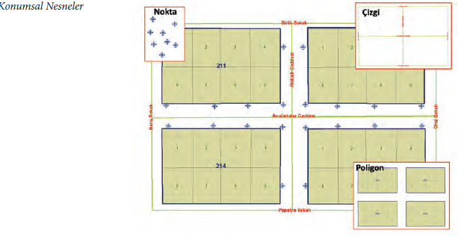
Data lifecycle: visual application
WEEK 5
Planning, production, maintenance, and archiving are designed together
MIS 369
Dr. Murat BAŞEĞMEZ
Notes:
Instructor note: Have students identify the data layers, analysis inputs, and potential outputs shown in the visual.
Source: https://pro.arcgis.com/en/pro-app/3.5/help/data/geodatabases/manage-file-gdb/file-geodatabases.htm; User-provided GIS Instructor notes

Slide 10
CHAPTER 2
Geodatabase structure
Related datasets managed in a common spatial repository
Notes:
Instructor note: Related datasets managed in a common spatial repository
Source: Lesson plan

Slide 11
Geodatabase structure
WEEK 5
01
02
03
Feature class
Dataset
Table
Single geometry type
Common reference and topology
Non-spatial record
MIS 369
Dr. Murat BAŞEĞMEZ
Notes:
Instructor note: Explain the concepts using an example.
Source: https://pro.arcgis.com/en/pro-app/3.5/help/data/geodatabases/manage-file-gdb/file-geodatabases.htm; user-provided GIS Instructor notes

Slide 12
Geodatabase structure: concept and implementation
WEEK 5
Kavramsal anlam
ArcGIS Pro equivalent
feature class: Single geometry type
New File Geodatabase and Feature Dataset
Dataset: Common reference and topology
The output is examined together in the map and table.
Table: Non-spatial record
Parameters and environment settings are saved.
MIS 369
Dr. Murat BAŞEĞMEZ
Notes:
Instructor note: Relate the concept to the software tool; do not use the tool name in place of the concept.
Source: https://pro.arcgis.com/en/pro-app/3.5/help/data/geodatabases/manage-file-gdb/file-geodatabases.htm; user-provided GIS Instructor notes

Slide 13
Geodatabase structure workflow
WEEK 5
01
02
03
04
05
Question
Data
Process
Kontrol
Yorum
Related datasets managed in a common spatial repository
feature class and Dataset
New File Geodatabase and Feature Dataset
Parameters and output quality
Decision context and constraints
MIS 369
Dr. Murat BAŞEĞMEZ
Notes:
Instructor note: Ask students to adapt the workflow to their own project questions.
Source: https://pro.arcgis.com/en/pro-app/3.5/help/data/geodatabases/manage-file-gdb/file-geodatabases.htm; user-provided GIS Instructor notes

Slide 14
Critical checks for geodatabase structure
WEEK 5
1
2
3
!
Data
Scale
Method
Risk
Does the input data meet the feature class requirement?
Are the unit of analysis and resolution appropriate for the question?
Have the New File Geodatabase and Feature Dataset parameters been justified?
Folder structure is not a substitute for a geodatabase data model
MIS 369
Dr. Murat BAŞEĞMEZ
Notes:
Instructor note: Use these checks as a quick checklist before the practical exercise.
Source: https://pro.arcgis.com/en/pro-app/3.5/help/data/geodatabases/manage-file-gdb/file-geodatabases.htm; user-provided GIS Instructor notes

Slide 15
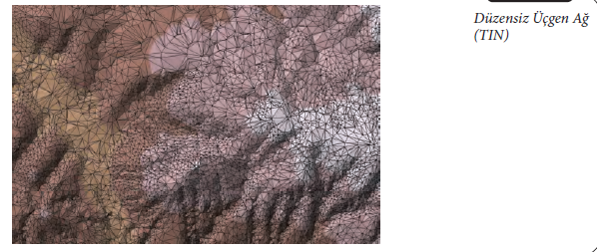
Geodatabase structure: visual application
WEEK 5
Related datasets managed in a common spatial repository
MIS 369
Dr. Murat BAŞEĞMEZ
Notes:
Instructor note: Have students identify the data layers, analysis inputs, and potential outputs shown in the visual.
Source: https://pro.arcgis.com/en/pro-app/3.5/help/data/geodatabases/manage-file-gdb/file-geodatabases.htm; User-provided GIS Instructor notes

Slide 16
SECTION 3
Field and domain
Field type and valid value rules ensure data integrity
Notes:
Instructor note: Field type and valid value rules ensure data integrity
Source: Lesson plan

Slide 17
Field and domain
WEEK 5
01
02
03
Field type
Coded domain
Range domain
Text, number, and date
List of permitted values
Valid numeric range
MIS 369
Dr. Murat BAŞEĞMEZ
Notes:
Instructor note: Explain the concepts using an example.
Source: https://pro.arcgis.com/en/pro-app/3.5/help/data/geodatabases/manage-file-gdb/file-geodatabases.htm; user-provided GIS Instructor notes

Slide 18
Field and domain: concepts and application
WEEK 5
Kavramsal anlam
ArcGIS Pro equivalent
Field type: Text, number, and date
Fields view and Domains view
Coded domain: List of permitted values
The output is examined together in the map and table.
Range domain: Valid numeric range
Parameters and environment settings are saved.
MIS 369
Dr. Murat BAŞEĞMEZ
Notes:
Instructor note: Relate the concept to the software tool; do not use the tool name in place of the concept.
Source: https://pro.arcgis.com/en/pro-app/3.5/help/data/geodatabases/manage-file-gdb/file-geodatabases.htm; user-provided GIS Instructor notes

Slide 19
Field and domain workflow
WEEK 5
01
02
03
04
05
Question
Data
Process
Kontrol
Yorum
Field type and valid value rules ensure data integrity
Field type and Coded domain
Fields view and Domains view
Parameters and output quality
Decision context and constraints
MIS 369
Dr. Murat BAŞEĞMEZ
Notes:
Instructor note: Ask students to adapt the workflow to their own project questions.
Source: https://pro.arcgis.com/en/pro-app/3.5/help/data/geodatabases/manage-file-gdb/file-geodatabases.htm; user-provided GIS Instructor notes

Slide 20
Critical checks for fields and domains
WEEK 5
1
2
3
!
Data
Scale
Method
Risk
Does the input data meet the field type requirement?
Are the unit of analysis and resolution appropriate for the question?
Have the Fields view and Domains view parameters been justified?
Incorrect field type leads to calculation and sorting issues
MIS 369
Dr. Murat BAŞEĞMEZ
Notes:
Instructor note: Use these checks as a quick checklist before the practical exercise.
Source: https://pro.arcgis.com/en/pro-app/3.5/help/data/geodatabases/manage-file-gdb/file-geodatabases.htm; user-provided GIS Instructor notes

Slide 21
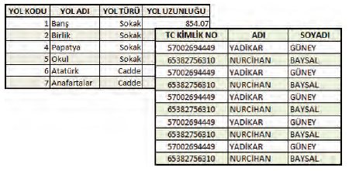
Field and domain: visual application
WEEK 5
Field type and valid value rules ensure data integrity
MIS 369
Dr. Murat BAŞEĞMEZ
Notes:
Instructor note: Have students identify the data layers, analysis inputs, and potential outputs shown in the visual.
Source: https://pro.arcgis.com/en/pro-app/3.5/help/data/geodatabases/manage-file-gdb/file-geodatabases.htm; User-provided GIS Instructor notes

Slide 22
CHAPTER 4
Join and relate
Tables are linked temporarily or permanently via a common key
Notes:
Explanatory note: Tables are linked temporarily or permanently via a common key
Source: Lesson plan

Slide 23
Join and relate
WEEK 5
01
02
03
Join
Relate
Key
Adding columns
Relationship between records
Matching field
MIS 369
Dr. Murat BAŞEĞMEZ
Notes:
Instructor note: Explain the concepts using an example.
Source: https://pro.arcgis.com/en/pro-app/3.5/help/data/geodatabases/manage-file-gdb/file-geodatabases.htm; user-provided GIS Instructor notes

Slide 24
Join and relate: concepts and application
WEEK 5
Kavramsal anlam
ArcGIS Pro equivalent
Join: Adding columns
Add Join, Add Relate, and Relationship Class
Relate: Relationship between records
The output is examined together in the map and table.
Key: Matching field
Parameters and environment settings are saved.
MIS 369
Dr. Murat BAŞEĞMEZ
Notes:
Instructor note: Relate the concept to the software tool; do not use the tool name in place of the concept.
Source: https://pro.arcgis.com/en/pro-app/3.5/help/data/geodatabases/manage-file-gdb/file-geodatabases.htm; user-provided GIS Instructor notes

Slide 25
Join and relate workflow
WEEK 5
01
02
03
04
05
Question
Data
Process
Kontrol
Yorum
Tables are linked temporarily or permanently via a common key
Join and Relate
Add Join, Add Relate, and Relationship Class
Parameters and output quality
Decision context and constraints
MIS 369
Dr. Murat BAŞEĞMEZ
Notes:
Instructor note: Ask students to adapt the workflow to their own project questions.
Source: https://pro.arcgis.com/en/pro-app/3.5/help/data/geodatabases/manage-file-gdb/file-geodatabases.htm; user-provided GIS Instructor notes

Slide 26
Critical checks for join and relate
WEEK 5
1
2
3
!
Data
Scale
Method
Risk
Does the input data meet the join requirements?
Are the unit of analysis and resolution appropriate for the question?
Have the Add Join, Add Relate, and Relationship Class parameters been justified?
Duplicate or null keys result in incorrect record matching
MIS 369
Dr. Murat BAŞEĞMEZ
Notes:
Instructor note: Use these checks as a quick checklist before the practical exercise.
Source: https://pro.arcgis.com/en/pro-app/3.5/help/data/geodatabases/manage-file-gdb/file-geodatabases.htm; user-provided GIS Instructor notes

Slide 27
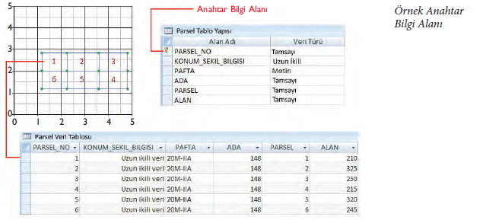
Join and relate: visual demonstration
WEEK 5
Tables are linked temporarily or permanently via a common key
MIS 369
Dr. Murat BAŞEĞMEZ
Notes:
Instructor note: Have students identify the data layers, analysis inputs, and potential outputs shown in the visual.
Source: https://pro.arcgis.com/en/pro-app/3.5/help/data/geodatabases/manage-file-gdb/file-geodatabases.htm; User-provided GIS Instructor notes

Slide 28
CHAPTER 5
Quality and topology
Systematic checking of geometry, attribute, and consistency errors
Notes:
Instructor note: Systematic checking of geometry, attribute, and consistency errors
Source: Lesson plan

Slide 29
Quality and topology
WEEK 5
01
02
03
Completeness
Consistency
Topology
Missing record
Kural uyumu
Spatial relationship rules
MIS 369
Dr. Murat BAŞEĞMEZ
Notes:
Instructor note: Explain the concepts using an example.
Source: https://pro.arcgis.com/en/pro-app/3.5/help/data/geodatabases/manage-file-gdb/file-geodatabases.htm; user-provided GIS Instructor notes

Slide 30
Quality and topology: concepts and application
WEEK 5
Kavramsal anlam
ArcGIS Pro equivalent
Completeness: Missing record
Check Geometry, Repair Geometry, and topology rules
Consistency: Kural uyumu
The output is examined together in the map and table.
Topology: Spatial relationship rules
Parameters and environment settings are saved.
MIS 369
Dr. Murat BAŞEĞMEZ
Notes:
Instructor note: Relate the concept to the software tool; do not use the tool name in place of the concept.
Source: https://pro.arcgis.com/en/pro-app/3.5/help/data/geodatabases/manage-file-gdb/file-geodatabases.htm; user-provided GIS Instructor notes

Slide 31
Quality and topology workflow
WEEK 5
01
02
03
04
05
Question
Data
Process
Kontrol
Yorum
Systematic checking of geometry, attribute, and consistency errors
Completeness and Consistency
Check Geometry, Repair Geometry, and topology rules
Parameters and output quality
Decision context and constraints
MIS 369
Dr. Murat BAŞEĞMEZ
Notes:
Instructor note: Ask students to adapt the workflow to their own project questions.
Source: https://pro.arcgis.com/en/pro-app/3.5/help/data/geodatabases/manage-file-gdb/file-geodatabases.htm; user-provided GIS Instructor notes

Slide 32
Critical checks for quality and topology
WEEK 5
1
2
3
!
Data
Scale
Method
Risk
Does the input data meet completeness requirements?
Are the unit of analysis and resolution appropriate for the question?
Have the parameters for Check Geometry, Repair Geometry, and topology rules been justified?
Cleanup performed without an error report is not reproducible
MIS 369
Dr. Murat BAŞEĞMEZ
Notes:
Instructor note: Use these checks as a quick checklist before the practical exercise.
Source: https://pro.arcgis.com/en/pro-app/3.5/help/data/geodatabases/manage-file-gdb/file-geodatabases.htm; user-provided GIS Instructor notes

Slide 33
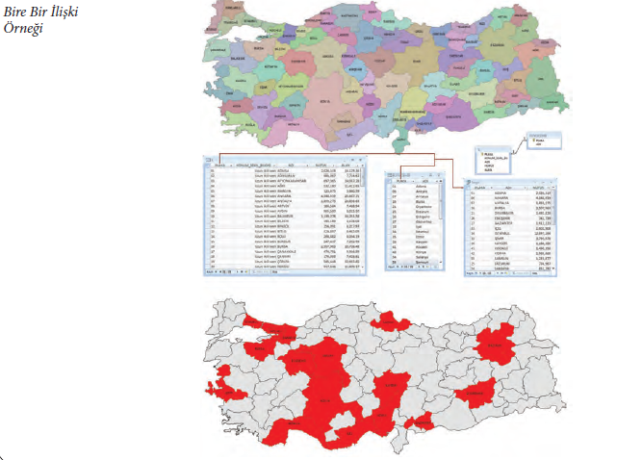
Quality and topology: visual demonstration
WEEK 5
Systematic checking of geometry, attribute, and consistency errors
MIS 369
Dr. Murat BAŞEĞMEZ
Notes:
Instructor note: Have students identify the data layers, analysis inputs, and potential outputs shown in the visual.
Source: https://pro.arcgis.com/en/pro-app/3.5/help/data/geodatabases/manage-file-gdb/file-geodatabases.htm; User-provided GIS Instructor notes

Slide 34
LAB
Guided exercise
Creating a file geodatabase, defining fields, using domains, and preparing a quality control report
Notes:
Instructor note: Creating a file geodatabase, defining fields, using domains, and preparing a quality control report
Source: Lesson plan

Slide 35
Laboratory procedure plan
WEEK 5
Prepare the working folder and the geodatabase.
Creating a file geodatabase, defining fields, using domains, and preparing a quality control report
Check intermediate results using the map and table.
Record the processing history and parameters.
Add a note regarding the methodology and limitations to the final map.
MIS 369
Dr. Murat BAŞEĞMEZ
Notes:
Instructor note: Break the exercise down into small steps and check the students' screens at each step.
Source: https://pro.arcgis.com/en/pro-app/3.5/help/data/geodatabases/manage-file-gdb/file-geodatabases.htm; user-provided GIS Instructor notes

Slide 36
Lab submission package
WEEK 5
01
02
03
Map
Evidence
Yorum
Title, legend, scale, and source
Tool parameters or notebook output
150–200-word summary of findings and limitations
MIS 369
Dr. Murat BAŞEĞMEZ
Notes:
Instructor note: Explain the concepts using an example.
Source: https://pro.arcgis.com/en/pro-app/3.5/help/data/geodatabases/manage-file-gdb/file-geodatabases.htm; user-provided GIS Instructor notes

Slide 37
Implementation checklist
WEEK 5
01
02
03
Input
Process
Output
Correct layer, area, and coordinate system
Parameters and environment settings saved
Map, table, and interpretation are consistent with each other
MIS 369
Dr. Murat BAŞEĞMEZ
Notes:
Instructor note: Explain the concepts using an example.
Source: https://pro.arcgis.com/en/pro-app/3.5/help/data/geodatabases/manage-file-gdb/file-geodatabases.htm; user-provided GIS Instructor notes

Slide 38
Connection to the term project
WEEK 5
Which of this week's concepts is essential for your project problem?
Which data or method could most significantly influence your decision?
Add a quality control item related to this week to your project log.
MIS 369
Dr. Murat BAŞEĞMEZ
Notes:
Instructor note: Ask students to make a brief addition to their project log.
Source: https://pro.arcgis.com/en/pro-app/3.5/help/data/geodatabases/manage-file-gdb/file-geodatabases.htm; user-provided GIS Instructor notes

Slide 39
End-of-lesson check 1
WEEK 5
What is the most important initial decision regarding the data lifecycle?
A
Simply choosing a color
B
Defining the problem and data requirements
C
Using the most complex tool
D
Sharing the output without checking it
MIS 369
Dr. Murat BAŞEĞMEZ
Notes:
Instructor note: The correct answer is option B.
Source: https://pro.arcgis.com/en/pro-app/3.5/help/data/geodatabases/manage-file-gdb/file-geodatabases.htm; user-provided GIS Instructor notes

Slide 40
End-of-lesson check 2
WEEK 5
Which of the following most strengthens quality in field and domain work?
A
Saving parameters and validating the result
B
Not changing layer names
C
Using only a single criterion
D
Making the map as colorful as possible
MIS 369
Dr. Murat BAŞEĞMEZ
Notes:
Instructor note: The correct answer is option A.
Source: https://pro.arcgis.com/en/pro-app/3.5/help/data/geodatabases/manage-file-gdb/file-geodatabases.htm; user-provided GIS Instructor notes

Slide 41
End-of-lesson check 3
WEEK 5
Why is the mere execution of an ArcGIS Pro tool not proof of a correct result?
A
Because tools work only with raster data
B
Because the output file can be very large
C
Because data, scale, parameters, and validation affect the result
D
Because the map lacks a north arrow
MIS 369
Dr. Murat BAŞEĞMEZ
Notes:
Instructor note: The correct answer is option C.
Source: https://pro.arcgis.com/en/pro-app/3.5/help/data/geodatabases/manage-file-gdb/file-geodatabases.htm; user-provided GIS Instructor notes

Slide 42
WEEK 5 SUMMARY
Data Quality and Geodatabase Management
Data lifecycle
Geodatabase structure
Field and domain
Join and relate
Quality and topology
Preparation for next week: review the concepts in your exercise file
Notes:
Instructor note: Ask students to review the week's five key concepts using examples.
Source: https://pro.arcgis.com/en/pro-app/3.5/help/data/geodatabases/manage-file-gdb/file-geodatabases.htm; user-provided GIS Instructor notes

Slide 43
Resources and further reading
WEEK 5
https://pro.arcgis.com/en/pro-app/3.5/help/data/geodatabases/manage-file-gdb/file-geodatabases.htm
ArcGIS Pro 3.5 Documentation
User-provided GIS Instructor notes
In-class exercise data and instructor notes
MIS 369
Dr. Murat BAŞEĞMEZ
Notes:
Instructor note: Share the resources with students after the lesson.
Source: https://pro.arcgis.com/en/pro-app/3.5/help/data/geodatabases/manage-file-gdb/file-geodatabases.htm; user-provided GIS Instructor notes

