Slide 1

AI-ENHANCED
GEOGRAPHIC INFORMATION SYSTEMS
WEEK 3
Map Design and Spatial Visualization
MIS 369 · Ankara Science University
Dr. Murat BAŞEĞMEZ
Notes:
Instructor note: Introduce the week's topic by connecting it to the previous lesson.
Source: https://pro.arcgis.com/en/pro-app/3.5/help/mapping/layer-properties/symbolize-feature-layers.htm; user-provided GIS Instructor notes

Slide 2
This week's learning outcomes
WEEK 3
01
02
03
Concept
Application
Critique
Uses key terms correctly
Executes the ArcGIS Pro workflow
Explains data and method limitations
MIS 369
Dr. Murat BAŞEĞMEZ
Notes:
Instructor note: Explain the concepts using an example.
Source: https://pro.arcgis.com/en/pro-app/3.5/help/mapping/layer-properties/symbolize-feature-layers.htm; user-provided GIS Instructor notes

Slide 3
Three-hour lesson flow
WEEK 3
Part one: conceptual foundation and visual examples
Part two: step-by-step demonstration in ArcGIS Pro
Part three: guided lab and assessment
MIS 369
Dr. Murat BAŞEĞMEZ
Notes:
Instructor note: Explain the small output to be submitted at the end of the lesson at the beginning.
Source: https://pro.arcgis.com/en/pro-app/3.5/help/mapping/layer-properties/symbolize-feature-layers.htm; user-provided GIS Instructor notes

Slide 4
SECTION 1
Purpose of the map
The map is designed for a specific user and decision-making context
Notes:
Instructor note: The map is designed for a specific user and decision-making context
Source: Lesson plan

Slide 5
Purpose of the map
WEEK 3
01
02
03
Purpose
Target audience
Ortam
The question the map answers
Reading level and needs
Screen, print, or mobile
MIS 369
Dr. Murat BAŞEĞMEZ
Notes:
Instructor note: Explain the concepts using an example.
Source: https://pro.arcgis.com/en/pro-app/3.5/help/mapping/layer-properties/symbolize-feature-layers.htm; user-provided GIS Instructor notes

Slide 6
Purpose of the map: concept and application
WEEK 3
Kavramsal anlam
ArcGIS Pro equivalent
Purpose: The question the map answers
Map, Layout, and sharing size settings
Target audience: Reading level and needs
The output is examined together in the map and table.
Medium: Screen, print, or mobile
Parameters and environment settings are saved.
MIS 369
Dr. Murat BAŞEĞMEZ
Notes:
Instructor note: Relate the concept to the software tool; do not use the tool name in place of the concept.
Source: https://pro.arcgis.com/en/pro-app/3.5/help/mapping/layer-properties/symbolize-feature-layers.htm; User-provided GIS Instructor notes

Slide 7
Map purpose workflow
WEEK 3
01
02
03
04
05
Question
Data
Process
Kontrol
Yorum
The map is designed for a specific user and decision-making context
Purpose and target audience
Map, Layout, and sharing size settings
Parameters and output quality
Decision context and constraints
MIS 369
Dr. Murat BAŞEĞMEZ
Notes:
Instructor note: Ask students to adapt the workflow to their own project questions.
Source: https://pro.arcgis.com/en/pro-app/3.5/help/mapping/layer-properties/symbolize-feature-layers.htm; user-provided GIS Instructor notes

Slide 8
Critical checks for map purpose
WEEK 3
1
2
3
!
Data
Scale
Method
Risk
Does the input data meet the purpose requirements?
Are the unit of analysis and resolution appropriate for the question?
Have the Map, Layout, and sharing size settings/parameters been justified?
A single map is not suitable for every user
MIS 369
Dr. Murat BAŞEĞMEZ
Notes:
Instructor note: Use these checks as a quick checklist before implementation.
Source: https://pro.arcgis.com/en/pro-app/3.5/help/mapping/layer-properties/symbolize-feature-layers.htm; user-provided GIS Instructor notes

Slide 9
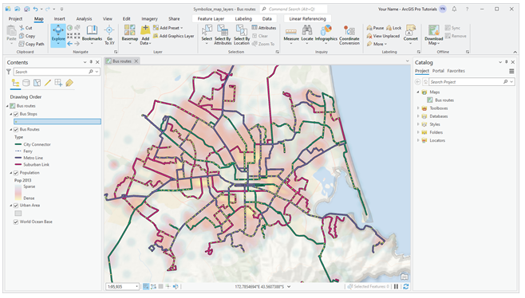
Map purpose: visual application
WEEK 3
The map is designed for a specific user and decision-making context
MIS 369
Dr. Murat BAŞEĞMEZ
Notes:
Instructor note: Have students identify the data layers, analysis inputs, and potential outputs shown in the visual.
Source: https://pro.arcgis.com/en/pro-app/3.5/help/mapping/layer-properties/symbolize-feature-layers.htm; User-provided GIS Instructor notes

Slide 10
CHAPTER 2
Visual variables
Color, size, shape, and texture encode the meaning of the data
Notes:
Note: Color, size, shape, and texture encode the meaning of the data
Source: Lesson plan

Slide 11
Visual variables
WEEK 3
01
02
03
Renk tonu
Lightness
Boyut
Categorical distinction
Numerical order
Quantitative comparison
MIS 369
Dr. Murat BAŞEĞMEZ
Notes:
Instructor note: Explain the concepts using an example.
Source: https://pro.arcgis.com/en/pro-app/3.5/help/mapping/layer-properties/symbolize-feature-layers.htm; user-provided GIS Instructor notes

Slide 12
Visual variables: concept and application
WEEK 3
Kavramsal anlam
ArcGIS Pro equivalent
Hue: Categorical distinction
Symbology pane and Gallery
Lightness: Numerical order
The output is examined together in the map and table.
Size: Quantitative comparison
Parameters and environment settings are saved.
MIS 369
Dr. Murat BAŞEĞMEZ
Notes:
Instructor note: Relate the concept to the software tool; do not use the tool name in place of the concept.
Source: https://pro.arcgis.com/en/pro-app/3.5/help/mapping/layer-properties/symbolize-feature-layers.htm; User-provided GIS Instructor notes

Slide 13
Visual variables workflow
WEEK 3
01
02
03
04
05
Question
Data
Process
Kontrol
Yorum
Color, size, shape, and texture encode the meaning of the data
Hue and Lightness
Symbology pane and Gallery
Parameters and output quality
Decision context and constraints
MIS 369
Dr. Murat BAŞEĞMEZ
Notes:
Instructor note: Ask students to adapt the workflow to their own project questions.
Source: https://pro.arcgis.com/en/pro-app/3.5/help/mapping/layer-properties/symbolize-feature-layers.htm; user-provided GIS Instructor notes

Slide 14
Critical checks for visual variables
WEEK 3
1
2
3
!
Data
Scale
Method
Risk
Does the input data meet the hue requirement?
Are the unit of analysis and resolution appropriate for the question?
Are the Symbology pane and Gallery parameters justified?
An incorrect visual variable can make ordinal data appear categorical
MIS 369
Dr. Murat BAŞEĞMEZ
Notes:
Instructor note: Use these checks as a quick checklist before implementation.
Source: https://pro.arcgis.com/en/pro-app/3.5/help/mapping/layer-properties/symbolize-feature-layers.htm; user-provided GIS Instructor notes

Slide 15
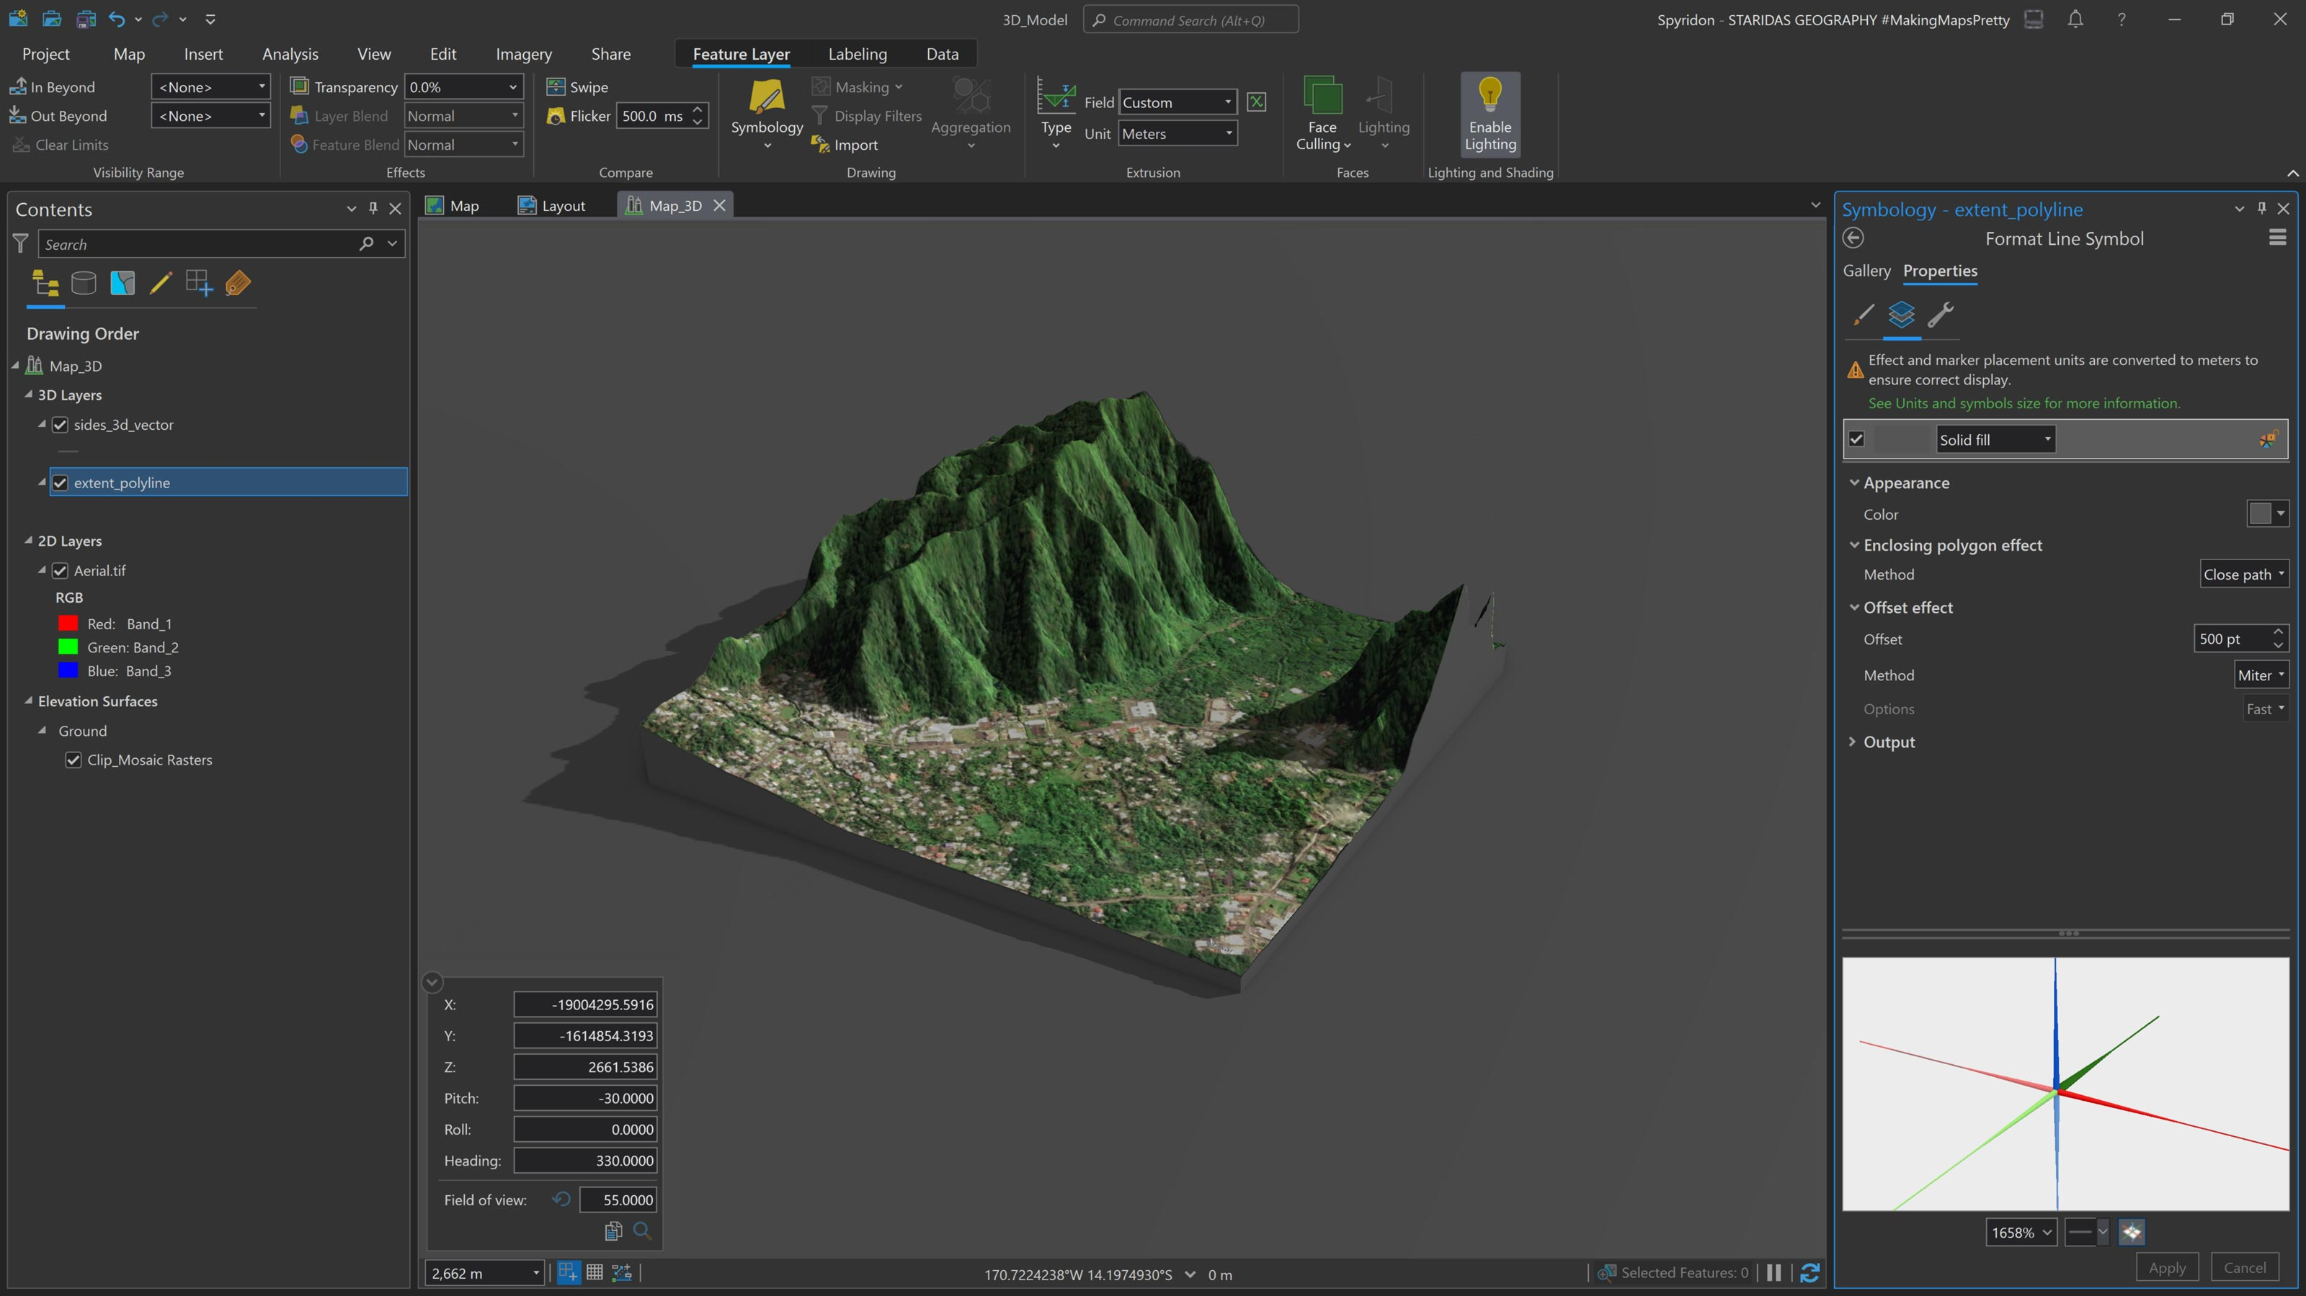
Visual variables: visual application
WEEK 3
Color, size, shape, and texture encode the meaning of the data
MIS 369
Dr. Murat BAŞEĞMEZ
Notes:
Instructor note: Have students identify the data layers, analysis inputs, and potential outputs shown in the visual.
Source: https://pro.arcgis.com/en/pro-app/3.5/help/mapping/layer-properties/symbolize-feature-layers.htm; User-provided GIS Instructor notes

Slide 16
SECTION 3
Classification methods
Class breaks alter the pattern shown on the map
Notes:
Explanatory note: Class breaks alter the pattern shown on the map
Source: Lesson plan

Slide 17
Classification methods
WEEK 3
01
02
03
Natural Breaks
Quantile
Equal Interval
Natural clusters in the data
Equal number of observations in each class
Equal value intervals
MIS 369
Dr. Murat BAŞEĞMEZ
Notes:
Instructor note: Explain the concepts using an example.
Source: https://pro.arcgis.com/en/pro-app/3.5/help/mapping/layer-properties/symbolize-feature-layers.htm; user-provided GIS Instructor notes

Slide 18
Classification methods: concept and application
WEEK 3
Kavramsal anlam
ArcGIS Pro equivalent
Natural Breaks: Natural clusters in the data
Graduated Colors and histogram
Quantile: Equal number of observations in each class
The output is examined together in the map and table.
Equal Interval: Equal value intervals
Parameters and environment settings are saved.
MIS 369
Dr. Murat BAŞEĞMEZ
Notes:
Instructor note: Relate the concept to the software tool; do not use the tool name in place of the concept.
Source: https://pro.arcgis.com/en/pro-app/3.5/help/mapping/layer-properties/symbolize-feature-layers.htm; User-provided GIS Instructor notes

Slide 19
Classification methods workflow
WEEK 3
01
02
03
04
05
Question
Data
Process
Kontrol
Yorum
Class breaks alter the pattern shown on the map
Natural Breaks and Quantile
Graduated Colors and histogram
Parameters and output quality
Decision context and constraints
MIS 369
Dr. Murat BAŞEĞMEZ
Notes:
Instructor note: Ask students to adapt the workflow to their own project questions.
Source: https://pro.arcgis.com/en/pro-app/3.5/help/mapping/layer-properties/symbolize-feature-layers.htm; user-provided GIS Instructor notes

Slide 20
Critical checks for classification methods
WEEK 3
1
2
3
!
Data
Scale
Method
Risk
Does the input data meet the requirements for Natural Breaks?
Are the unit of analysis and resolution appropriate for the question?
Have the parameters for Graduated Colors and the histogram been justified?
A classified map without a specified method can be misleading
MIS 369
Dr. Murat BAŞEĞMEZ
Notes:
Instructor note: Use these checks as a quick checklist before implementation.
Source: https://pro.arcgis.com/en/pro-app/3.5/help/mapping/layer-properties/symbolize-feature-layers.htm; user-provided GIS Instructor notes

Slide 21
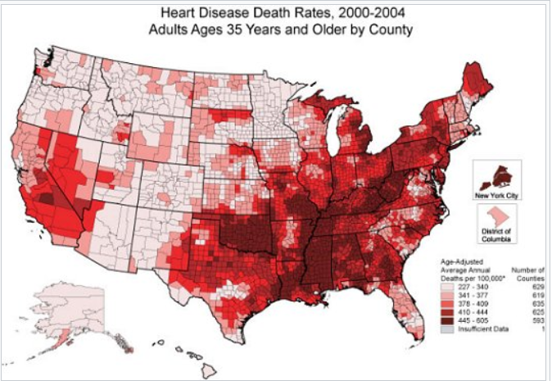
Classification methods: visual application
WEEK 3
Class breaks alter the pattern shown on the map
MIS 369
Dr. Murat BAŞEĞMEZ
Notes:
Instructor note: Have students identify the data layers, analysis inputs, and potential outputs shown in the visual.
Source: https://pro.arcgis.com/en/pro-app/3.5/help/mapping/layer-properties/symbolize-feature-layers.htm; User-provided GIS Instructor notes

Slide 22
CHAPTER 4
Labeling and annotation
Text hierarchy determines map readability
Notes:
Note: Text hierarchy determines map readability
Source: Lesson plan

Slide 23
Labeling and annotation
WEEK 3
01
02
03
Label
Annotation
Lejant
Dinamik metin
Editable persistent text
Explanation of symbol meanings
MIS 369
Dr. Murat BAŞEĞMEZ
Notes:
Instructor note: Explain the concepts using an example.
Source: https://pro.arcgis.com/en/pro-app/3.5/help/mapping/layer-properties/symbolize-feature-layers.htm; user-provided GIS Instructor notes

Slide 24
Labeling and annotation: concepts and application
WEEK 3
Kavramsal anlam
ArcGIS Pro equivalent
Label: Dinamik metin
Labeling tab, Label Class, and Convert Labels
Annotation: Editable persistent text
The output is examined together in the map and table.
Legend: Explanation of symbol meanings
Parameters and environment settings are saved.
MIS 369
Dr. Murat BAŞEĞMEZ
Notes:
Instructor note: Relate the concept to the software tool; do not use the tool name in place of the concept.
Source: https://pro.arcgis.com/en/pro-app/3.5/help/mapping/layer-properties/symbolize-feature-layers.htm; User-provided GIS Instructor notes

Slide 25
Labeling and annotation workflow
WEEK 3
01
02
03
04
05
Question
Data
Process
Kontrol
Yorum
Text hierarchy determines map readability
Labels and Annotation
Labeling tab, Label Class, and Convert Labels
Parameters and output quality
Decision context and constraints
MIS 369
Dr. Murat BAŞEĞMEZ
Notes:
Instructor note: Ask students to adapt the workflow to their own project questions.
Source: https://pro.arcgis.com/en/pro-app/3.5/help/mapping/layer-properties/symbolize-feature-layers.htm; user-provided GIS Instructor notes

Slide 26
Critical checks for labeling and annotation
WEEK 3
1
2
3
!
Data
Scale
Method
Risk
Does the input data meet labeling requirements?
Are the unit of analysis and resolution appropriate for the question?
Have the Labeling tab, Label Class, and Convert Labels parameters been justified?
Too many labels create visual clutter
MIS 369
Dr. Murat BAŞEĞMEZ
Notes:
Instructor note: Use these checks as a quick checklist before implementation.
Source: https://pro.arcgis.com/en/pro-app/3.5/help/mapping/layer-properties/symbolize-feature-layers.htm; user-provided GIS Instructor notes

Slide 27
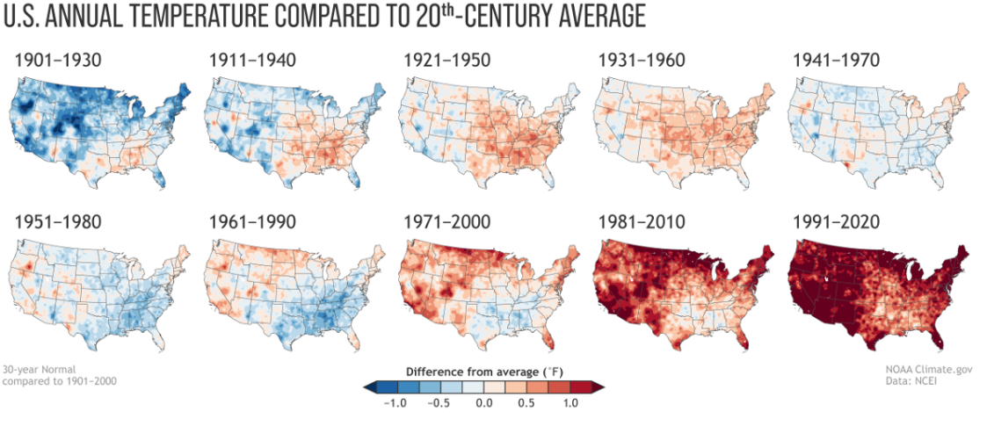
Labels and annotation: visual implementation
WEEK 3
Text hierarchy determines map readability
MIS 369
Dr. Murat BAŞEĞMEZ
Notes:
Instructor note: Have students identify the data layers, analysis inputs, and potential outputs shown in the visual.
Source: https://pro.arcgis.com/en/pro-app/3.5/help/mapping/layer-properties/symbolize-feature-layers.htm; User-provided GIS Instructor notes

Slide 28
CHAPTER 5
Layout and labeling
Title, scale, and source information complete the map
Notes:
Explanatory note: Title, scale, and source information complete the map
Source: Lesson plan

Slide 29
Layout and labeling
WEEK 3
01
02
03
Title
Source
Accessibility
Subject of the map
Origin of the data
Color blindness and readability
MIS 369
Dr. Murat BAŞEĞMEZ
Notes:
Instructor note: Explain the concepts using an example.
Source: https://pro.arcgis.com/en/pro-app/3.5/help/mapping/layer-properties/symbolize-feature-layers.htm; user-provided GIS Instructor notes

Slide 30
Layout and labeling: concept and implementation
WEEK 3
Kavramsal anlam
ArcGIS Pro equivalent
Title: Subject of the map
Insert, Map Frame, Legend, and Export Layout
Source: Origin of the data
The output is examined together in the map and table.
Accessibility: Color blindness and readability
Parameters and environment settings are saved.
MIS 369
Dr. Murat BAŞEĞMEZ
Notes:
Instructor note: Relate the concept to the software tool; do not use the tool name in place of the concept.
Source: https://pro.arcgis.com/en/pro-app/3.5/help/mapping/layer-properties/symbolize-feature-layers.htm; User-provided GIS Instructor notes

Slide 31
Layout and labeling workflow
WEEK 3
01
02
03
04
05
Question
Data
Process
Kontrol
Yorum
Title, scale, and source information complete the map
Title and Source
Insert, Map Frame, Legend, and Export Layout
Parameters and output quality
Decision context and constraints
MIS 369
Dr. Murat BAŞEĞMEZ
Notes:
Instructor note: Ask students to adapt the workflow to their own project questions.
Source: https://pro.arcgis.com/en/pro-app/3.5/help/mapping/layer-properties/symbolize-feature-layers.htm; user-provided GIS Instructor notes

Slide 32
Critical checks for layout and labeling
WEEK 3
1
2
3
!
Data
Scale
Method
Risk
Does the input data meet the title requirement?
Are the unit of analysis and resolution appropriate for the question?
Have the Insert, Map Frame, Legend, and Export Layout parameters been justified?
Color and class selection can subconsciously influence perception
MIS 369
Dr. Murat BAŞEĞMEZ
Notes:
Instructor note: Use these checks as a quick checklist before implementation.
Source: https://pro.arcgis.com/en/pro-app/3.5/help/mapping/layer-properties/symbolize-feature-layers.htm; user-provided GIS Instructor notes

Slide 33
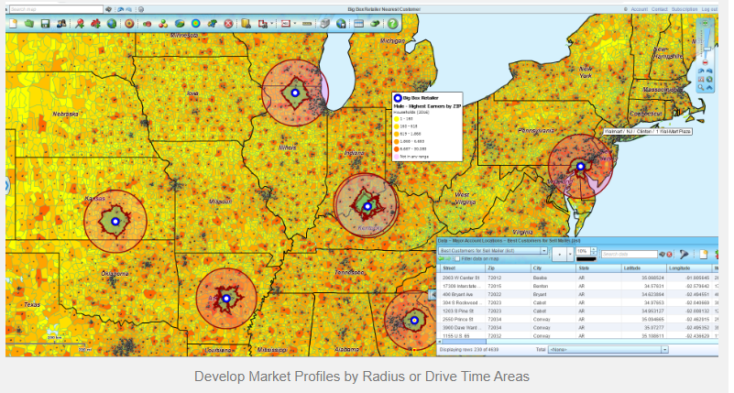
Layout and ethics: visual application
WEEK 3
Title, scale, and source information complete the map
MIS 369
Dr. Murat BAŞEĞMEZ
Notes:
Instructor note: Have students identify the data layers, analysis inputs, and potential outputs shown in the visual.
Source: https://pro.arcgis.com/en/pro-app/3.5/help/mapping/layer-properties/symbolize-feature-layers.htm; User-provided GIS Instructor notes

Slide 34
LAB
Guided exercise
Generating and comparing categorical, graduated color, and proportional symbol maps using the same population data
Notes:
Instructor note: Generating and comparing categorical, graduated color, and proportional symbol maps using the same population data
Source: Lesson plan

Slide 35
Laboratory procedure plan
WEEK 3
Prepare the working folder and the geodatabase.
Generating and comparing categorical, graduated color, and proportional symbol maps using the same population data
Check intermediate results using the map and table.
Record the processing history and parameters.
Add a note regarding the methodology and limitations to the final map.
MIS 369
Dr. Murat BAŞEĞMEZ
Notes:
Instructor note: Break the exercise down into small steps and check students' screens at each step.
Source: https://pro.arcgis.com/en/pro-app/3.5/help/mapping/layer-properties/symbolize-feature-layers.htm; user-provided GIS Instructor notes

Slide 36
Lab submission package
WEEK 3
01
02
03
Map
Evidence
Yorum
Title, legend, scale, and source
Tool parameters or notebook output
150–200-word summary of findings and limitations
MIS 369
Dr. Murat BAŞEĞMEZ
Notes:
Instructor note: Explain the concepts using an example.
Source: https://pro.arcgis.com/en/pro-app/3.5/help/mapping/layer-properties/symbolize-feature-layers.htm; user-provided GIS Instructor notes

Slide 37
Implementation checklist
WEEK 3
01
02
03
Input
Process
Output
Correct layer, area, and coordinate system
Parameters and environment settings saved
Map, table, and interpretation are consistent with each other
MIS 369
Dr. Murat BAŞEĞMEZ
Notes:
Instructor note: Explain the concepts using an example.
Source: https://pro.arcgis.com/en/pro-app/3.5/help/mapping/layer-properties/symbolize-feature-layers.htm; user-provided GIS Instructor notes

Slide 38
Connection to the term project
WEEK 3
Which of this week's concepts is essential for your project problem?
Which data or method could most significantly influence your decision?
Add a quality control item related to this week to your project log.
MIS 369
Dr. Murat BAŞEĞMEZ
Notes:
Instructor note: Ask students to make a brief addition to their project log.
Source: https://pro.arcgis.com/en/pro-app/3.5/help/mapping/layer-properties/symbolize-feature-layers.htm; user-provided GIS Instructor notes

Slide 39
End-of-lesson check 1
WEEK 3
What is the most important initial decision regarding the map's purpose?
A
Simply choosing a color
B
Defining the problem and data requirements
C
Using the most complex tool
D
Sharing the output without checking it
MIS 369
Dr. Murat BAŞEĞMEZ
Notes:
Instructor note: The correct answer is option B.
Source: https://pro.arcgis.com/en/pro-app/3.5/help/mapping/layer-properties/symbolize-feature-layers.htm; user-provided GIS Instructor notes

Slide 40
End-of-lesson check 2
WEEK 3
Which of the following most enhances quality when working with classification methods?
A
Saving parameters and validating the result
B
Not changing layer names
C
Using only a single criterion
D
Making the map as colorful as possible
MIS 369
Dr. Murat BAŞEĞMEZ
Notes:
Instructor note: The correct answer is option A.
Source: https://pro.arcgis.com/en/pro-app/3.5/help/mapping/layer-properties/symbolize-feature-layers.htm; user-provided GIS Instructor notes

Slide 41
End-of-lesson check 3
WEEK 3
Why is the mere execution of an ArcGIS Pro tool not proof of a correct result?
A
Because tools work only with raster data
B
Because the output file can be very large
C
Because data, scale, parameters, and validation affect the result
D
Because the map lacks a north arrow
MIS 369
Dr. Murat BAŞEĞMEZ
Notes:
Instructor note: The correct answer is option C.
Source: https://pro.arcgis.com/en/pro-app/3.5/help/mapping/layer-properties/symbolize-feature-layers.htm; user-provided GIS Instructor notes

Slide 42
WEEK 3 SUMMARY
Map Design and Spatial Visualization
Purpose of the map
Visual variables
Classification methods
Labeling and annotation
Layout and labeling
Preparation for next week: review the concepts in your exercise file
Notes:
Instructor note: Ask students to review the week's five main concepts using examples.
Source: https://pro.arcgis.com/en/pro-app/3.5/help/mapping/layer-properties/symbolize-feature-layers.htm; user-provided GIS Instructor notes

Slide 43
Resources and further reading
WEEK 3
https://pro.arcgis.com/en/pro-app/3.5/help/mapping/layer-properties/symbolize-feature-layers.htm
ArcGIS Pro 3.5 Documentation
User-provided GIS Instructor notes
In-class exercise data and instructor notes
MIS 369
Dr. Murat BAŞEĞMEZ
Notes:
Instructor note: Share the resources with students after the lesson.
Source: https://pro.arcgis.com/en/pro-app/3.5/help/mapping/layer-properties/symbolize-feature-layers.htm; user-provided GIS Instructor notes

