Slide 1

AI-ENHANCED
GEOGRAPHIC INFORMATION SYSTEMS
WEEK 2
Spatial Data and Data Models
MIS 369 · Ankara Science University
Dr. Murat BAŞEĞMEZ
Notes:
Instructor note: Introduce the week's topic by linking it to the previous lesson.
Source: https://pro.arcgis.com/en/pro-app/3.5/help/data/geodatabases/overview/what-is-a-geodatabase-.htm; user-provided GIS Instructor notes

Slide 2
This week's learning outcomes
WEEK 2
01
02
03
Concept
Application
Critique
Uses key terms correctly
Executes the ArcGIS Pro workflow
Explains data and method limitations
MIS 369
Dr. Murat BAŞEĞMEZ
Notes:
Instructor note: Explain concepts using examples.
Source: https://pro.arcgis.com/en/pro-app/3.5/help/data/geodatabases/overview/what-is-a-geodatabase-.htm; user-provided GIS Instructor notes

Slide 3
Three-hour lesson flow
WEEK 2
Part one: conceptual foundation and visual examples
Part two: step-by-step demonstration in ArcGIS Pro
Part three: guided lab and assessment
MIS 369
Dr. Murat BAŞEĞMEZ
Notes:
Instructor note: Explain the small deliverable due at the end of the lesson right at the beginning.
Source: https://pro.arcgis.com/en/pro-app/3.5/help/data/geodatabases/overview/what-is-a-geodatabase-.htm; user-provided GIS Instructor notes

Slide 4
SECTION 1
Spatial data structure
Location, geometry, attribute, and time are read together
Notes:
Instructor note: Location, geometry, attribute, and time are read together
Source: Lesson plan

Slide 5
Spatial data structure
WEEK 2
01
02
03
Location
Attribute
Time
Coordinate or geometry
Fields describing the object
Observation and update date
MIS 369
Dr. Murat BAŞEĞMEZ
Notes:
Instructor note: Explain concepts using examples.
Source: https://pro.arcgis.com/en/pro-app/3.5/help/data/geodatabases/overview/what-is-a-geodatabase-.htm; user-provided GIS Instructor notes

Slide 6
Spatial data structure: concept and implementation
WEEK 2
Kavramsal anlam
ArcGIS Pro equivalent
Location: Coordinate or geometry
Add Data, Properties, and Fields views
Attribute: Fields describing the object
The output is examined together in the map and table.
Time: Observation and update date
Parameters and environment settings are saved.
MIS 369
Dr. Murat BAŞEĞMEZ
Notes:
Instructor note: Relate the concept to the software tool; do not use the tool name in place of the concept.
Source: https://pro.arcgis.com/en/pro-app/3.5/help/data/geodatabases/overview/what-is-a-geodatabase-.htm; User-provided GIS Instructor notes

Slide 7
Spatial data structure workflow
WEEK 2
01
02
03
04
05
Question
Data
Process
Kontrol
Yorum
Location, geometry, attribute, and time are read together
Location and Attribute
Add Data, Properties, and Fields views
Parameters and output quality
Decision context and constraints
MIS 369
Dr. Murat BAŞEĞMEZ
Notes:
Instructor note: Ask students to adapt the workflow to their own project questions.
Source: https://pro.arcgis.com/en/pro-app/3.5/help/data/geodatabases/overview/what-is-a-geodatabase-.htm; user-provided GIS Instructor notes

Slide 8
Critical checks for spatial data structure
WEEK 2
1
2
3
!
Data
Scale
Method
Risk
Does the input data meet the location requirement?
Are the unit of analysis and resolution appropriate for the question?
Have the parameters in the Add Data, Properties, and Fields views been justified?
Breaking the link between location and attribute leads to misinterpretation
MIS 369
Dr. Murat BAŞEĞMEZ
Notes:
Instructor note: Use these checks as a quick checklist before implementation.
Source: https://pro.arcgis.com/en/pro-app/3.5/help/data/geodatabases/overview/what-is-a-geodatabase-.htm; user-provided GIS Instructor notes

Slide 9
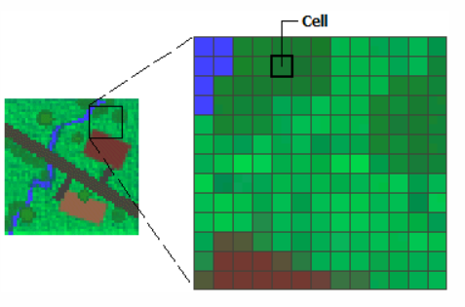
Spatial data structure: visual application
WEEK 2
Location, geometry, attribute, and time are read together
MIS 369
Dr. Murat BAŞEĞMEZ
Notes:
Instructor note: Have students identify the data layers, analysis inputs, and potential outputs shown in the visual.
Source: https://pro.arcgis.com/en/pro-app/3.5/help/data/geodatabases/overview/what-is-a-geodatabase-.htm; user-provided GIS Instructor notes

Slide 10
CHAPTER 2
Vector data model
Discrete geographic objects are represented by points, lines, and polygons
Notes:
Instructor note: Discrete geographic objects are represented by points, lines, and polygons
Source: Lesson plan

Slide 11
Vector data model
WEEK 2
01
02
03
Point
Line
Polygon
Tekil konumlar
Connectivity and flow
Area and boundary
MIS 369
Dr. Murat BAŞEĞMEZ
Notes:
Instructor note: Explain concepts using examples.
Source: https://pro.arcgis.com/en/pro-app/3.5/help/data/geodatabases/overview/what-is-a-geodatabase-.htm; user-provided GIS Instructor notes

Slide 12
Vector data model: concept and application
WEEK 2
Kavramsal anlam
ArcGIS Pro equivalent
Point: Individual locations
feature class, Create Features, and Attribute Table
Line: Connectivity and flow
The output is examined together in the map and table.
Polygon: Area and boundary
Parameters and environment settings are saved.
MIS 369
Dr. Murat BAŞEĞMEZ
Notes:
Instructor note: Relate the concept to the software tool; do not use the tool name in place of the concept.
Source: https://pro.arcgis.com/en/pro-app/3.5/help/data/geodatabases/overview/what-is-a-geodatabase-.htm; User-provided GIS Instructor notes

Slide 13
Vector data model workflow
WEEK 2
01
02
03
04
05
Question
Data
Process
Kontrol
Yorum
Discrete geographic objects are represented by points, lines, and polygons
Point and Line
feature class, Create Features, and Attribute Table
Parameters and output quality
Decision context and constraints
MIS 369
Dr. Murat BAŞEĞMEZ
Notes:
Instructor note: Ask students to adapt the workflow to their own project questions.
Source: https://pro.arcgis.com/en/pro-app/3.5/help/data/geodatabases/overview/what-is-a-geodatabase-.htm; user-provided GIS Instructor notes

Slide 14
Critical checks for the vector data model
WEEK 2
1
2
3
!
Data
Scale
Method
Risk
Does the input data meet the point requirement?
Are the unit of analysis and resolution appropriate for the question?
Have the feature class, Create Features, and Attribute Table parameters been justified?
Analysis scale alters geometry selection
MIS 369
Dr. Murat BAŞEĞMEZ
Notes:
Instructor note: Use these checks as a quick checklist before implementation.
Source: https://pro.arcgis.com/en/pro-app/3.5/help/data/geodatabases/overview/what-is-a-geodatabase-.htm; user-provided GIS Instructor notes

Slide 15
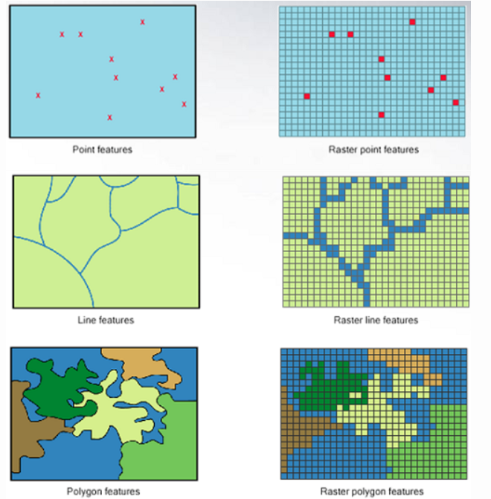
Vector data model: visual application
WEEK 2
Discrete geographic objects are represented by points, lines, and polygons
MIS 369
Dr. Murat BAŞEĞMEZ
Notes:
Instructor note: Have students identify the data layers, analysis inputs, and potential outputs shown in the visual.
Source: https://pro.arcgis.com/en/pro-app/3.5/help/data/geodatabases/overview/what-is-a-geodatabase-.htm; user-provided GIS Instructor notes

Slide 16
SECTION 3
Raster data model
Continuous surfaces represented by regular cells
Notes:
Explanatory note: Continuous surfaces represented by regular cells
Source: Lesson plan

Slide 17
Raster data model
WEEK 2
01
02
03
Cell
Resolution
Bant
Single value at a single location
Effect of cell size on detail
Different measurements of the same area
MIS 369
Dr. Murat BAŞEĞMEZ
Notes:
Instructor note: Explain concepts using examples.
Source: https://pro.arcgis.com/en/pro-app/3.5/help/data/geodatabases/overview/what-is-a-geodatabase-.htm; user-provided GIS Instructor notes

Slide 18
Raster data model: concept and application
WEEK 2
Kavramsal anlam
ArcGIS Pro equivalent
Cell: Single value at a single location
Raster Properties, Pixel Inspector, and Symbology
Resolution: Effect of cell size on detail
The output is examined together in the map and table.
Band: Different measurements of the same area
Parameters and environment settings are saved.
MIS 369
Dr. Murat BAŞEĞMEZ
Notes:
Instructor note: Relate the concept to the software tool; do not use the tool name in place of the concept.
Source: https://pro.arcgis.com/en/pro-app/3.5/help/data/geodatabases/overview/what-is-a-geodatabase-.htm; User-provided GIS Instructor notes

Slide 19
Raster data model workflow
WEEK 2
01
02
03
04
05
Question
Data
Process
Kontrol
Yorum
Continuous surfaces represented by regular cells
Cell and Resolution
Raster Properties, Pixel Inspector, and Symbology
Parameters and output quality
Decision context and constraints
MIS 369
Dr. Murat BAŞEĞMEZ
Notes:
Instructor note: Ask students to adapt the workflow to their own project questions.
Source: https://pro.arcgis.com/en/pro-app/3.5/help/data/geodatabases/overview/what-is-a-geodatabase-.htm; user-provided GIS Instructor notes

Slide 20
Critical checks for the raster data model
WEEK 2
1
2
3
!
Data
Scale
Method
Risk
Does the input data meet cell requirements?
Are the unit of analysis and resolution appropriate for the question?
Are the Raster Properties, Pixel Inspector, and Symbology parameters justified?
Directly comparing rasters of different resolutions is misleading
MIS 369
Dr. Murat BAŞEĞMEZ
Notes:
Instructor note: Use these checks as a quick checklist before implementation.
Source: https://pro.arcgis.com/en/pro-app/3.5/help/data/geodatabases/overview/what-is-a-geodatabase-.htm; user-provided GIS Instructor notes

Slide 21
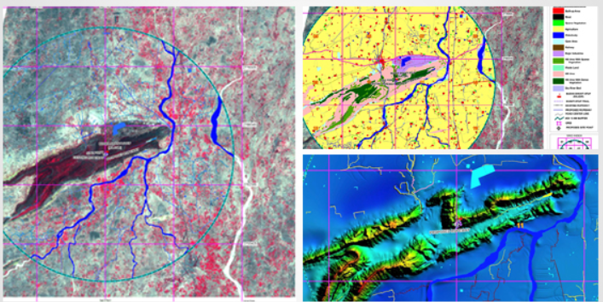
Raster data model: visual application
WEEK 2
Continuous surfaces represented by regular cells
MIS 369
Dr. Murat BAŞEĞMEZ
Notes:
Instructor note: Have students identify the data layers, analysis inputs, and potential outputs shown in the visual.
Source: https://pro.arcgis.com/en/pro-app/3.5/help/data/geodatabases/overview/what-is-a-geodatabase-.htm; user-provided GIS Instructor notes

Slide 22
CHAPTER 4
Data formats
Format selection depends on capacity, sharing, and analysis requirements
Notes:
Note: Format selection depends on capacity, sharing, and analysis requirements
Source: Lesson plan

Slide 23
Data formats
WEEK 2
01
02
03
Shapefile
Geodatabase
GeoTIFF
Common but limited
Rich data behavior
Georeferenced raster
MIS 369
Dr. Murat BAŞEĞMEZ
Notes:
Instructor note: Explain concepts using examples.
Source: https://pro.arcgis.com/en/pro-app/3.5/help/data/geodatabases/overview/what-is-a-geodatabase-.htm; user-provided GIS Instructor notes

Slide 24
Data formats: concept and application
WEEK 2
Kavramsal anlam
ArcGIS Pro equivalent
Shapefile: Common but limited
Catalog pane, New Geodatabase, and Export Features
Geodatabase: Rich data behavior
The output is examined together in the map and table.
GeoTIFF: Georeferenced raster
Parameters and environment settings are saved.
MIS 369
Dr. Murat BAŞEĞMEZ
Notes:
Instructor note: Relate the concept to the software tool; do not use the tool name in place of the concept.
Source: https://pro.arcgis.com/en/pro-app/3.5/help/data/geodatabases/overview/what-is-a-geodatabase-.htm; User-provided GIS Instructor notes

Slide 25
Data formats workflow
WEEK 2
01
02
03
04
05
Question
Data
Process
Kontrol
Yorum
Format selection depends on capacity, sharing, and analysis requirements
Shapefile and Geodatabase
Catalog pane, New Geodatabase, and Export Features
Parameters and output quality
Decision context and constraints
MIS 369
Dr. Murat BAŞEĞMEZ
Notes:
Instructor note: Ask students to adapt the workflow to their own project questions.
Source: https://pro.arcgis.com/en/pro-app/3.5/help/data/geodatabases/overview/what-is-a-geodatabase-.htm; user-provided GIS Instructor notes

Slide 26
Critical checks for data formats
WEEK 2
1
2
3
!
Data
Scale
Method
Risk
Does the input data meet shapefile requirements?
Are the unit of analysis and resolution appropriate for the question?
Have the Catalog pane, New Geodatabase, and Export Features parameters been justified?
File extension does not guarantee data quality
MIS 369
Dr. Murat BAŞEĞMEZ
Notes:
Instructor note: Use these checks as a quick checklist before implementation.
Source: https://pro.arcgis.com/en/pro-app/3.5/help/data/geodatabases/overview/what-is-a-geodatabase-.htm; user-provided GIS Instructor notes

Slide 27
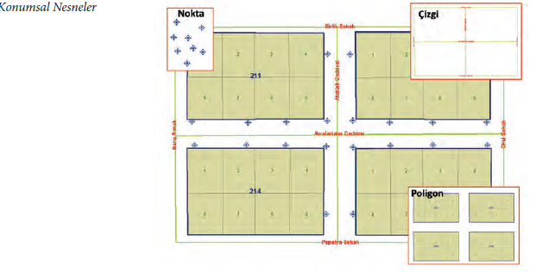
Data formats: visual application
WEEK 2
Format selection depends on capacity, sharing, and analysis requirements
MIS 369
Dr. Murat BAŞEĞMEZ
Notes:
Instructor note: Have students identify the data layers, analysis inputs, and potential outputs shown in the visual.
Source: https://pro.arcgis.com/en/pro-app/3.5/help/data/geodatabases/overview/what-is-a-geodatabase-.htm; user-provided GIS Instructor notes

Slide 28
CHAPTER 5
Scale and accuracy
Positional accuracy and map scale are evaluated together
Notes:
Note: Positional accuracy and map scale are evaluated together
Source: Lesson plan

Slide 29
Scale and accuracy
WEEK 2
01
02
03
Scale
Accuracy
Hassasiyet
Level of detail
Proximity to the true location
Repeatability of measurement
MIS 369
Dr. Murat BAŞEĞMEZ
Notes:
Instructor note: Explain concepts using examples.
Source: https://pro.arcgis.com/en/pro-app/3.5/help/data/geodatabases/overview/what-is-a-geodatabase-.htm; user-provided GIS Instructor notes

Slide 30
Scale and accuracy: concept and application
WEEK 2
Kavramsal anlam
ArcGIS Pro equivalent
Scale: Level of detail
Reviewing Map Properties, Measure, and metadata
Accuracy: Proximity to the true location
The output is examined together in the map and table.
Precision: Repeatability of measurement
Parameters and environment settings are saved.
MIS 369
Dr. Murat BAŞEĞMEZ
Notes:
Instructor note: Relate the concept to the software tool; do not use the tool name in place of the concept.
Source: https://pro.arcgis.com/en/pro-app/3.5/help/data/geodatabases/overview/what-is-a-geodatabase-.htm; User-provided GIS Instructor notes

Slide 31
Scale and accuracy workflow
WEEK 2
01
02
03
04
05
Question
Data
Process
Kontrol
Yorum
Positional accuracy and map scale are evaluated together
Scale and Accuracy
Reviewing Map Properties, Measure, and metadata
Parameters and output quality
Decision context and constraints
MIS 369
Dr. Murat BAŞEĞMEZ
Notes:
Instructor note: Ask students to adapt the workflow to their own project questions.
Source: https://pro.arcgis.com/en/pro-app/3.5/help/data/geodatabases/overview/what-is-a-geodatabase-.htm; user-provided GIS Instructor notes

Slide 32
Critical checks for scale and accuracy
WEEK 2
1
2
3
!
Data
Scale
Method
Risk
Does the input data meet the scale requirement?
Are the unit of analysis and resolution appropriate for the question?
Have the parameters for reviewing Map Properties, Measure, and metadata been justified?
A decision made at a large scale should not be based on small-scale data
MIS 369
Dr. Murat BAŞEĞMEZ
Notes:
Instructor note: Use these checks as a quick checklist before implementation.
Source: https://pro.arcgis.com/en/pro-app/3.5/help/data/geodatabases/overview/what-is-a-geodatabase-.htm; user-provided GIS Instructor notes

Slide 33
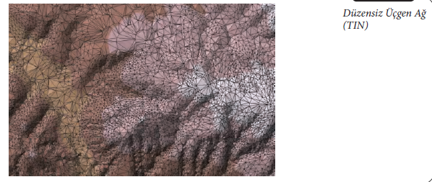
Scale and accuracy: visual application
WEEK 2
Positional accuracy and map scale are evaluated together
MIS 369
Dr. Murat BAŞEĞMEZ
Notes:
Instructor note: Have students identify the data layers, analysis inputs, and potential outputs shown in the visual.
Source: https://pro.arcgis.com/en/pro-app/3.5/help/data/geodatabases/overview/what-is-a-geodatabase-.htm; user-provided GIS Instructor notes

Slide 34
LAB
Guided exercise
Adding vector and raster data in various formats for Ankara to ArcGIS Pro and preparing a data dictionary
Notes:
Instructor note: Adding vector and raster data in various formats for Ankara to ArcGIS Pro and preparing a data dictionary
Source: Lesson plan

Slide 35
Laboratory procedure plan
WEEK 2
Prepare the working folder and the geodatabase.
Adding vector and raster data in various formats for Ankara to ArcGIS Pro and preparing a data dictionary
Check intermediate results using the map and table.
Record the processing history and parameters.
Add a note regarding the methodology and limitations to the final map.
MIS 369
Dr. Murat BAŞEĞMEZ
Notes:
Instructor note: Break the exercise down into small steps and check the students' screens at each step.
Source: https://pro.arcgis.com/en/pro-app/3.5/help/data/geodatabases/overview/what-is-a-geodatabase-.htm; GIS Instructor notes provided by the user

Slide 36
Lab submission package
WEEK 2
01
02
03
Map
Evidence
Yorum
Title, legend, scale, and source
Tool parameters or notebook output
150–200-word summary of findings and limitations
MIS 369
Dr. Murat BAŞEĞMEZ
Notes:
Instructor note: Explain concepts using examples.
Source: https://pro.arcgis.com/en/pro-app/3.5/help/data/geodatabases/overview/what-is-a-geodatabase-.htm; user-provided GIS Instructor notes

Slide 37
Implementation checklist
WEEK 2
01
02
03
Input
Process
Output
Correct layer, area, and coordinate system
Parameters and environment settings saved
Map, table, and interpretation are consistent with each other
MIS 369
Dr. Murat BAŞEĞMEZ
Notes:
Instructor note: Explain concepts using examples.
Source: https://pro.arcgis.com/en/pro-app/3.5/help/data/geodatabases/overview/what-is-a-geodatabase-.htm; user-provided GIS Instructor notes

Slide 38
Connection to the term project
WEEK 2
Which of this week's concepts is essential for your project problem?
Which data or method could most significantly influence your decision?
Add a quality control item related to this week to your project log.
MIS 369
Dr. Murat BAŞEĞMEZ
Notes:
Instructor note: Ask students to make a brief addition to their project log.
Source: https://pro.arcgis.com/en/pro-app/3.5/help/data/geodatabases/overview/what-is-a-geodatabase-.htm; GIS Instructor notes provided by the user

Slide 39
End-of-lesson check 1
WEEK 2
What is the most important initial decision regarding spatial data structure?
A
Simply choosing a color
B
Defining the problem and data requirements
C
Using the most complex tool
D
Sharing the output without checking it
MIS 369
Dr. Murat BAŞEĞMEZ
Notes:
Instructor note: The correct answer is option B.
Source: https://pro.arcgis.com/en/pro-app/3.5/help/data/geodatabases/overview/what-is-a-geodatabase-.htm; GIS Instructor notes provided by the user

Slide 40
End-of-lesson check 2
WEEK 2
Which of the following most enhances quality in a raster data model workflow?
A
Saving parameters and validating the result
B
Not changing layer names
C
Using only a single criterion
D
Making the map as colorful as possible
MIS 369
Dr. Murat BAŞEĞMEZ
Notes:
Explanation: The correct answer is option A.
Source: https://pro.arcgis.com/en/pro-app/3.5/help/data/geodatabases/overview/what-is-a-geodatabase-.htm; GIS Instructor notes provided by the user

Slide 41
End-of-lesson check 3
WEEK 2
Why is the mere execution of an ArcGIS Pro tool not proof of a correct result?
A
Because tools work only with raster data
B
Because the output file can be very large
C
Because data, scale, parameters, and validation affect the result
D
Because the map lacks a north arrow
MIS 369
Dr. Murat BAŞEĞMEZ
Notes:
Explanation: The correct answer is option C.
Source: https://pro.arcgis.com/en/pro-app/3.5/help/data/geodatabases/overview/what-is-a-geodatabase-.htm; User-provided GIS Instructor notes

Slide 42
WEEK 2 SUMMARY
Spatial Data and Data Models
Spatial data structure
Vector data model
Raster data model
Data formats
Scale and accuracy
Preparation for next week: review the concepts in your exercise file
Notes:
Instructor note: Ask students to review the week's five key concepts using examples.
Source: https://pro.arcgis.com/en/pro-app/3.5/help/data/geodatabases/overview/what-is-a-geodatabase-.htm; user-provided GIS Instructor notes

Slide 43
Resources and further reading
WEEK 2
https://pro.arcgis.com/en/pro-app/3.5/help/data/geodatabases/overview/what-is-a-geodatabase-.htm
ArcGIS Pro 3.5 Documentation
User-provided GIS Instructor notes
In-class exercise data and instructor notes
MIS 369
Dr. Murat BAŞEĞMEZ
Notes:
Instructor note: Share the resources with students after the class.
Source: https://pro.arcgis.com/en/pro-app/3.5/help/data/geodatabases/overview/what-is-a-geodatabase-.htm; user-provided GIS Instructor notes

