Slide 1

AI-ENHANCED
GEOGRAPHIC INFORMATION SYSTEMS
WEEK 1
What is GIS and
Why is it Used?
MIS 369 · Ankara Science University
Dr. Murat BAŞEĞMEZ
Notes:
Instructor note: Frame the course not as software training, but as a lesson on location-based problem solving.
Source: User-provided GIS Instructor notes

Slide 2
What will we achieve in this course?
WEEK 1
01
02
03
Spatial thinking
Using GIS
GeoAI
Explaining where a problem occurs and how location alters the outcome.
Collecting, organizing, and analyzing spatial data, and presenting it on a map.
machine learning and deep learning applications using GIS data by the end of the term
MIS 369
Dr. Murat BAŞEĞMEZ
Notes:
Instructor note: Show students the expected proficiency level for the end of the term; do not delve into technical details during the first week.

Slide 3

We use GIS every day
WEEK 1
Navigation apps calculate the optimal route using location and road network data.
Food delivery and courier apps manage addresses, distances, and service areas.
Weather apps provide forecasts based on your current location.
Location-based digital services in daily life
MIS 369
Dr. Murat BAŞEĞMEZ
Notes:
Instructor note: Ask students to list the location-based apps they use from the moment they wake up until they arrive at class.
Source: User-provided GIS Instructor notes

Slide 4
Three questions of spatial thinking
WEEK 1
?
?
?
Nerede?
Why is it there?
What else could it be?
What is the location of the event, entity, or need?
What are the environmental, social, or economic factors explaining the distribution?
How would a new road, school, or disaster scenario alter the spatial outcome?
MIS 369
Dr. Murat BAŞEĞMEZ
Notes:
Instructor note: Emphasize that these three questions represent the fundamental inquiries behind every method throughout the lesson.

Slide 5

Everything happens somewhere
WEEK 1
Location integrates diverse data sources within a common context
MIS 369
Dr. Murat BAŞEĞMEZ
Notes:
Instructor note: Using the visual, ask how urban elements, transportation, the environment, and human activities converge in the same geographic setting.
Source: User-provided GIS Instructor notes

Slide 6
SECTION 1
The concept of GIS
A system for data, analysis, and decision support—beyond mere map production
Notes:
Instructor note: A system for data, analysis, and decision support—beyond mere map production

Slide 7
The difference between a map and GIS
WEEK 1
Map
GIS
It is a visualization or communication product.
Stores and updates data.
It is prepared for a specific time and purpose.
Performs queries and analysis.
It is limited to the information it displays.
Generates new information and scenarios.
MIS 369
Dr. Murat BAŞEĞMEZ
Notes:
Instructor note: Explain that a PDF map is not GIS, although it can be generated from within a GIS.

Slide 8
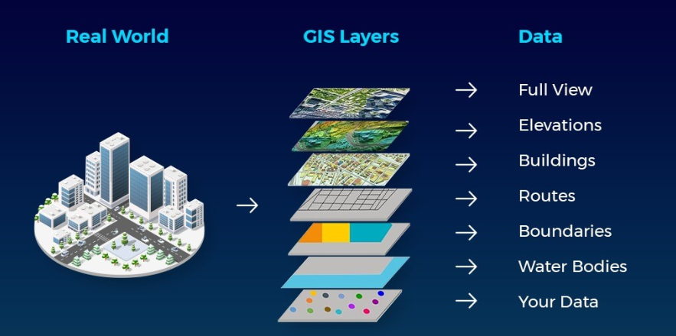
Working definition of GIS
WEEK 1
GIS is an information system that enables the collection, management, analysis, and presentation of location-based data.
It combines location and attributes within the same data structure.
It can present analysis results as maps, tables, charts, or web applications.
The real world, GIS layers, and data relationships
MIS 369
Dr. Murat BAŞEĞMEZ
Notes:
Instructor note: Instead of having the definition memorized, ask for examples of each verb: collecting, managing, analyzing, and presenting.
Source: User-provided GIS Instructor notes

Slide 9
GIS is an information system
WEEK 1
G
I
S
Geographic
Information
System
Location, distance, direction, area, adjacency, and spatial relationships.
Transformation of raw data into meaningful information through query and analysis.
The collaborative operation of people, data, software, hardware, and methods.
MIS 369
Dr. Murat BAŞEĞMEZ
Notes:
Instructor note: Explain the GIS acronym as three separate concepts.

Slide 10
Spatial and non-spatial information
WEEK 1
Spatial information
Attribute information
Contains coordinates or geometry.
Describes what the object is.
Indicates where the object is located.
Carries values ​​such as name, type, capacity, and date.
Represented by a point, line, polygon, or raster cell.
Stored in table rows.
MIS 369
Dr. Murat BAŞEĞMEZ
Notes:
Instructor note: Explain that the same school is represented as a point on the map, while in the table, it is represented by its name, number of students, and building age.

Slide 11
Location, attribute, and time
WEEK 1
X,Y
A
T
Location
Attribute
Time
Where is the object? What are its coordinates, address, or geometry?
What are the object's name, type, capacity, and other characteristics?
When was it observed, updated, or changed?
MIS 369
Dr. Murat BAŞEĞMEZ
Notes:
Instructor note: Emphasize that temporal information is also important in most modern GIS data.

Slide 12
CHAPTER 2
Representing the real world with data
Layer, vector, raster, and attribute table
Notes:
Instructor note: Layer, vector, raster, and attribute table

Slide 13
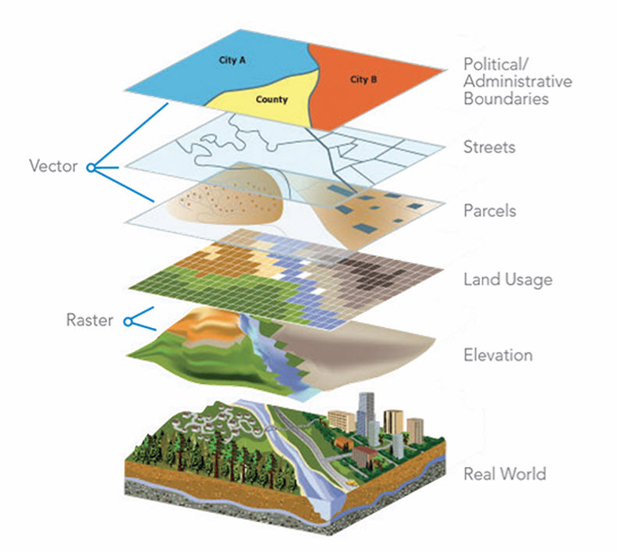
Layer logic
WEEK 1
Different themes are superimposed on the same geographic reference
MIS 369
Dr. Murat BAŞEĞMEZ
Notes:
Instructor note: Show how road, parcel, land use, and elevation layers answer different questions.
Source: Esri, The Importance of Where

Slide 14
Layers create meaning together
WEEK 1
Okullar
Vector layer
Yollar
Vector layer
Parseller
Vector layer
Land use
Raster layer
Elevation
Raster layer
MIS 369
Dr. Murat BAŞEĞMEZ
Notes:
Instructor note: Ask students to propose five layers needed for a school site selection problem.

Slide 15
From the real world to the data model
WEEK 1
1
2
3
Selection
Soyutlama
Model
Entities relevant to the problem are identified: school, road, building, river, or neighborhood.
Each entity is represented with appropriate geometry and attributes.
Layers and relationships are combined into an analyzable data structure.
MIS 369
Dr. Murat BAŞEĞMEZ
Notes:
Explanatory note: Explain that every model simplifies reality and is constructed based on the research objective.

Slide 16
Vector data model
WEEK 1
POINT
LINE
POLYGON
MIS 369
Dr. Murat BAŞEĞMEZ
Notes:
Explanatory note: Explain that points, lines, and polygons are not merely shapes but represent different types of geographic entities.

Slide 17
Point geometry
WEEK 1
•
E
?
Single location
Examples
Analysis
Represents objects whose size is negligible at a given scale.
School, hospital, well, bus stop, and earthquake epicenter.
Analyses of nearest facility, density, distribution, and service area.
MIS 369
Dr. Murat BAŞEĞMEZ
Notes:
Explanatory note: Mention that a school might appear as a point at a small scale and as a building polygon at a large scale.

Slide 18
Line geometry
WEEK 1
—
E
?
Connectivity
Examples
Analysis
Entities that possess length and connect two or more locations.
Road, stream, power line, and public transport route.
Route, network connectivity, flow direction, and accessibility.
MIS 369
Dr. Murat BAŞEĞMEZ
Notes:
Explanatory note: Explain that information regarding direction and connectivity in lines is critical for certain analyses.

Slide 19
Polygon geometry
WEEK 1
▰
E
?
Area
Examples
Analysis
Represents geographic entities that have boundaries and surface area.
Land parcel, building, neighborhood, lake, and protected area.
Area calculation, overlap, containment, and zoning.
MIS 369
Dr. Murat BAŞEĞMEZ
Notes:
Explanatory note: Explain that polygon boundaries can be defined legally, naturally, or analytically.

Slide 20
Raster data model
WEEK 1
Each cell holds a value
MIS 369
Dr. Murat BAŞEĞMEZ
Notes:
Explanatory note: Show that the raster consists of regular cells and that each cell carries a value, such as temperature or elevation.

Slide 21
Comparison of vector and raster
WEEK 1
Vector
Raster
Suitable for discrete objects.
Suitable for continuous surfaces.
Boundaries and geometries are distinct.
Resolution depends on cell size.
Establishes a strong relationship with attribute tables.
Allows for map algebra and image analysis.
Represents entities such as roads and parcels.
Represents elevation and satellite imagery.
MIS 369
Dr. Murat BAŞEĞMEZ
Notes:
Explanatory note: Emphasize that neither model is inherently superior to the other; the problem determines the data model.

Slide 22
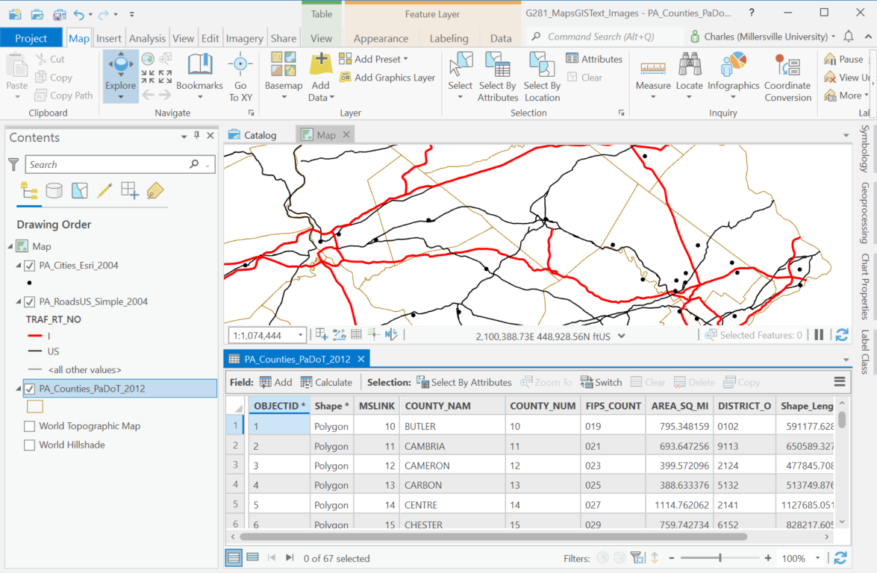
Attribute table
WEEK 1
Each row represents a geographic object.
Each column holds a property of the object.
A selection on the map is reflected in the table, and a selection in the table is reflected on the map.
ArcGIS Pro map and attribute table
MIS 369
Dr. Murat BAŞEĞMEZ
Notes:
Instructor note: Demonstrate that the map and the table are two views of the same objects.
Source: Millersville University, Maps and GIS course material

Slide 23
ID field and association
WEEK 1
ID
1:n
QC
Benzersiz kimlik
Relationship
Data integrity
It enables each object to be distinguished from the others.
Different tables can be linked using common fields.
Duplicate IDs and incorrect matching compromise analysis results.
MIS 369
Dr. Murat BAŞEĞMEZ
Notes:
Instructor note: Mention that the details of "joins" will be covered in later weeks, and that understanding the concept of a relationship is sufficient at this stage.

Slide 24
SECTION 3
GIS components
Not just standalone software, but a system of components working together
Notes:
Note: Not just software, but a system of components working together

Slide 25
The five components of GIS
WEEK 1
1
2
3
4
5
Hardware
Software
Data
People
Method
Data collection, storage, and processing capacity.
Data management, analysis, and mapping tools.
Spatial and attribute information analyzed by the system.
Individuals who define the problem, generate the data, and interpret the results.
Standards, workflows, and quality control rules.
MIS 369
Dr. Murat BAŞEĞMEZ
Notes:
Note: Explain the components from the previous GIS presentation in a more systematic way.

Slide 26
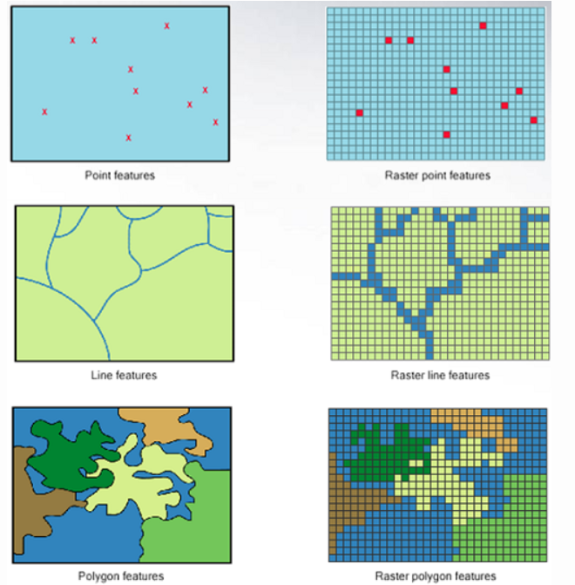
Hardware
WEEK 1
Desktop computers and servers process and store data.
GNSS receivers, mobile devices, and sensors collect spatial data.
Accelerators like GPUs become important for large-scale raster and GeoAI operations.
GIS hardware and data collection environment
MIS 369
Dr. Murat BAŞEĞMEZ
Notes:
Note: Emphasize that hardware selection depends on data volume and the analysis to be performed.
Source: User-provided GIS Instructor notes

Slide 27
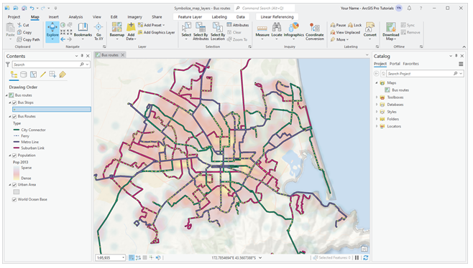
Software
WEEK 1
Desktop GIS is used for detailed data generation and analysis.
Web GIS shares maps and applications via a web browser.
Database and server software support multi-user enterprise structures.
GIS software ecosystem
MIS 369
Dr. Murat BAŞEĞMEZ
Notes:
Instructor note: State that ArcGIS Pro will be the primary application environment for the course, but mention that open-source alternatives also exist.
Source: User-provided GIS Instructor notes

Slide 28
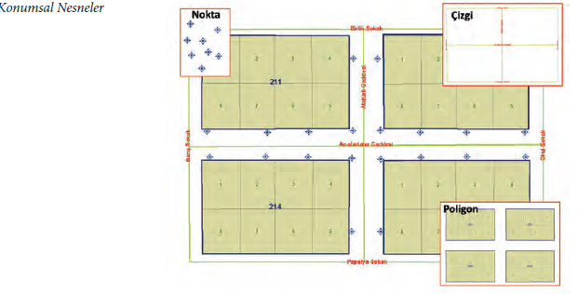
Data
WEEK 1
Positional accuracy, currency, and scale determine the quality of the analysis.
Data may originate from various institutions, sensors, and platforms.
Incorrect or incomplete data cannot be rectified by good software.
Spatial data layers
MIS 369
Dr. Murat BAŞEĞMEZ
Notes:
Instructor note: Explain the "garbage in, garbage out" principle in the context of spatial accuracy.
Source: User-provided GIS Instructor notes

Slide 29
People
WEEK 1
U
A
Y
G
User
Analist
Administrator
Developer
The person who obtains information from maps and applications.
Prepares, queries, and analyzes data, and interprets the results.
Uses GIS output for planning and resource allocation.
Develops automation, web applications, and enterprise integrations.
MIS 369
Dr. Murat BAŞEĞMEZ
Notes:
Instructor note: Emphasize that technical skills cannot replace an understanding of the problem.

Slide 30
Methods and standards
WEEK 1
SOP
QA
META
Workflow
Quality control
Metadata
Defines how data is collected, organized, and analyzed.
Checks for errors regarding location, attributes, geometry, and currency.
The source, date, accuracy, and conditions of use of the data are documented.
MIS 369
Dr. Murat BAŞEĞMEZ
Notes:
Explanatory note: Explain that the same data and software can yield different results depending on the methods used.

Slide 31
Basic GIS workflow
WEEK 1
01
02
03
04
05
Topla
Manage
Analyze
Visualize
Make a decision
Field, sensor, institutional, or open data
Edit, validate, and store
Query and calculate relationships
Map, chart, and application
Turn results into action
MIS 369
Dr. Murat BAŞEĞMEZ
Notes:
Explanatory note: Note that although the workflow appears linear, it involves feedback loops in practice.

Slide 32
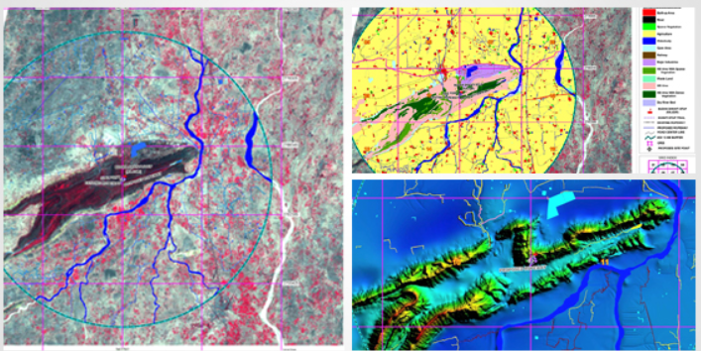
Data collection
WEEK 1
Field surveys and GNSS generate direct location data.
Satellite, aerial photography, and drone imagery observe large areas.
Surveys, administrative records, and sensor data can be linked to locations.
Various remote sensing and spatial data sources
MIS 369
Dr. Murat BAŞEĞMEZ
Notes:
Explanatory note: Explain that data sources are selected based on resolution, cost, and currency.
Source: GIS Instructor notes provided by the user

Slide 33
Data management
WEEK 1
DB
V
SEC
Depolama
Versioning and updating
Access
Files, geodatabases, or geodatabases can be used.
Tracks when and by whom the data was modified.
Authorization and sharing rules protect sensitive data.
MIS 369
Dr. Murat BAŞEĞMEZ
Notes:
Speaker note: Emphasize that data management precedes analysis.

Slide 34
Query and analysis
WEEK 1
Sorgu
Spatial analysis
Which schools have a capacity greater than 500?
Which neighborhoods are far from schools?
Which parcels are publicly owned?
How many buildings are in the flood zone?
Which roads require maintenance?
What is the most suitable location for the new facility?
MIS 369
Dr. Murat BAŞEĞMEZ
Notes:
Instructor note: Explain the difference between an attribute query and an analysis utilizing spatial relationships, using examples.

Slide 35
CHAPTER 4
What does GIS do?
The same spatial thinking approach across different sectors
Notes:
Instructor note: The same spatial thinking approach across different sectors

Slide 36
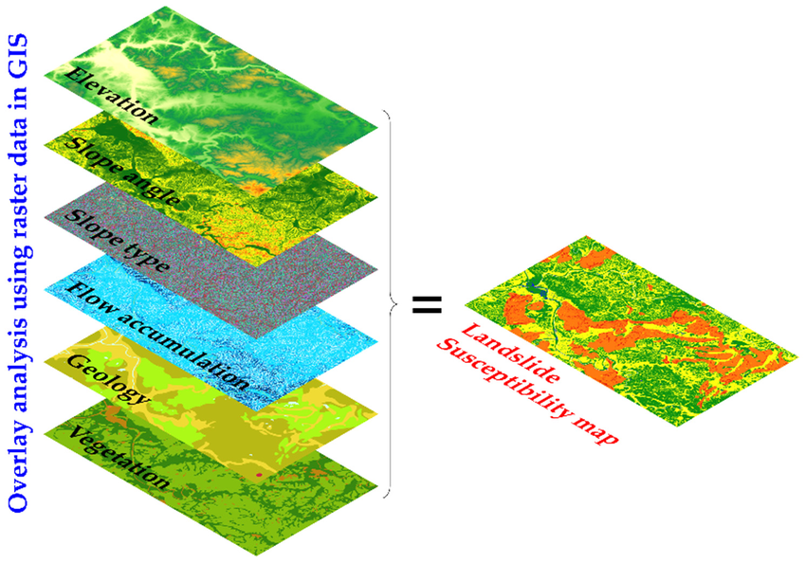
Spatial analysis
WEEK 1
Proximity, overlap, connectivity, and distribution can be calculated.
Multiple criteria can be combined on a common decision surface.
Potential impacts can be evaluated by comparing scenarios.
Examples of spatial analysis
MIS 369
Dr. Murat BAŞEĞMEZ
Notes:
Instructor note: Emphasize that analysis is not merely about producing colorful maps.
Source: User-provided GIS Instructor notes

Slide 37
Visualization and decision support
WEEK 1
Visualization
Decision support
Makes distribution visible.
Compares alternatives based on criteria.
Facilitates the comparison of complex information.
Identifies high-risk or priority areas.
Communicates effectively with the target audience.
Makes the evidence for a decision traceable.
MIS 369
Dr. Murat BAŞEĞMEZ
Notes:
Instructor note: Explain that the map does not automatically make the decision but provides the evidence.

Slide 38
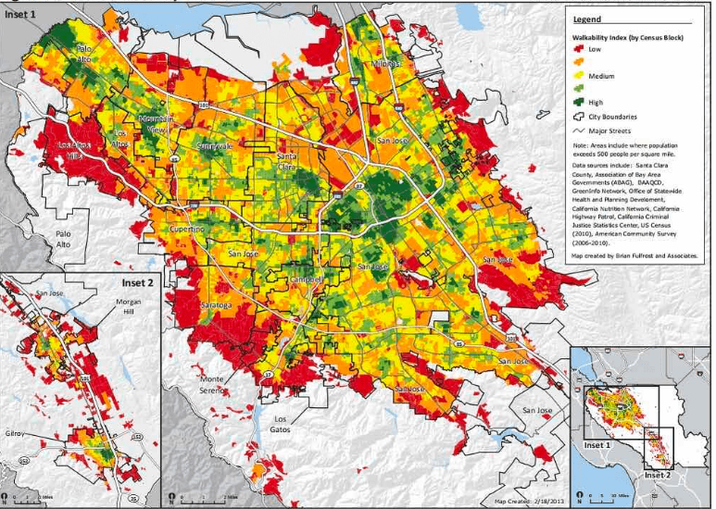
Urban and regional planning
WEEK 1
Land use, transportation, population, and infrastructure are evaluated together
MIS 369
Dr. Murat BAŞEĞMEZ
Notes:
Explanatory note: Explain how different colors represent land-use classes and influence road accessibility and development.
Source: User-provided GIS Instructor notes

Slide 39
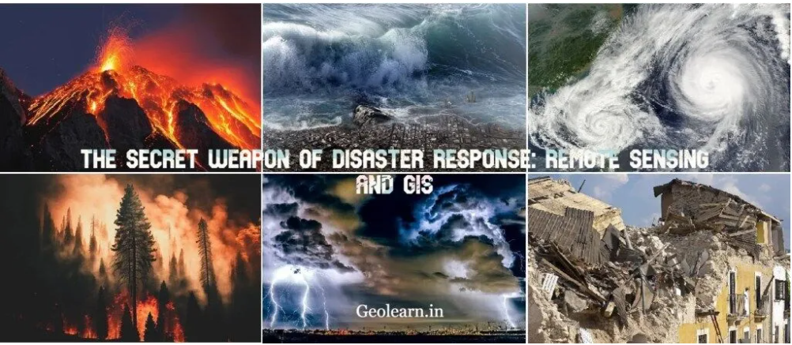
Disaster and risk management
WEEK 1
Hazard, exposure, and vulnerability are spatially integrated
MIS 369
Dr. Murat BAŞEĞMEZ
Notes:
Explanatory note: Distinguish between pre-disaster risk reduction, emergency response, and recovery phases.
Source: User-provided GIS Instructor notes

Slide 40
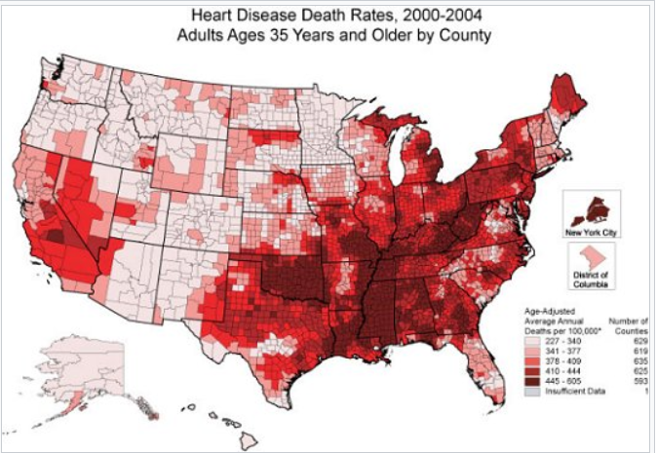
Health and epidemiology
WEEK 1
Disease distribution, population, and access to healthcare services can be examined together
MIS 369
Dr. Murat BAŞEĞMEZ
Notes:
Explanatory note: Note that high values ​​on the map do not necessarily indicate direct causality.
Source: User-provided GIS Instructor notes

Slide 41
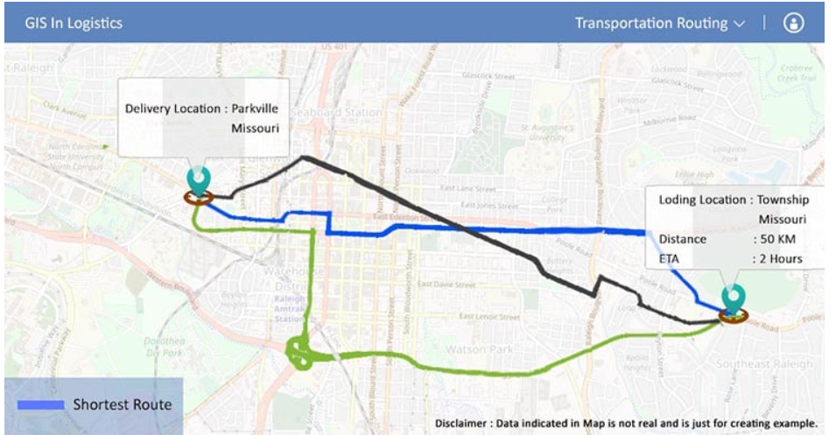
Transportation and logistics
WEEK 1
Routes, travel times, service areas, and traffic conditions are analyzed
MIS 369
Dr. Murat BAŞEĞMEZ
Notes:
Explanatory note: Explain that the shortest route may not be the fastest or the least costly route.
Source: User-provided GIS Instructor notes

Slide 42
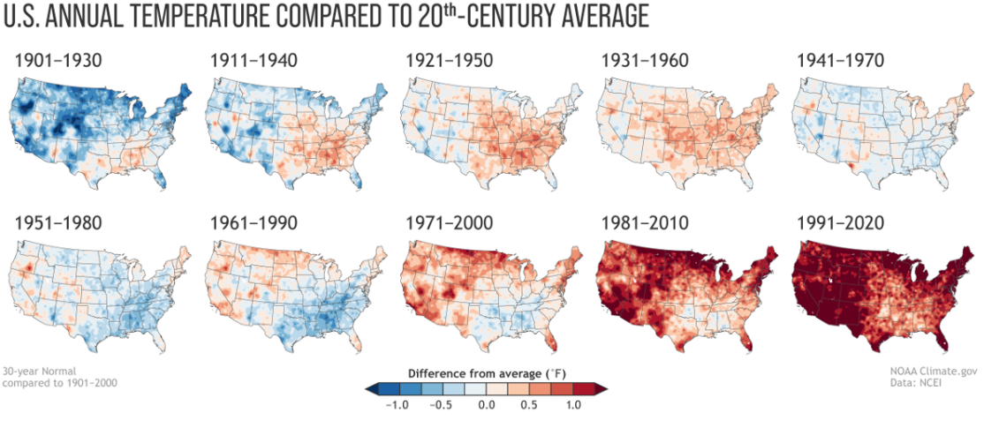
Environment and climate
WEEK 1
Temporal change maps display climate trends within a spatial context
MIS 369
Dr. Murat BAŞEĞMEZ
Notes:
Explanatory note: Explain the importance of using consistent color scales and comparable classes in time-series maps.
Source: GIS Instructor notes provided by the user

Slide 43
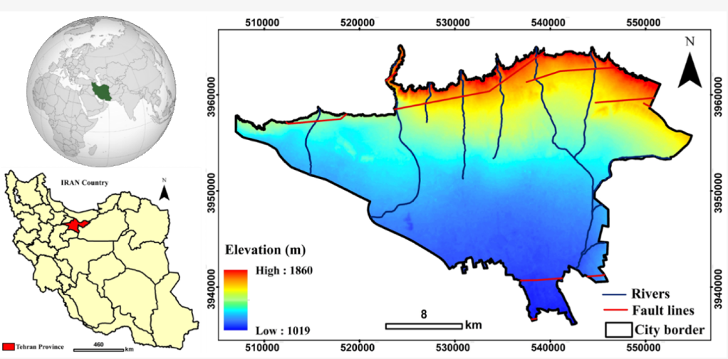
Educational facility planning
WEEK 1
School location, student population, road network, and disaster risk can be evaluated together
MIS 369
Dr. Murat BAŞEĞMEZ
Notes:
Instructor note: Discuss examples from your own professional experience, such as student transportation and school site selection problems.
Source: GIS Instructor notes provided by the user

Slide 44
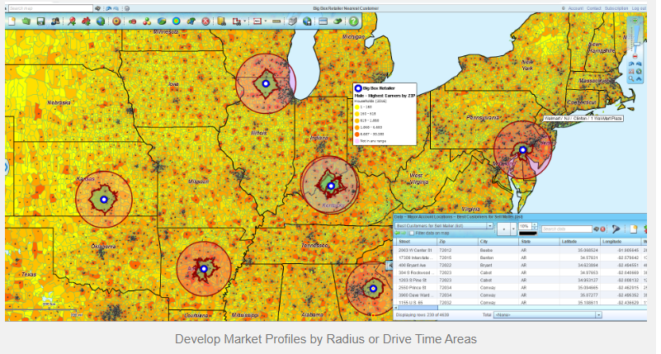
Business and market analysis
WEEK 1
Demand, competitors, accessibility, and demographics influence the site selection decision
MIS 369
Dr. Murat BAŞEĞMEZ
Notes:
Instructor note: Ask the class what criteria might be included in a site selection map.
Source: GIS Instructor notes provided by the user

Slide 45
GIS usage environments
WEEK 1
PC
WEB
MOB
ENT
Desktop GIS
Web GIS
Mobil GIS
Kurumsal GIS
Detailed data creation, analysis, and map design.
Sharing and using maps via a web browser.
Data collection, updating, and navigation in the field.
Integration of databases, servers, users, and business processes.
MIS 369
Dr. Murat BAŞEĞMEZ
Notes:
Instructor note: Explain that these environments complement each other and that a single project can encompass all of them.

Slide 46
CHAPTER 5
First steps with ArcGIS Pro
Project, map, layer, and attribute table
Notes:
Instructor note: Project, map, layer, and attribute table

Slide 47
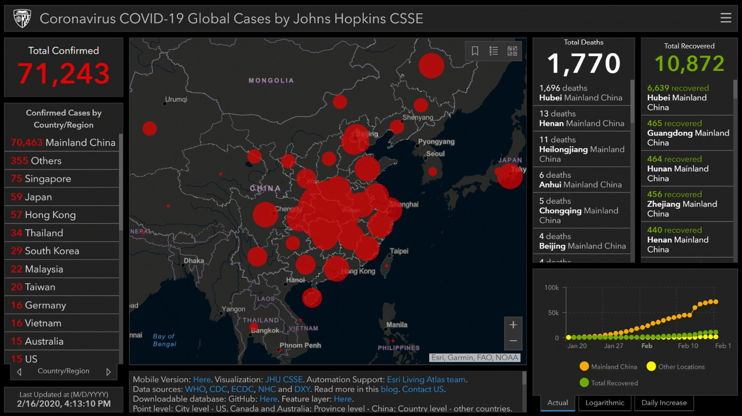
ArcGIS ekosistemi
WEEK 1
ArcGIS Pro enables data creation and advanced analysis on the desktop.
ArcGIS Online supports the sharing of maps, layers, and applications.
Field Maps and Survey123 connect to field data collection workflows.
Web GIS and cloud-based working environment
MIS 369
Dr. Murat BAŞEĞMEZ
Notes:
Instructor note: Explain that the focus this week is on ArcGIS Pro and that other components will be used in subsequent weeks.
Source: User-provided GIS Instructor notes

Slide 48
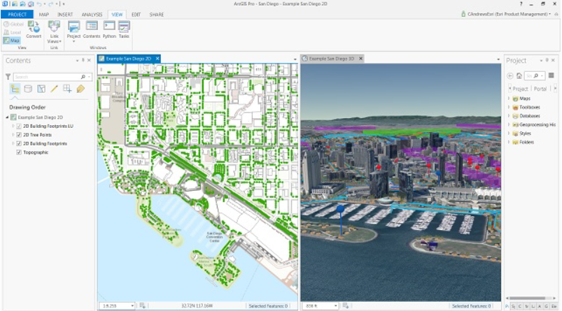
ArcGIS Pro workspace
WEEK 1
Map, Contents, Catalog, ribbon menu, and tool panels operate within the same project
MIS 369
Dr. Murat BAŞEĞMEZ
Notes:
Instructor note: Point out the Contents, Catalog, and map view areas on the screen one by one.
Source: User-provided GIS Instructor notes

Slide 49
ArcGIS Pro project structure
WEEK 1
APRX
MAP
SCN
LAY
Project
Map
Scene
Layout
Keeps maps, connections, tool history, and layouts together.
Workspace where 2D layers are displayed and analyzed.
Local or global view featuring elevation and 3D objects.
Page containing a title, legend, and scale bar for printing or PDF export.
MIS 369
Dr. Murat BAŞEĞMEZ
Notes:
Instructor note: Explain that the project file does not always contain the actual data itself.

Slide 50
Map, Scene, and Layout
WEEK 1
Analysis environments
Presentation environment
Map: two-dimensional analysis
Layout: map page
Scene: three-dimensional visualization
Legend, scale bar, and north arrow
Layers and tables can be shared
Print and PDF output
MIS 369
Dr. Murat BAŞEĞMEZ
Notes:
Instructor note: Remind students not to confuse the purposes of the Map and Layout tabs.

Slide 51
ArcGIS Pro interface
WEEK 1
R
C
CAT
GP
Ribbon
Contents
Catalog
Geoprocessing
Command and tool tabs that change based on the selected item.
Access to layer order, visibility, and symbology.
Connections to folders, geodatabases, toolboxes, and portals.
Searching for, entering parameters for, and running analysis tools.
MIS 369
Dr. Murat BAŞEĞMEZ
Notes:
Instructor note: Show students that if panels close, they can be reopened from the View tab.

Slide 52
Adding data to the map
WEEK 1
01
02
03
04
05
Open project
Establish a connection
Veriyi ekle
Kontrol et
Kaydet
Create a new Map project
Add folder to Catalog
Select layer using Add Data
Examine location and coordinate system
Save project with a meaningful name
MIS 369
Dr. Murat BAŞEĞMEZ
Notes:
Instructor note: Mention that while it is possible to drag data from the desktop, using a folder connection is more organized.

Slide 53
Contents pane and layer order
WEEK 1
↑
👁
1:n
Top layer
Visibility
Scale range
Can obscure layers beneath it. Points and lines are usually kept at the top.
Turns the layer's display on or off; does not delete the data.
The layer is visible only at specified map scales.
MIS 369
Dr. Murat BAŞEĞMEZ
Notes:
Instructor note: Demonstrate the difference between turning off layer visibility and removing the layer from the project.

Slide 54
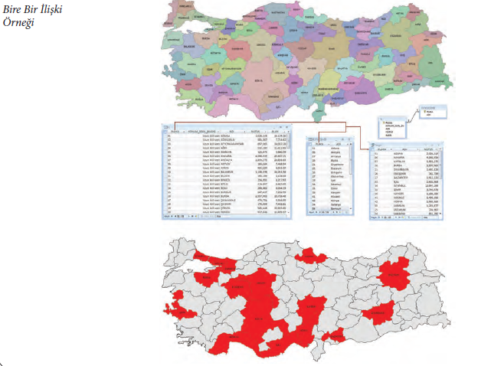
Attribute table and selection
WEEK 1
Right-click the layer to open the Attribute Table.
When a row is selected, the corresponding geographic feature is highlighted on the map.
Selections based on specific criteria can be made using "Select By Attributes."
Examining tables and records in ArcGIS Pro
MIS 369
Dr. Murat BAŞEĞMEZ
Notes:
Instructor note: Perform a simple selection with students based on a population or area field.
Source: User-provided GIS Instructor notes

Slide 55
Basit semboloji
WEEK 1
1
U
G
Tek sembol
Unique Values
Graduated Colors
All features are displayed using the same symbol.
Different symbols are used based on type or category fields.
Numerical values ​​are divided into classes and displayed using color gradients.
MIS 369
Dr. Murat BAŞEĞMEZ
Notes:
Instructor note: Emphasize that the choice of symbology must be appropriate for the data type.

Slide 56
Guided classification exercise
WEEK 1
01
02
03
04
05
Open
Ekle
Examine
Select
Display
Create a new Map project
Add two layers to the map
Open the attribute table
Set an attribute-based condition
Change symbology
MIS 369
Dr. Murat BAŞEĞMEZ
Notes:
Instructor note: The exercise should take approximately 35–40 minutes. Ask students to provide a screenshot and a two-sentence comment.

Slide 57
Common initial errors
WEEK 1
!
!
!
!
File paths
Coordinate system
Field type
Kaydetme
Moving data later can break project links.
This is the first thing to check if a layer appears in the wrong place.
Numbers stored as text cause issues with sorting and calculations.
Project, editing, and analysis outputs may need to be saved separately.
MIS 369
Dr. Murat BAŞEĞMEZ
Notes:
Instructor note: Demonstrate these errors intentionally during the exercise.

Slide 58
End-of-lesson check 1
WEEK 1
Which of the following is the fundamental feature that distinguishes GIS from a mere map?
A
Its use of a north arrow
B
Its ability to query and analyze spatial data
C
Its inclusion of colored symbols
D
Its ability to be printed on paper
MIS 369
Dr. Murat BAŞEĞMEZ
Notes:
Explanation: Querying and analysis demonstrate the "information system" nature of GIS. Correct option: B.

Slide 59
End-of-lesson check 2
WEEK 1
What type of information do "number of students" and "building age" represent in a school layer?
A
Geometri
B
Coordinate system
C
Attribute
D
Raster cell
MIS 369
Dr. Murat BAŞEĞMEZ
Notes:
Explanation: Number of students and building age are attributes of the school object. Correct option: C.

Slide 60
End-of-lesson check 3
WEEK 1
Which data model is generally suitable for representing an elevation surface continuously?
A
Point
B
Line
C
Table
D
Raster
MIS 369
Dr. Murat BAŞEĞMEZ
Notes:
Explanation: The raster data model is commonly used for continuous surfaces. Correct option: D.

Slide 61
WEEK 1 SUMMARY
GIS provides analysis and decision support by combining location with information.
The real world is modeled using layers, geometry, and attributes.
People, data, software, hardware, and methods work together.
ArcGIS Pro manages projects, maps, layers, and tables in a shared environment.
Next week: Spatial data and data models
Notes:
Instructor note: Ask students to summarize the lesson in a single sentence.

